Slide 1
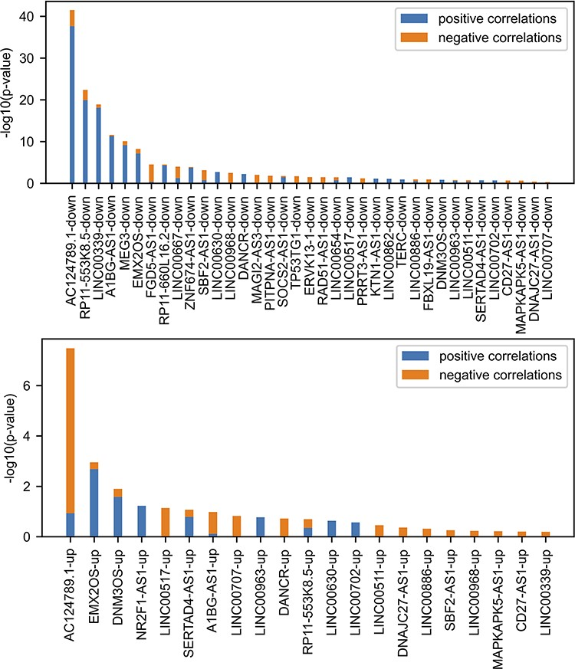
Figure 3. Comparing FANTOM6 lncRNA knockdowns followed by expression with gene–gene co-expression correlation data from ...
Notes:
Figure 3. Comparing FANTOM6 lncRNA knockdowns followed by expression with gene–gene co-expression correlation data from ARCHS4. For each lncRNA in FANTOM6, we computed the significance of the overlap between the top 200 DEGs for each lncRNA knockdown (|log2 fold change (FC)| > 0.5; false discovery rate (FDR) 1.645) in at least one knock-down condition and the top 200 most positively and top 200 most negatively correlated genes from the ARCHS4 gene–gene co-expression matrix using Fisher’s exact test. The P-values were then converted to −log10(P-values) and are visualized as stacked bar charts where the bottom part of the bar denotes the significance of overlap with positively correlated genes and the top part of each bar denotes the significance of overlap with the negatively correlated genes for each lncRNA. Only the top 37 lncRNA’s down genes with the most overlap and the top 21 lncRNA’s up genes with the most overlap are shown out of a total of 87 assessed.
Unless provided in the caption above, the following copyright applies to the content of this slide: © The Author(s) 2023. Published by Oxford University Press.This is an Open Access article distributed under the terms of the Creative Commons Attribution License (https://creativecommons.org/licenses/by/4.0/), which permits unrestricted reuse, distribution, and reproduction in any medium, provided the original work is properly cited.

