Slide 1
Figure 1. XXX RNA interacts with the DNA locus and forms contact #1. In the case of one-to-all methods, we see only the ...
Notes:
Figure 1. XXX RNA interacts with the DNA locus and forms contact #1. In the case of one-to-all methods, we see only the DNA-parts of the contacts, while in the case of all-to-all methods, we see both DNA-parts and RNA-parts of the contacts. Cis- and trans-migration is the migration of RNA within and outside the parent chromosome, respectively.
Unless provided in the caption above, the following copyright applies to the content of this slide: © The Author(s) 2023. Published by Oxford University Press.This is an Open Access article distributed under the terms of the Creative Commons Attribution License (https://creativecommons.org/licenses/by/4.0/), which permits unrestricted reuse, distribution, and reproduction in any medium, provided the original work is properly cited.

Slide 2
Figure 2. RNA–chromatin interactions data processing protocol. Dotted arrows correspond to all-to-all data processing ...
Notes:
Figure 2. RNA–chromatin interactions data processing protocol. Dotted arrows correspond to all-to-all data processing steps and solid arrows are related to one-to-all data.
Unless provided in the caption above, the following copyright applies to the content of this slide: © The Author(s) 2023. Published by Oxford University Press.This is an Open Access article distributed under the terms of the Creative Commons Attribution License (https://creativecommons.org/licenses/by/4.0/), which permits unrestricted reuse, distribution, and reproduction in any medium, provided the original work is properly cited.

Slide 3
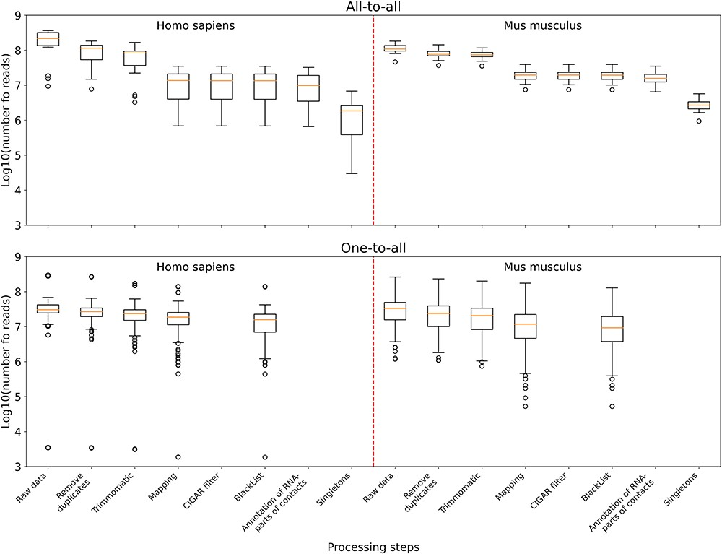
Figure 3. The distribution of the number of reads in the data sets left after the corresponding processing step and all ...
Notes:
Figure 3. The distribution of the number of reads in the data sets left after the corresponding processing step and all the previous ones. Upper panel: boxplots plotted from all-to-all data, namely 17 human data sets and 18 mouse data sets. Lower panel: boxplots plotted from one-to-all data, namely 159 human data sets and 291 mouse data sets.
Unless provided in the caption above, the following copyright applies to the content of this slide: © The Author(s) 2023. Published by Oxford University Press.This is an Open Access article distributed under the terms of the Creative Commons Attribution License (https://creativecommons.org/licenses/by/4.0/), which permits unrestricted reuse, distribution, and reproduction in any medium, provided the original work is properly cited.

Slide 4
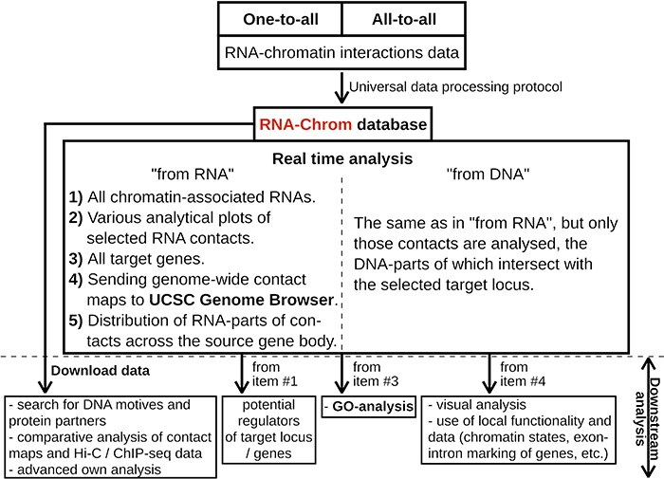
Figure 4. RNA-Chrom functionality and downstream analysis.
Notes:
Figure 4. RNA-Chrom functionality and downstream analysis.
Unless provided in the caption above, the following copyright applies to the content of this slide: © The Author(s) 2023. Published by Oxford University Press.This is an Open Access article distributed under the terms of the Creative Commons Attribution License (https://creativecommons.org/licenses/by/4.0/), which permits unrestricted reuse, distribution, and reproduction in any medium, provided the original work is properly cited.

Slide 5
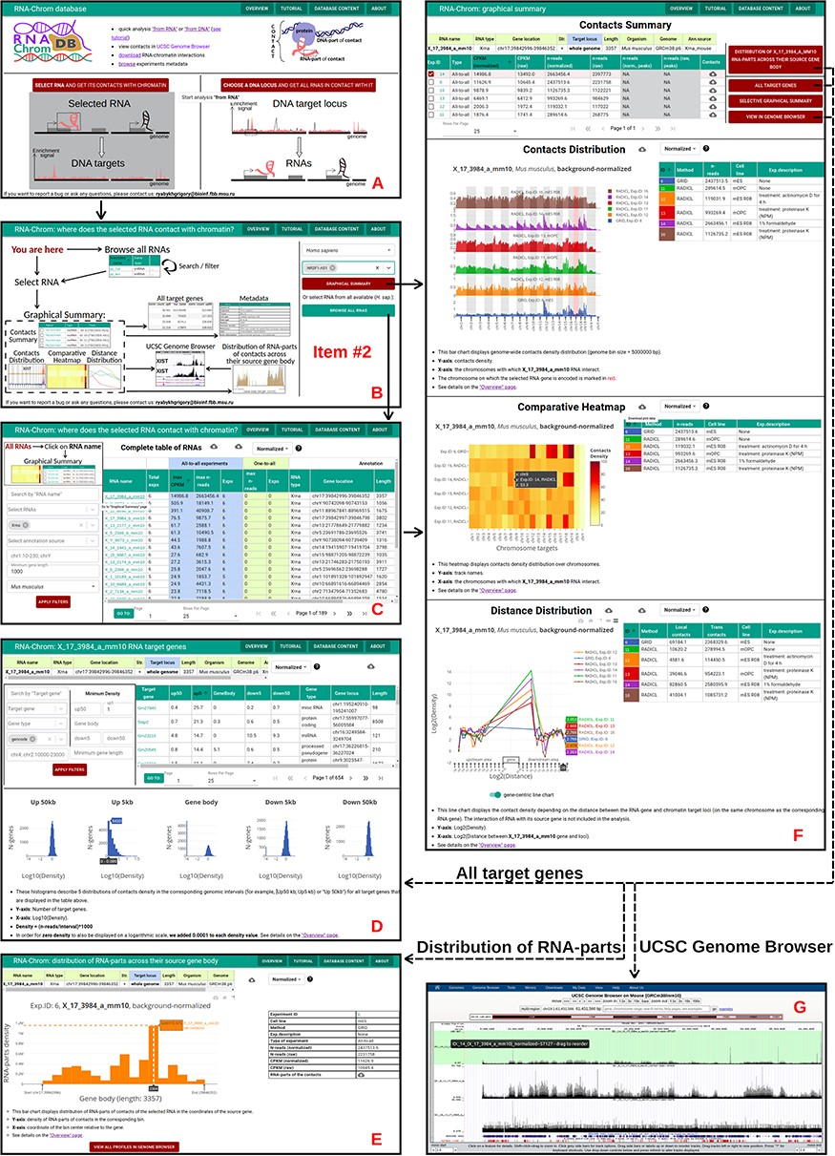
Figure 5. ‘From RNA’ analysis for X_17_3984_a_mm10 RNA (Mus musculus). The arrows reflect the workflow. A. A user ...
Notes:
Figure 5. ‘From RNA’ analysis for X_17_3984_a_mm10 RNA (Mus musculus). The arrows reflect the workflow. A. A user chooses ‘from RNA’ analysis. B. Then the user either enters the RNA name of interest in the ‘Select RNA’ field or presses ‘BROWSE ALL RNAS’ button. C. ‘Complete table of RNAs’. Here a user selects RNA for analysis. D. The ‘Graphical Summary’ page consists of the ‘Contacts Summary’ and three analytical plots. By selecting one or more contact maps of X_17_3984_a_mm10 RNA in the ‘Contacts Summary’ table, a user continues to analyze them by clicking on one of the four buttons located to the right of the table. E. ‘All target genes’ page displays the association of contacts with genes and their upstream and downstream regions. By applying several filters, a user downloads a list of target genes. From this point, the user can switch to ‘from DNA’ analysis. To do this, the user clicks on the target gene of interest. F. Distribution of X_17_3984_a_mm10 RNA-parts across their source gene body (may reflect the exon–intron structure, the multiple isoforms of the transcribed gene, etc.) A user can send distributions for all experiments to the UCSC Genome Browser for a more detailed study or download them. G. A user sends X_17_3984_a_mm10 contact maps (DNA-parts) to the UCSC Genome Browser if they want to view them in the higher resolution or visually match them to genomic annotations (gene sets, epigenetic marks, etc.) or data (ChIP-seq, Hi-C, etc.)
Unless provided in the caption above, the following copyright applies to the content of this slide: © The Author(s) 2023. Published by Oxford University Press.This is an Open Access article distributed under the terms of the Creative Commons Attribution License (https://creativecommons.org/licenses/by/4.0/), which permits unrestricted reuse, distribution, and reproduction in any medium, provided the original work is properly cited.

Slide 6
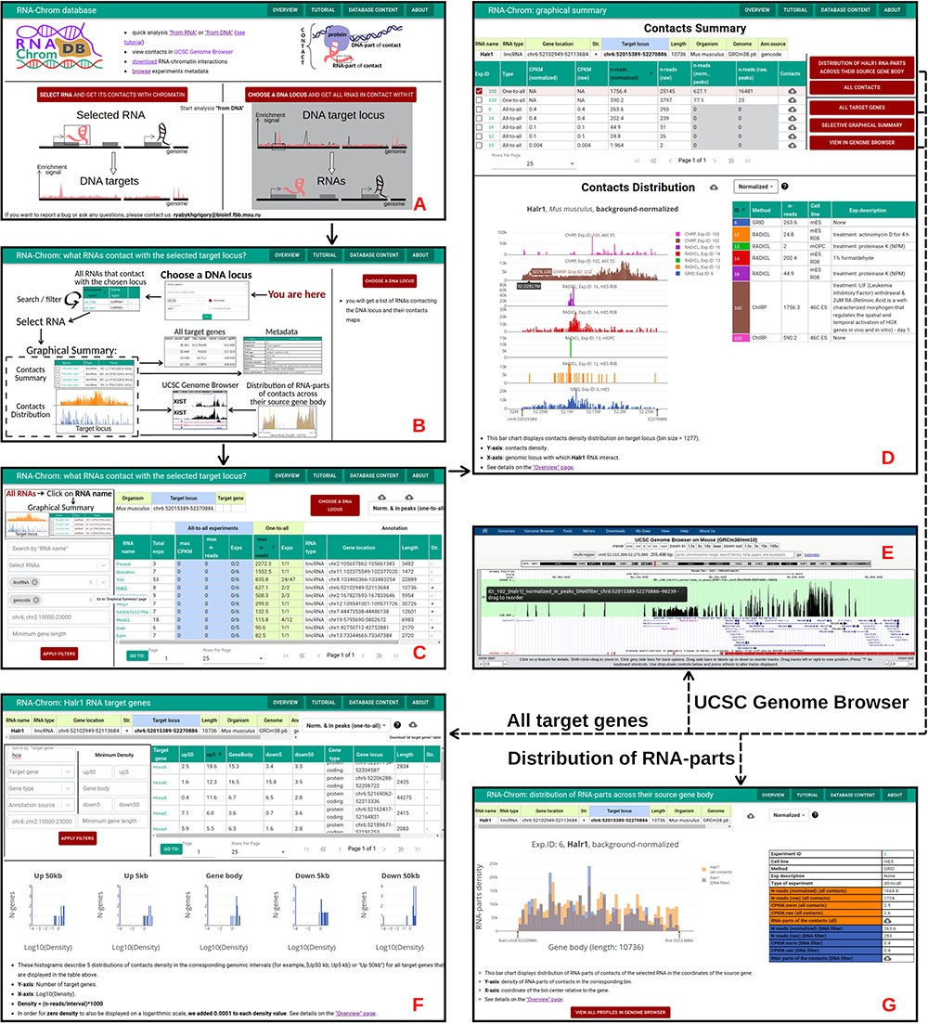
Figure 6. ‘From DNA’ analysis for HoxA cluster (chr6:52 015 389-52 270 886, M. musculus). The arrows reflect the ...
Notes:
Figure 6. ‘From DNA’ analysis for HoxA cluster (chr6:52 015 389-52 270 886, M. musculus). The arrows reflect the workflow. A. A user chooses ‘from DNA’ analysis and B. clicks on the ‘CHOOSE A DNA LOCUS’ button, selects the organism, enters the approximate coordinates of the HoxA cluster and clicks on the ‘APPLY’ button. C. All RNAs that contact with the chosen locus are presented in the table. A user applies filters if necessary. To go to the ‘Graphical Summary’ page, the user clicks on the RNA name of interest (for example, Halr1). D. The ‘Graphic Summary’ page is divided into two blocks: ‘Contacts Summary’ and ‘Contacts Distribution’. Five buttons located to the right of the ‘Contacts Summary’ table represent five options for further work with the Halr1 contacts. E. To get more details about the locus, a user sends contact maps to the UCSC Genome Browser. F. ‘All target genes’ page displays the association of contacts with genes located at the selected locus and their upstream and downstream regions. The gene list can be filtered in different ways. From this point, a user continues the analysis in the ‘from DNA’ way. G. ‘Distribution of Halr1 RNA-parts across their source gene body’ bar chart is plotted both for all contacts and for contacts with the target locus. These distributions can be downloaded or sent to the UCSC Genome Browser for a more detailed study.
Unless provided in the caption above, the following copyright applies to the content of this slide: © The Author(s) 2023. Published by Oxford University Press.This is an Open Access article distributed under the terms of the Creative Commons Attribution License (https://creativecommons.org/licenses/by/4.0/), which permits unrestricted reuse, distribution, and reproduction in any medium, provided the original work is properly cited.

