Slide 1
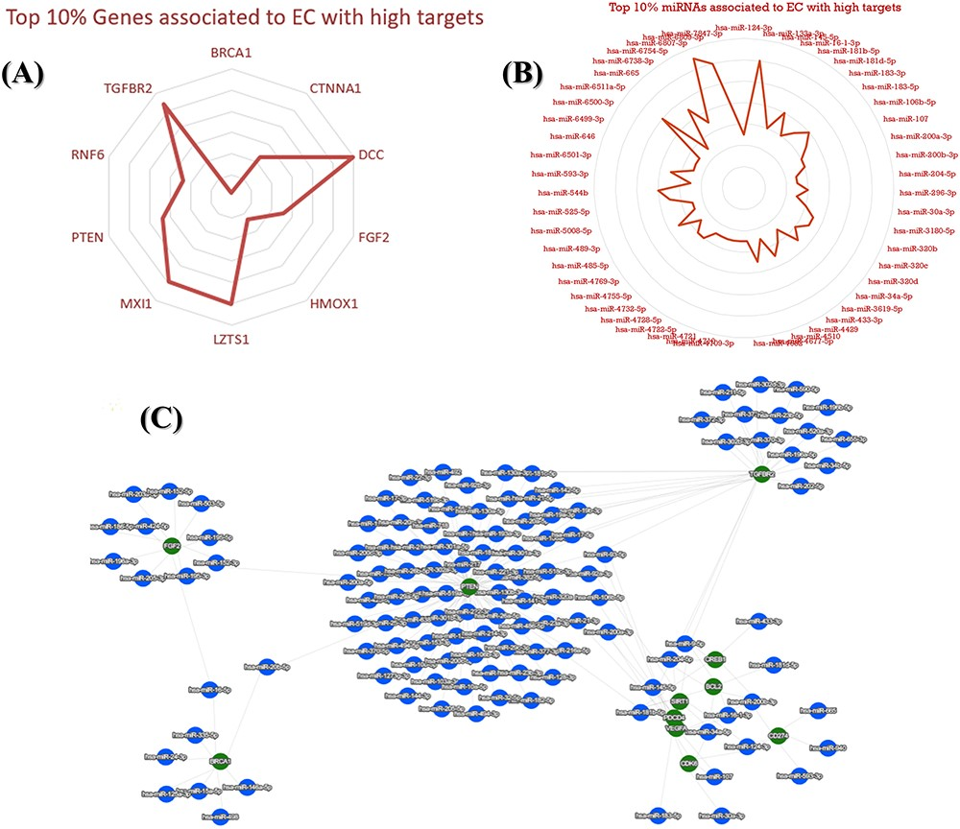
Figure 10. An illustration of top key mRNA and miRNA targets associated with EC. (A) The top 10% identified genes ...
Notes:
Figure 10. An illustration of top key mRNA and miRNA targets associated with EC. (A) The top 10% identified genes associated with EC. (B) The top 10% identified miRNAs associated with EC. (C) A network that visualizes the top connections and associations between mRNA and miRNAs, highlighting the most significant interactions among them.
Unless provided in the caption above, the following copyright applies to the content of this slide: © The Author(s) 2023. Published by Oxford University Press.This is an Open Access article distributed under the terms of the Creative Commons Attribution License (https://creativecommons.org/licenses/by/4.0/), which permits unrestricted reuse, distribution, and reproduction in any medium, provided the original work is properly cited.

