Slide 1
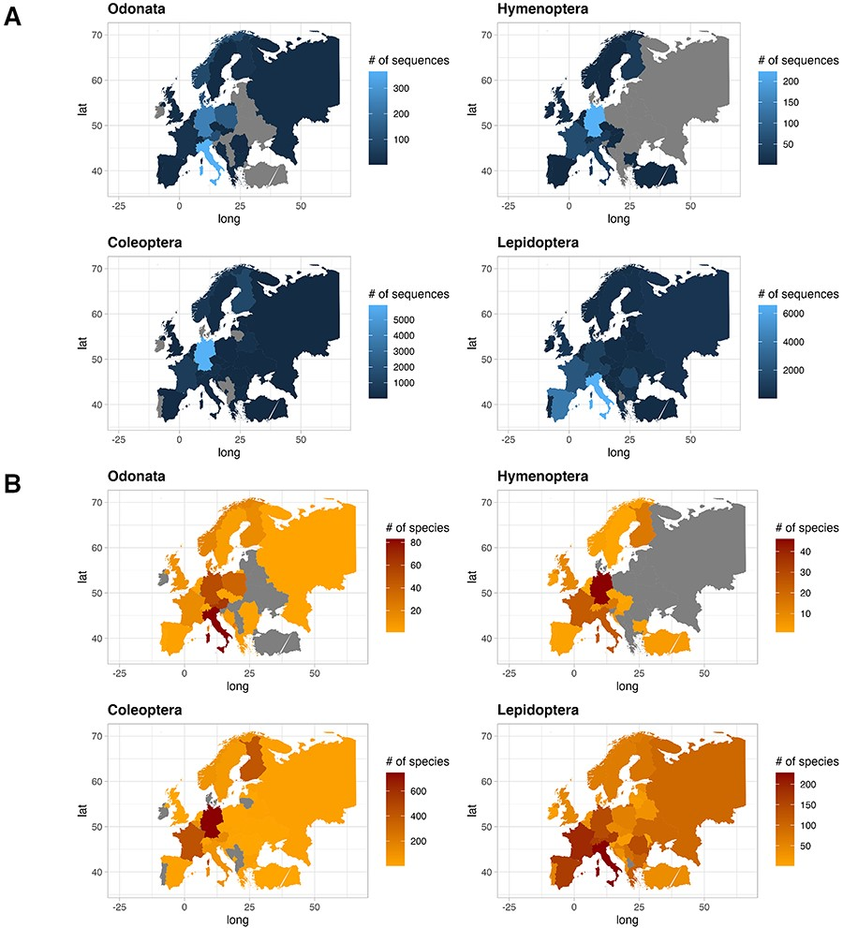
Figure 4. Plot showing the number of sequences for each country for the four IUCN Red Listed insect orders in the final ...
Notes:
Figure 4. Plot showing the number of sequences for each country for the four IUCN Red Listed insect orders in the final database (A), and plot showing the number of species for each country for the four IUCN Red Listed insect orders in the final database (B), where grey color refers to the absence of information.
Unless provided in the caption above, the following copyright applies to the content of this slide: © The Author(s) 2024. Published by Oxford University Press.This is an Open Access article distributed under the terms of the Creative Commons Attribution License (https://creativecommons.org/licenses/by/4.0/), which permits unrestricted reuse, distribution, and reproduction in any medium, provided the original work is properly cited.

