Slide 1
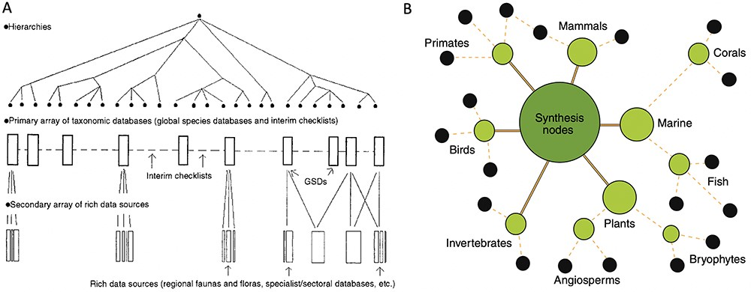
Figure 4. Two heuristic approaches to unified data pooling. (A) Image from Bisby (28), illustrating his envisioned ...
Notes:
Figure 4. Two heuristic approaches to unified data pooling. (A) Image from Bisby (28), illustrating his envisioned unified hierarchy of classificatory theories for taxonomic domains. The hierarchy would enable a centralized aggregator or modular system of data pools. (B) Image from Gallagher et al. (52), illustrating a modular hub-and-spoke system for integrating trait data about species by taxonomic domains. Black circles at the edges of the network show primary data publishers or sources. Intermediate nodes show projects harmonizing data and developing standards. The central, largest node represents a trait dataset registry that functions as a basic search index portal across domains.
Unless provided in the caption above, the following copyright applies to the content of this slide: © The Author(s) 2023. Published by Oxford University Press.This is an Open Access article distributed under the terms of the Creative Commons Attribution License (https://creativecommons.org/licenses/by/4.0/), which permits unrestricted reuse, distribution, and reproduction in any medium, provided the original work is properly cited.

