Slide 1
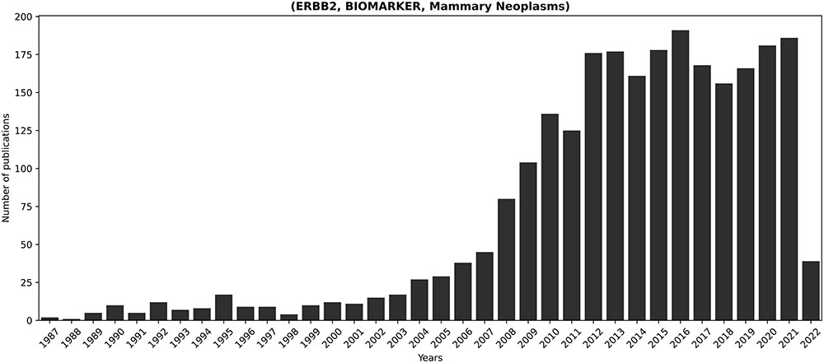
Figure 5. Temporal progression of publications concerning the longest-discussed fact in literature: (ERBB2, BIOMARKER, ...
Notes:
Figure 5. Temporal progression of publications concerning the longest-discussed fact in literature: (ERBB2, BIOMARKER, Mammary Neoplasms). ERBB2 is a known proto-oncogene, amplified or overexpressed in around 30% of human breast cancers (73). Its relevance in breast cancer justifies the prominent presence of the corresponding fact in the scientific discourse.
Unless provided in the caption above, the following copyright applies to the content of this slide: © The Author(s) 2023. Published by Oxford University Press.This is an Open Access article distributed under the terms of the Creative Commons Attribution License (https://creativecommons.org/licenses/by/4.0/), which permits unrestricted reuse, distribution, and reproduction in any medium, provided the original work is properly cited.

