Slide 1
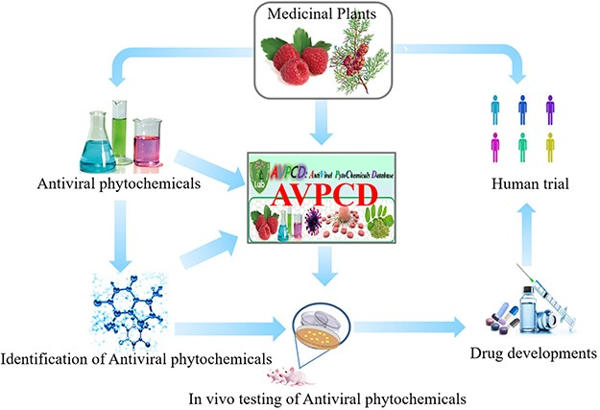
Figure 1. The graphical abstract of the AVPCD.
Notes:
Figure 1. The graphical abstract of the AVPCD.
Unless provided in the caption above, the following copyright applies to the content of this slide: © The Author(s) 2023. Published by Oxford University Press.This is an Open Access article distributed under the terms of the Creative Commons Attribution License (https://creativecommons.org/licenses/by/4.0/), which permits unrestricted reuse, distribution, and reproduction in any medium, provided the original work is properly cited.

Slide 2
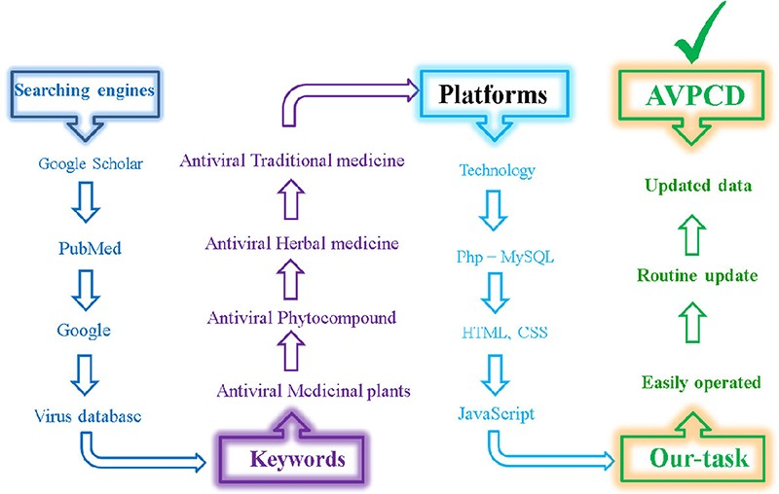
Figure 2. Color-wise and graphical representation of the collection of antiviral phyto-compounds and construction of ...
Notes:
Figure 2. Color-wise and graphical representation of the collection of antiviral phyto-compounds and construction of AVPCD.
Unless provided in the caption above, the following copyright applies to the content of this slide: © The Author(s) 2023. Published by Oxford University Press.This is an Open Access article distributed under the terms of the Creative Commons Attribution License (https://creativecommons.org/licenses/by/4.0/), which permits unrestricted reuse, distribution, and reproduction in any medium, provided the original work is properly cited.

Slide 3
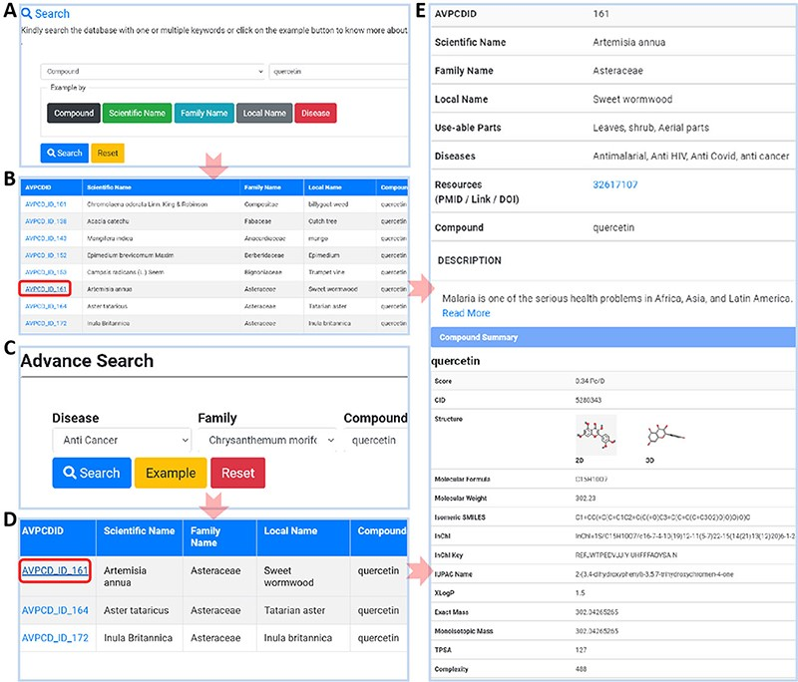
Figure 3. Usage of AVPCD. (A) The simple search with five search options. (B) The compound list by the selected option ...
Notes:
Figure 3. Usage of AVPCD. (A) The simple search with five search options. (B) The compound list by the selected option in simple search. (C) The advanced search of the AVPCD. (D) The compound list by the advanced search. (E) All the needed and final data of the searched query.
Unless provided in the caption above, the following copyright applies to the content of this slide: © The Author(s) 2023. Published by Oxford University Press.This is an Open Access article distributed under the terms of the Creative Commons Attribution License (https://creativecommons.org/licenses/by/4.0/), which permits unrestricted reuse, distribution, and reproduction in any medium, provided the original work is properly cited.

Slide 4
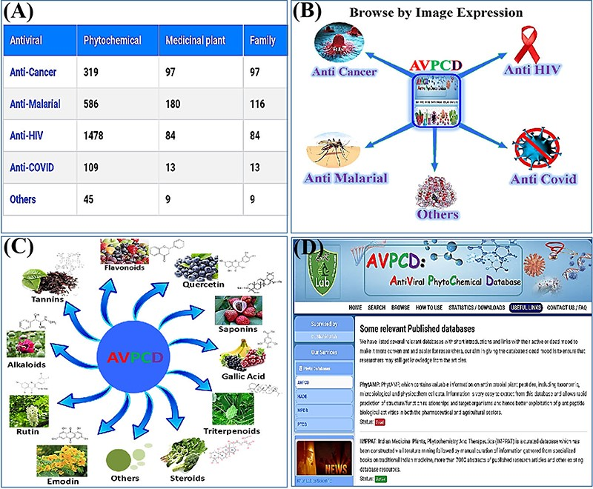
Figure 4. Usage of the database. (A) The browse option by antiviral category. (B) Browse by disease-wise image ...
Notes:
Figure 4. Usage of the database. (A) The browse option by antiviral category. (B) Browse by disease-wise image expression. (C) Browse page of the AVPCD based on the top 10 rich compound images and formula. (D) Useful links to the relevant databases with two modes.
Unless provided in the caption above, the following copyright applies to the content of this slide: © The Author(s) 2023. Published by Oxford University Press.This is an Open Access article distributed under the terms of the Creative Commons Attribution License (https://creativecommons.org/licenses/by/4.0/), which permits unrestricted reuse, distribution, and reproduction in any medium, provided the original work is properly cited.

Slide 5
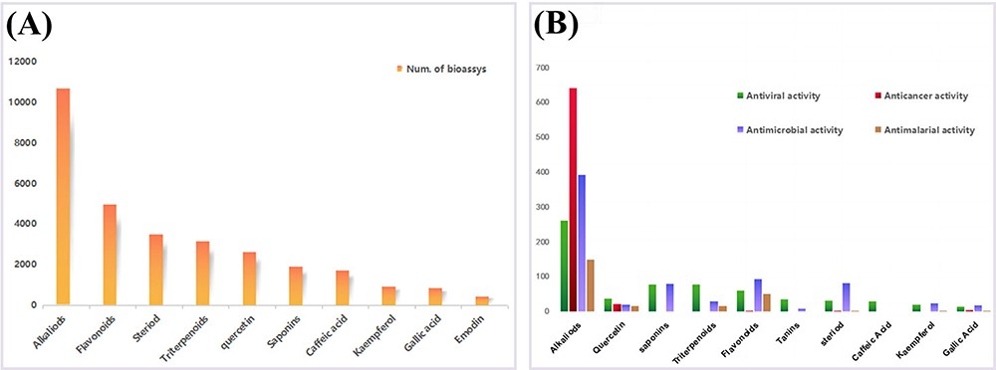
Figure 5. The top 10 compounds with different biological activities. (A) The bioassays of top 10 compounds. (B) The ...
Notes:
Figure 5. The top 10 compounds with different biological activities. (A) The bioassays of top 10 compounds. (B) The bioassays of mentioned antiviral compounds in AVPCD.
Unless provided in the caption above, the following copyright applies to the content of this slide: © The Author(s) 2023. Published by Oxford University Press.This is an Open Access article distributed under the terms of the Creative Commons Attribution License (https://creativecommons.org/licenses/by/4.0/), which permits unrestricted reuse, distribution, and reproduction in any medium, provided the original work is properly cited.

Slide 6
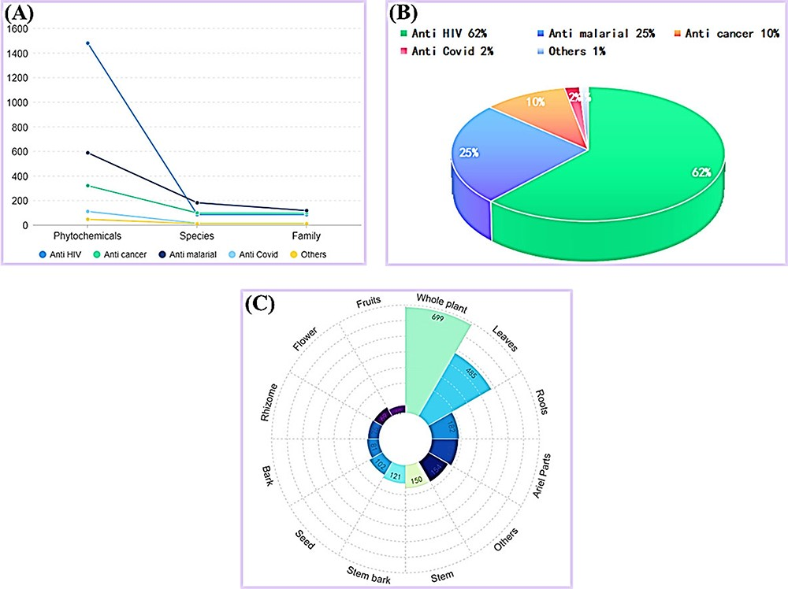
Figure 6. The statistics of AVPCD, (A) The number of antiviral phytochemicals, species and family. (C) The percentage ...
Notes:
Figure 6. The statistics of AVPCD, (A) The number of antiviral phytochemicals, species and family. (C) The percentage of antiviral phytochemical. (D) The number of all usable parts of medicinal plants.
Unless provided in the caption above, the following copyright applies to the content of this slide: © The Author(s) 2023. Published by Oxford University Press.This is an Open Access article distributed under the terms of the Creative Commons Attribution License (https://creativecommons.org/licenses/by/4.0/), which permits unrestricted reuse, distribution, and reproduction in any medium, provided the original work is properly cited.

Slide 7
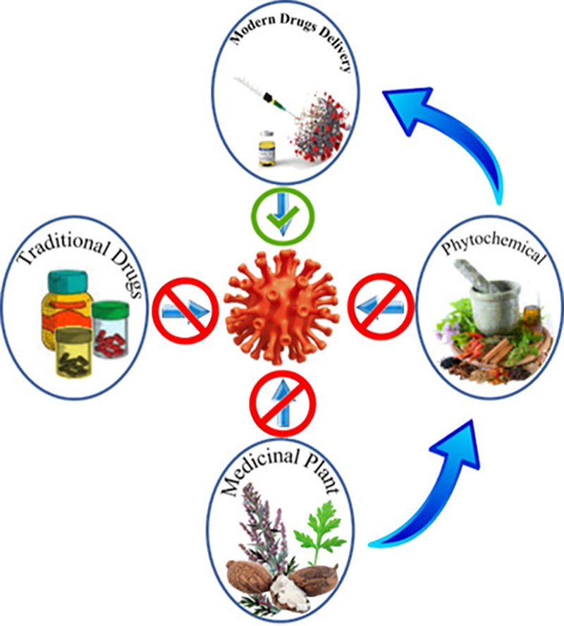
Figure 7. The future direction of the antiviral phytochemicals.
Notes:
Figure 7. The future direction of the antiviral phytochemicals.
Unless provided in the caption above, the following copyright applies to the content of this slide: © The Author(s) 2023. Published by Oxford University Press.This is an Open Access article distributed under the terms of the Creative Commons Attribution License (https://creativecommons.org/licenses/by/4.0/), which permits unrestricted reuse, distribution, and reproduction in any medium, provided the original work is properly cited.

