Slide 1
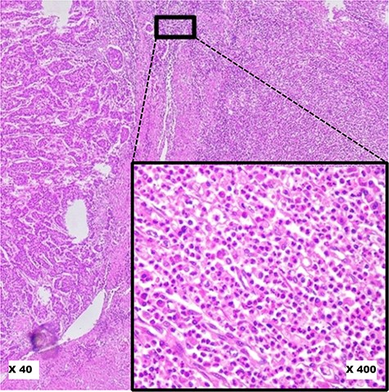
Figure 4. Pitfalls to avoid in selecting ‘Hot Spot’ areas on HE slides. This image shows a robust inflammatory response ...
Notes:
Figure 4. Pitfalls to avoid in selecting ‘Hot Spot’ areas on HE slides. This image shows a robust inflammatory response in the tumour microenvironment at low magnification (×40). At higher magnification (×400), it reveals a polymorphic inflammatory infiltrate particularly rich in neutrophilic granulocytes, which should not be considered. Alt text: Polymorphic inflammatory infiltrate rich in neutrophilic granulocytes, to avoid when selecting hot spots.
Unless provided in the caption above, the following copyright applies to the content of this slide: © The Author(s) 2023. Published by Oxford University Press.This is an Open Access article distributed under the terms of the Creative Commons Attribution License (https://creativecommons.org/licenses/by/4.0/), which permits unrestricted reuse, distribution, and reproduction in any medium, provided the original work is properly cited.

