Slide 1
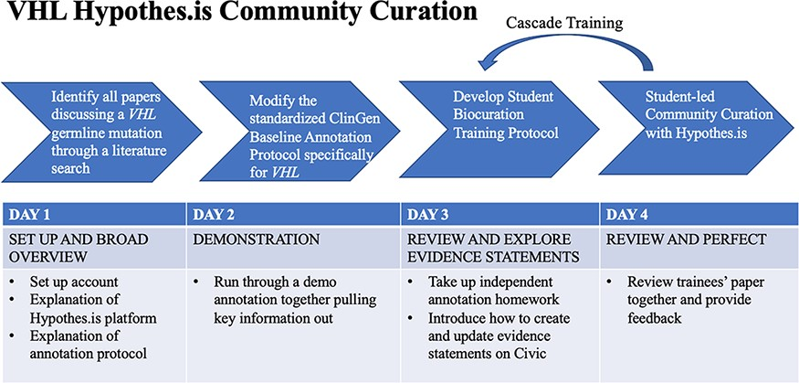
Figure 3. VHL-specific protocol development and training protocol. Summary of a 4-day lesson plan. Refer to ...
Notes:
Figure 3. VHL-specific protocol development and training protocol. Summary of a 4-day lesson plan. Refer to Supplementary Material and Methods for the full training protocol, which details the specific steps and homework tasks that were assigned, and the resource guide, which includes links and diagrams that are useful during the annotation process.
Unless provided in the caption above, the following copyright applies to the content of this slide: © The Author(s) 2023. Published by Oxford University Press.This is an Open Access article distributed under the terms of the Creative Commons Attribution License (https://creativecommons.org/licenses/by/4.0/), which permits unrestricted reuse, distribution, and reproduction in any medium, provided the original work is properly cited.

Slide 2
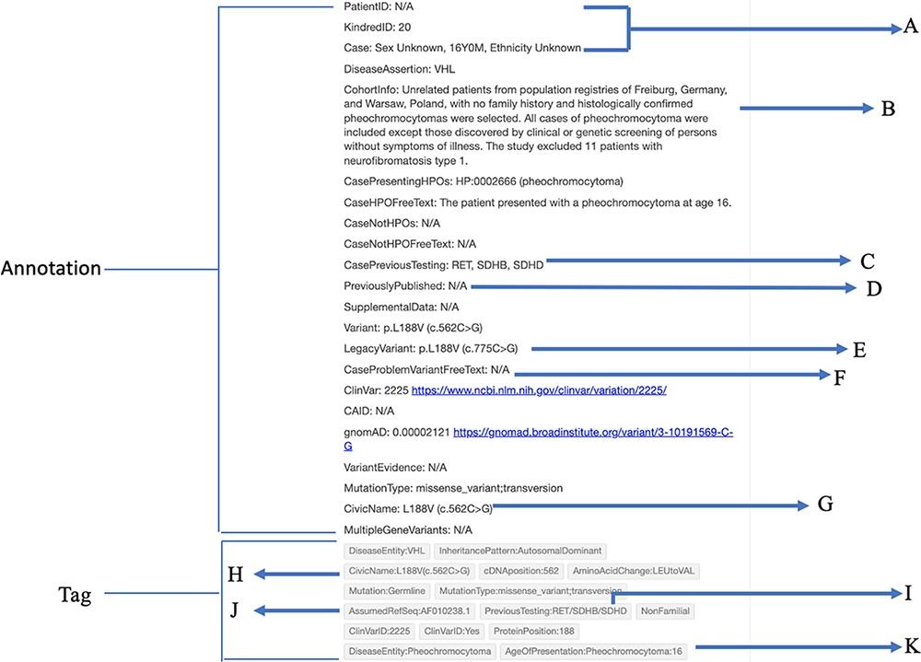
Figure 2. Case-individual type annotation on the Hypothes.is platform. (A) Patient identification information is ...
Notes:
Figure 2. Case-individual type annotation on the Hypothes.is platform. (A) Patient identification information is indicated by patient ID, kindred (family) ID and case information. (B) Description of the cohort. (C) Previous genes that were tested. (D) Previously published. (E) The non-standardized version of the variant, known as the Legacy variant. (F) Problems encountered with the variant. (G) The CIViC name associated with the variant. (H) Tag for the CIViC name. (I) Tag for previous genes that were tested. (J) Tag for the reference sequence used by the authors. In this case, the Latif sequence was assumed. (K) Tag for the age of presentation of a specific phenotype. In this case, a pheochromocytoma presenting at age 16 was tagged.
Unless provided in the caption above, the following copyright applies to the content of this slide: © The Author(s) 2023. Published by Oxford University Press.This is an Open Access article distributed under the terms of the Creative Commons Attribution License (https://creativecommons.org/licenses/by/4.0/), which permits unrestricted reuse, distribution, and reproduction in any medium, provided the original work is properly cited.

Slide 3
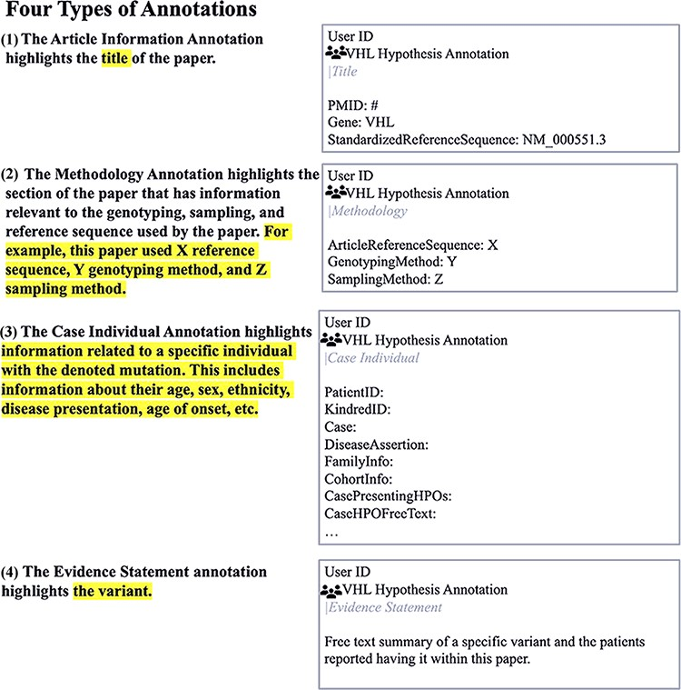
Figure 1. Four types of annotations and their associated text in a sample paper using the Hypothes.is platform.
Notes:
Figure 1. Four types of annotations and their associated text in a sample paper using the Hypothes.is platform.
Unless provided in the caption above, the following copyright applies to the content of this slide: © The Author(s) 2023. Published by Oxford University Press.This is an Open Access article distributed under the terms of the Creative Commons Attribution License (https://creativecommons.org/licenses/by/4.0/), which permits unrestricted reuse, distribution, and reproduction in any medium, provided the original work is properly cited.

