Slide 1
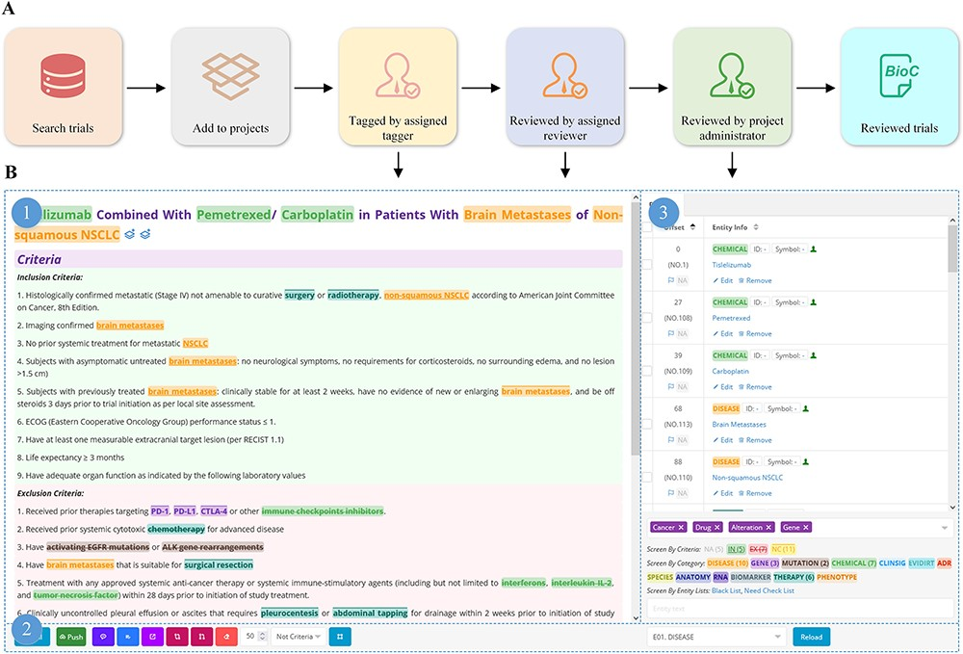
Figure 3. Manual tagging of clinical trials.
Notes:
Figure 3. Manual tagging of clinical trials. A) Workflow for manual tagging of clinical trials; B) overview of the trial tagging page: 1) trial details with highlighted bio-concepts, 2) the manual tagging tools bar, and 3) real-time presentation of entity information.
Unless provided in the caption above, the following copyright applies to the content of this slide: © The Author(s) 2023. Published by Oxford University Press.This is an Open Access article distributed under the terms of the Creative Commons Attribution License (https://creativecommons.org/licenses/by/4.0/), which permits unrestricted reuse, distribution, and reproduction in any medium, provided the original work is properly cited.

