Slide 1
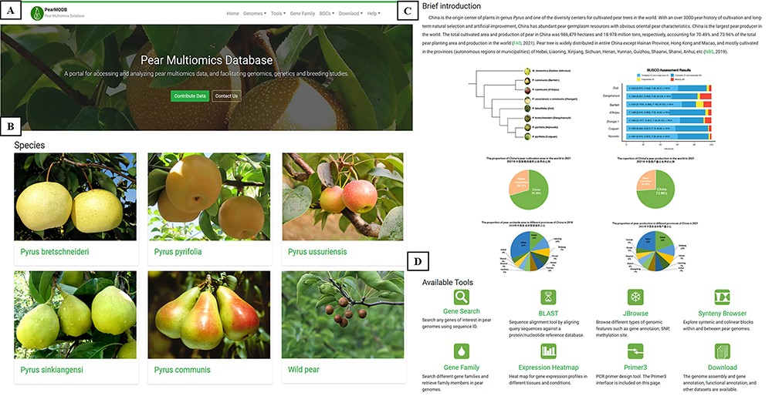
Figure 2. The home page of PearMODB. (A) Drop-down menus to explore different function modules and brief introduction. ...
Notes:
Figure 2. The home page of PearMODB. (A) Drop-down menus to explore different function modules and brief introduction. (B) Representative cultivars of five major cultivated species and wild pear species. (C) Brief introduction about pear cultivation and yield. (D) Available tools on PearMODB.
Unless provided in the caption above, the following copyright applies to the content of this slide: © The Author(s) 2023. Published by Oxford University Press.This is an Open Access article distributed under the terms of the Creative Commons Attribution License (https://creativecommons.org/licenses/by/4.0/), which permits unrestricted reuse, distribution, and reproduction in any medium, provided the original work is properly cited.

