Slide 1
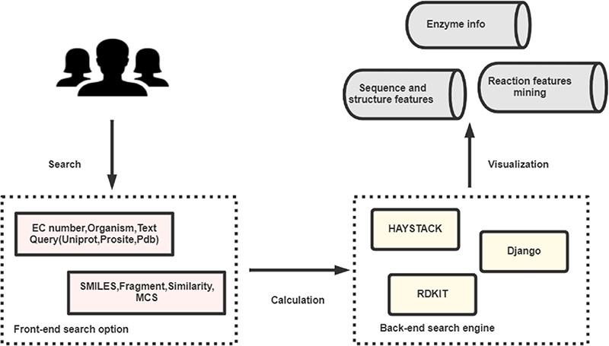
Figure 1. The broad architecture of EnzyMine processing, including the front-end and back-end search engines, which ...
Notes:
Figure 1. The broad architecture of EnzyMine processing, including the front-end and back-end search engines, which return displayed data.
Unless provided in the caption above, the following copyright applies to the content of this slide: © The Author(s) 2020. Published by Oxford University Press.This is an Open Access article distributed under the terms of the Creative Commons Attribution License (http://creativecommons.org/licenses/by/4.0/), which permits unrestricted reuse, distribution, and reproduction in any medium, provided the original work is properly cited.

Slide 2
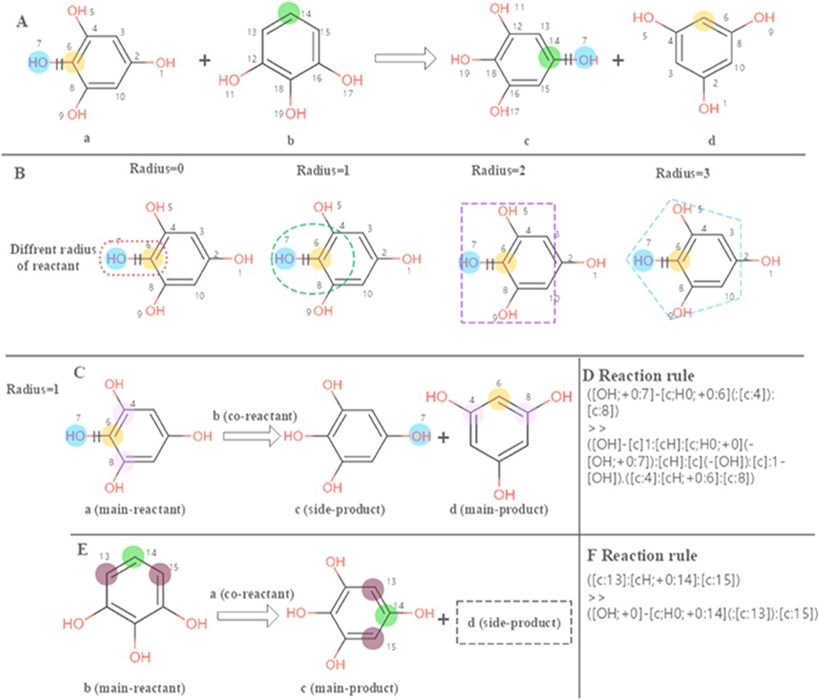
Figure 2. Calculation of the reaction rules for EC 1.97.1.2. (A) The reaction transformation is labelled. (B) Different ...
Notes:
Figure 2. Calculation of the reaction rules for EC 1.97.1.2. (A) The reaction transformation is labelled. (B) Different radius can be used to identify adjacent neighbours in the reaction. (C, E) The reaction rules are calculated for two reactants. (D, F) reaction rules encoded with SMART.
Unless provided in the caption above, the following copyright applies to the content of this slide: © The Author(s) 2020. Published by Oxford University Press.This is an Open Access article distributed under the terms of the Creative Commons Attribution License (http://creativecommons.org/licenses/by/4.0/), which permits unrestricted reuse, distribution, and reproduction in any medium, provided the original work is properly cited.

Slide 3
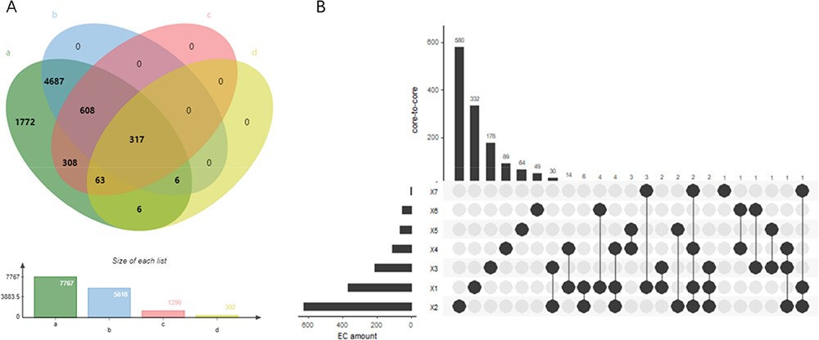
Figure 3. (A) Wynn diagram of four database coverage of EC number, a: sequence amount in UniProt, b: reaction amount in ...
Notes:
Figure 3. (A) Wynn diagram of four database coverage of EC number, a: sequence amount in UniProt, b: reaction amount in Rhea, c: family classification amount in PROSITE, d: 3D structure amount in Protein Data Bank. (B) The overall distribution of core-to-core across the seven types of enzyme.
Unless provided in the caption above, the following copyright applies to the content of this slide: © The Author(s) 2020. Published by Oxford University Press.This is an Open Access article distributed under the terms of the Creative Commons Attribution License (http://creativecommons.org/licenses/by/4.0/), which permits unrestricted reuse, distribution, and reproduction in any medium, provided the original work is properly cited.

Slide 4
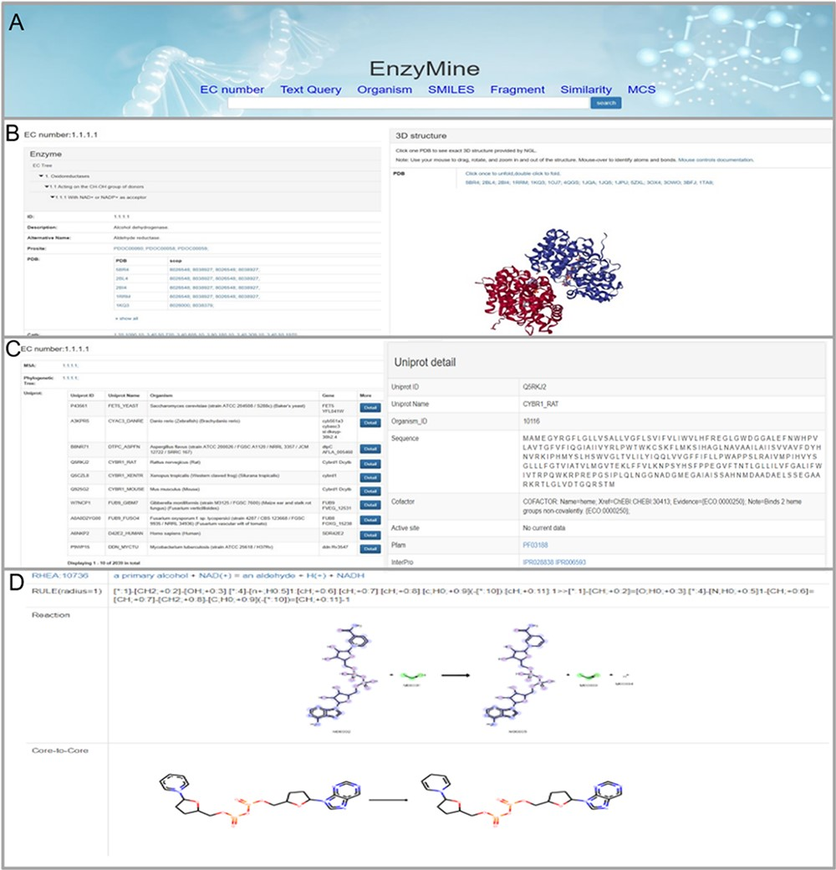
Figure 4. Detailed EnzyMine screenshot and search results for EC:1.1.1.1 are shown. (A) Front-end search methods based ...
Notes:
Figure 4. Detailed EnzyMine screenshot and search results for EC:1.1.1.1 are shown. (A) Front-end search methods based on text query and molecular searching query. (B) Basic enzyme information is listed, where EC classification, PROSITE and CATH classifications are shown on the left. Various display options related to protein 3D structures are provided by the NGL engine (27). (C) Multi-sequence alignment and phylogenetic trees related to the UniProt sequence under each the EC number are provided in a link, and single UniProt details are included by clicking the button on the right. (D) Reaction centre display, rules and core-to-core are shown. Detailed enzyme information and feature mining information are available for download.
Unless provided in the caption above, the following copyright applies to the content of this slide: © The Author(s) 2020. Published by Oxford University Press.This is an Open Access article distributed under the terms of the Creative Commons Attribution License (http://creativecommons.org/licenses/by/4.0/), which permits unrestricted reuse, distribution, and reproduction in any medium, provided the original work is properly cited.

Slide 5
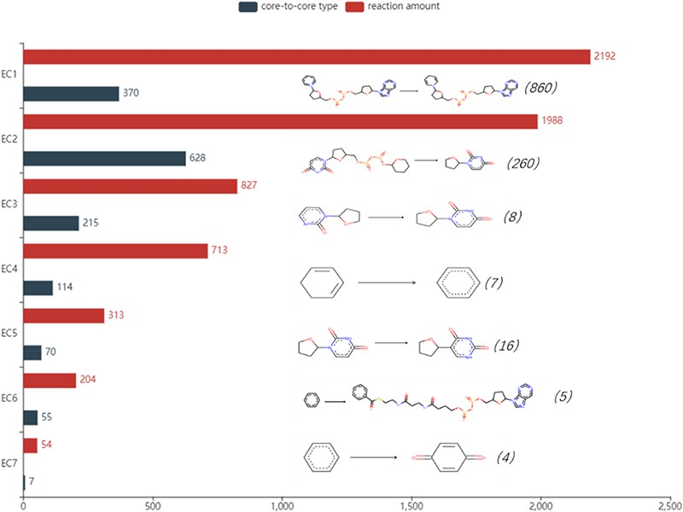
Figure 5. Detailed reaction amount and core-to-core type in seven types of enzymes, the most frequent amount marked in ...
Notes:
Figure 5. Detailed reaction amount and core-to-core type in seven types of enzymes, the most frequent amount marked in the parentheses and core-to-core pictures are listed on the right of the bar graph. EC1: Oxidoreductases, EC2: Transferases, EC3: Hydrolases, EC4: Lyases, EC5: Isomerases, EC6: Ligases, EC7: Translocases.
Unless provided in the caption above, the following copyright applies to the content of this slide: © The Author(s) 2020. Published by Oxford University Press.This is an Open Access article distributed under the terms of the Creative Commons Attribution License (http://creativecommons.org/licenses/by/4.0/), which permits unrestricted reuse, distribution, and reproduction in any medium, provided the original work is properly cited.

