Slide 1
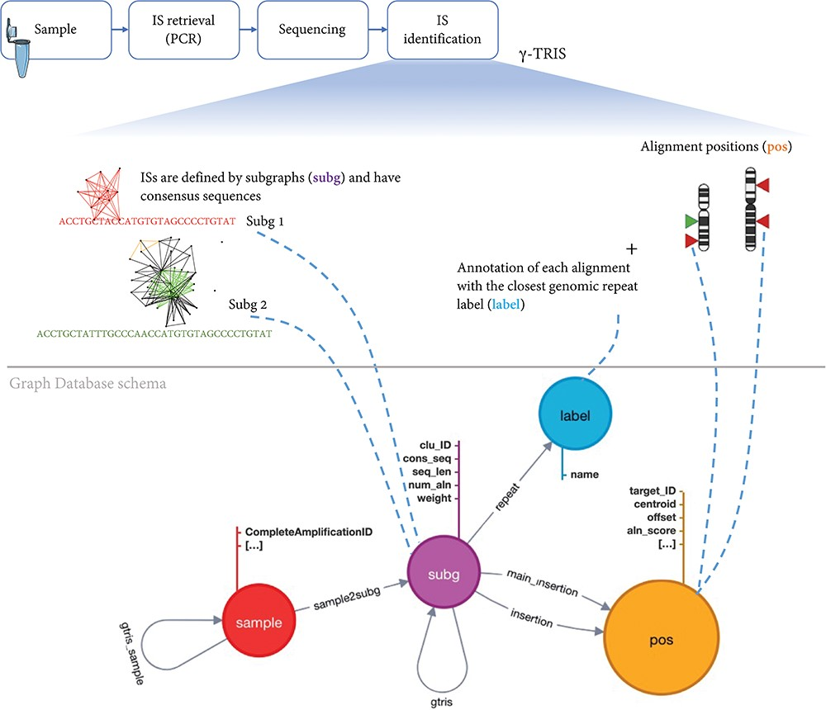
Figure 3. Schema of the graph database archiving clonal data obtained from ISs using γ-TRIS. A node subg represents a ...
Notes:
Figure 3. Schema of the graph database archiving clonal data obtained from ISs using γ-TRIS. A node subg represents a subgraph and collects information about a source IS and the consensus sequence. One sample node is connected to many subg nodes, while a subg node is linked to one and only one sample. Subgraph annotations/labels are represented by label nodes, as well as the genomic loci of the ISs on the reference genome are represented by pos nodes. The relationship connecting a subg and a label is called repeat, while the link between a subg and a pos is called insertion. This information is all included in the files representing the input of the tracking step. On the other hand, γ-TRIS links are computed during the tracking step using the rules described in ‘Data description’ section and incrementally, i.e. new gtris links are computed and added only when a new sample is inserted in the database. These links represent the novel approach for speeding up and scaling the tracking step analysis.
Unless provided in the caption above, the following copyright applies to the content of this slide: © The Author(s) 2023. Published by Oxford University Press.This is an Open Access article distributed under the terms of the Creative Commons Attribution License (https://creativecommons.org/licenses/by/4.0/), which permits unrestricted reuse, distribution, and reproduction in any medium, provided the original work is properly cited.

