Slide 1
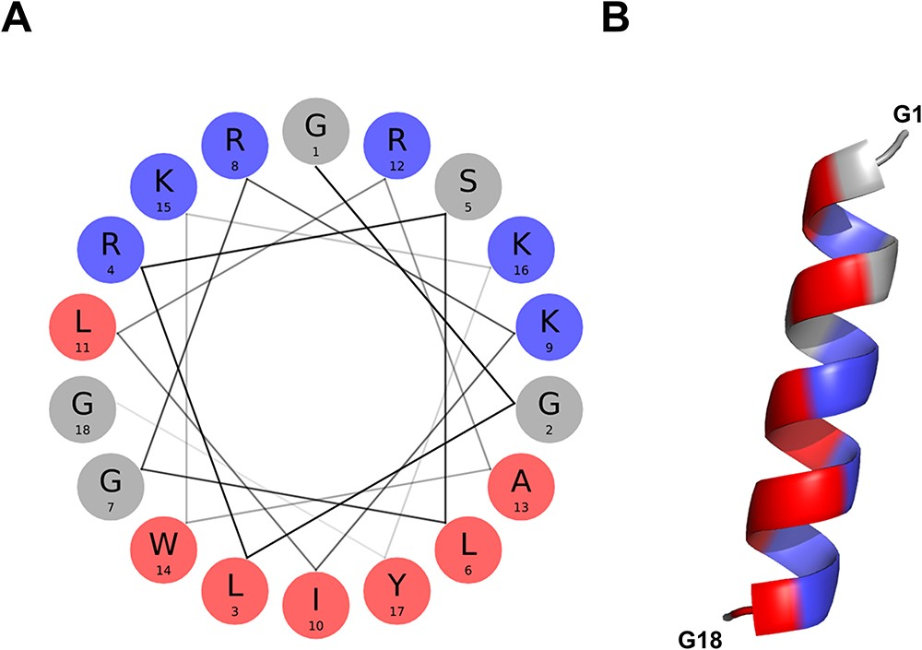
Figure 4. α-helical conformation of the food-derived bioactive BMAP-28 peptide (ASYNP110). (A) Helical wheel ...
Notes:
Figure 4. α-helical conformation of the food-derived bioactive BMAP-28 peptide (ASYNP110). (A) Helical wheel visualization of BMAP-28, which holds the highest amphipathicity of all peptides collected in the database (hydrophobic and cationic residues in red and dark blue, respectively). (B) Predicted α-helical conformation obtained for BMAP-28 (AlphaFold).
Unless provided in the caption above, the following copyright applies to the content of this slide: © The Author(s) 2023. Published by Oxford University Press.This is an Open Access article distributed under the terms of the Creative Commons Attribution License (https://creativecommons.org/licenses/by/4.0/), which permits unrestricted reuse, distribution, and reproduction in any medium, provided the original work is properly cited.

