Slide 1
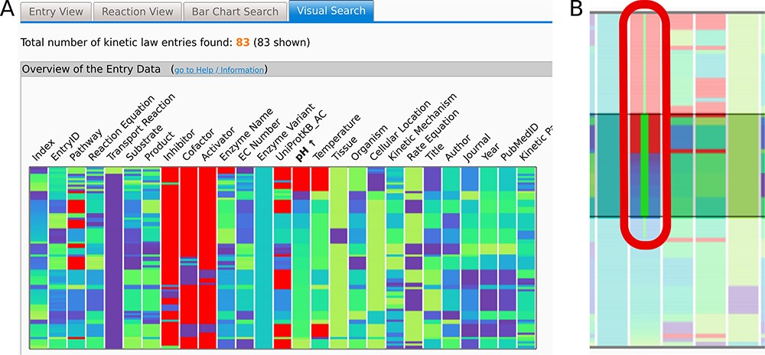
Figure 2. (A) The Overview heat map graph. Attribute names are given above the graph. Data can be sorted by any of the ...
Notes:
Figure 2. (A) The Overview heat map graph. Attribute names are given above the graph. Data can be sorted by any of the attributes. Here, the data are sorted by pH values. One horizontal line represents one entry of the data. Data can be selected by clicking or brushing. (B) Brushing extends the selection to capture all of the brushed border values (thin green line in (B)) including all entries with the same highlighted property (e.g. pH value 7.0). Selected data are highlighted in all of the graphs. Axes can be added or removed and rearranged as desired as well as the used color schemes. Here, the null values are denoted in red, while a ‘cool’ color scheme ranging from dark purple to lime is used per attribute or axis.
Unless provided in the caption above, the following copyright applies to the content of this slide: © The Author(s) 2023. Published by Oxford University Press.This is an Open Access article distributed under the terms of the Creative Commons Attribution License (https://creativecommons.org/licenses/by/4.0/), which permits unrestricted reuse, distribution, and reproduction in any medium, provided the original work is properly cited.

