Slide 1
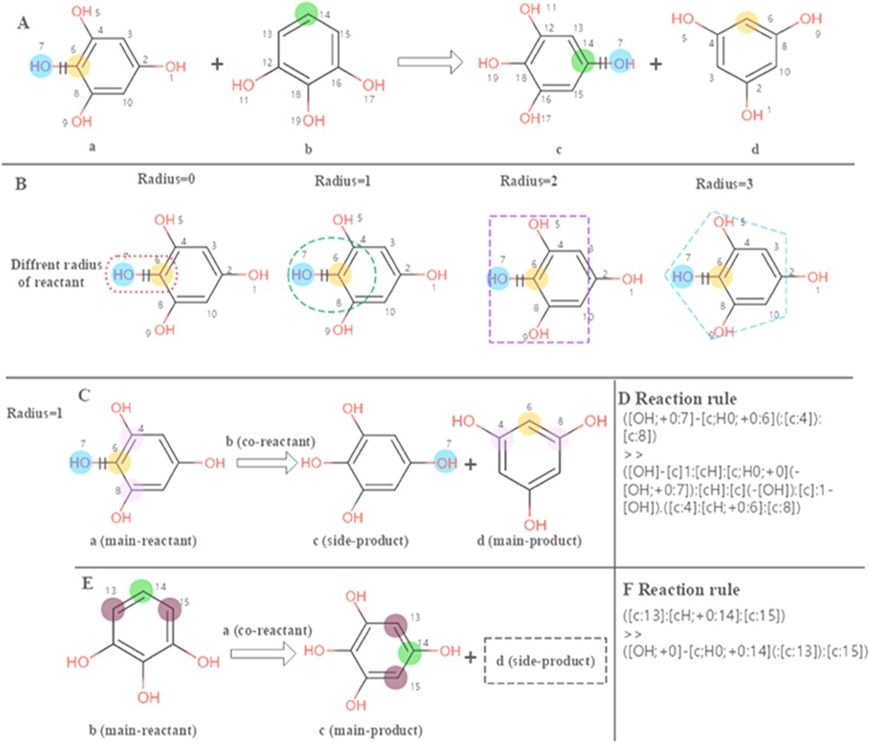
Figure 2. Calculation of the reaction rules for EC 1.97.1.2. (A) The reaction transformation is labelled. (B) Different ...
Notes:
Figure 2. Calculation of the reaction rules for EC 1.97.1.2. (A) The reaction transformation is labelled. (B) Different radius can be used to identify adjacent neighbours in the reaction. (C, E) The reaction rules are calculated for two reactants. (D, F) reaction rules encoded with SMART.
Unless provided in the caption above, the following copyright applies to the content of this slide: © The Author(s) 2020. Published by Oxford University Press.This is an Open Access article distributed under the terms of the Creative Commons Attribution License (http://creativecommons.org/licenses/by/4.0/), which permits unrestricted reuse, distribution, and reproduction in any medium, provided the original work is properly cited.

