Slide 1
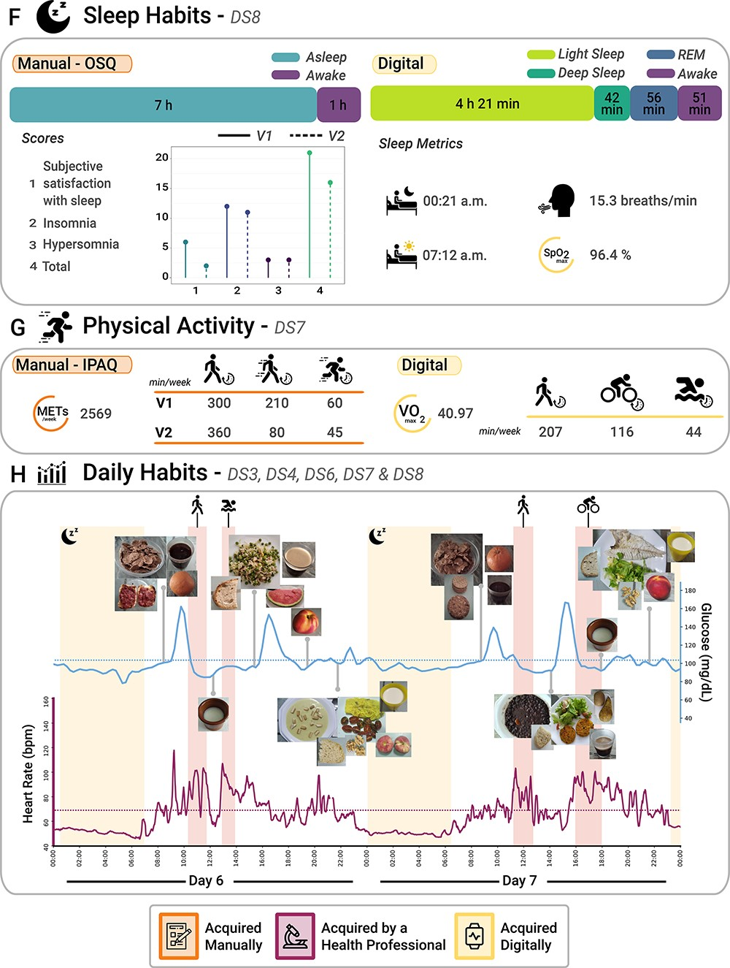
Figure 3.2 Continuing from Figure 3.1. (F) Sleep habits from both subjective (OSQ) and objective (wearable devices) ...
Notes:
Figure 3.2 Continuing from Figure 3.1. (F) Sleep habits from both subjective (OSQ) and objective (wearable devices) perspectives (extracted from Dataset 8). (G) Physical activity from both subjective (IPAQ) and objective (wearable devices) perspectives (Dataset 7). (H) Daily habits, which comprise a 2-day report that includes blood glucose levels, HR, night sleep activity, physical activity and images of the different foods consumed during these 2 days (Datasets 3, 4, 6, 7 and 8).
Unless provided in the caption above, the following copyright applies to the content of this slide: © The Author(s) 2023. Published by Oxford University Press.This is an Open Access article distributed under the terms of the Creative Commons Attribution License (https://creativecommons.org/licenses/by/4.0/), which permits unrestricted reuse, distribution, and reproduction in any medium, provided the original work is properly cited.

