Slide 1
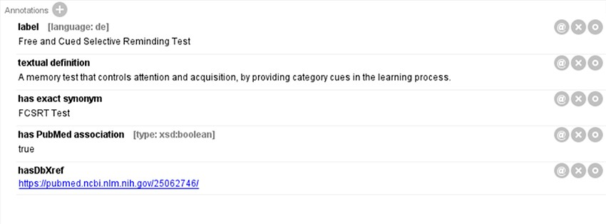
Figure 1. An original term ‘Free and Cued Selective Reminding Test’ defined in the integrated ADO.
Notes:
Figure 1. An original term ‘Free and Cued Selective Reminding Test’ defined in the integrated ADO.
Unless provided in the caption above, the following copyright applies to the content of this slide: © The Author(s) 2023. Published by Oxford University Press.This is an Open Access article distributed under the terms of the Creative Commons Attribution License (https://creativecommons.org/licenses/by/4.0/), which permits unrestricted reuse, distribution, and reproduction in any medium, provided the original work is properly cited.

Slide 2
Figure 2. An example of ADMO terms that describe the relations between molecules.
Notes:
Figure 2. An example of ADMO terms that describe the relations between molecules.
Unless provided in the caption above, the following copyright applies to the content of this slide: © The Author(s) 2023. Published by Oxford University Press.This is an Open Access article distributed under the terms of the Creative Commons Attribution License (https://creativecommons.org/licenses/by/4.0/), which permits unrestricted reuse, distribution, and reproduction in any medium, provided the original work is properly cited.

Slide 3
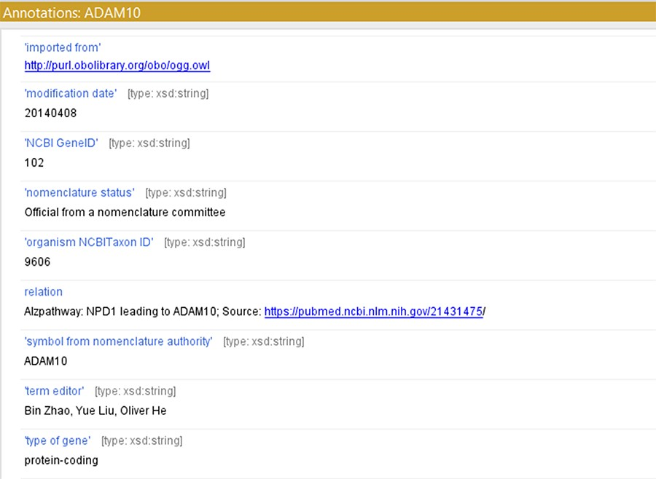
Figure 3. Using ‘relation’ to annotate the term with a reference source from ADMO or Alzpathway.
Notes:
Figure 3. Using ‘relation’ to annotate the term with a reference source from ADMO or Alzpathway.
Unless provided in the caption above, the following copyright applies to the content of this slide: © The Author(s) 2023. Published by Oxford University Press.This is an Open Access article distributed under the terms of the Creative Commons Attribution License (https://creativecommons.org/licenses/by/4.0/), which permits unrestricted reuse, distribution, and reproduction in any medium, provided the original work is properly cited.

Slide 4
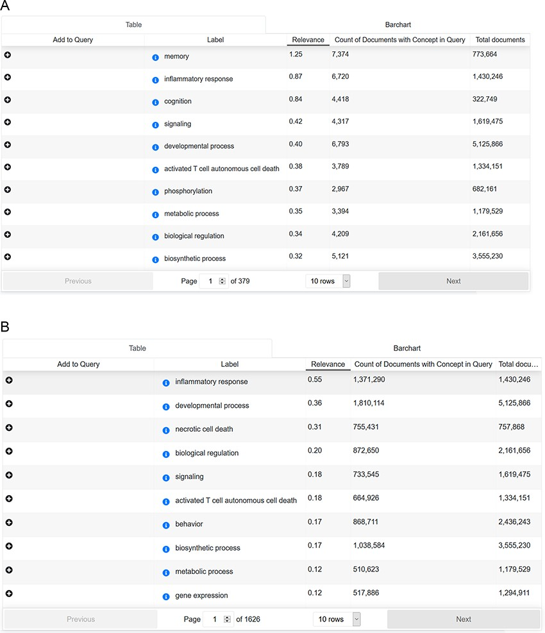
Figure 6. (A) Cross-analysis of AD-related symptoms and cellular processes. (B) Cross-analysis of AD-related symptoms ...
Notes:
Figure 6. (A) Cross-analysis of AD-related symptoms and cellular processes. (B) Cross-analysis of AD-related symptoms and cellular processes.
Unless provided in the caption above, the following copyright applies to the content of this slide: © The Author(s) 2023. Published by Oxford University Press.This is an Open Access article distributed under the terms of the Creative Commons Attribution License (https://creativecommons.org/licenses/by/4.0/), which permits unrestricted reuse, distribution, and reproduction in any medium, provided the original work is properly cited.

Slide 5
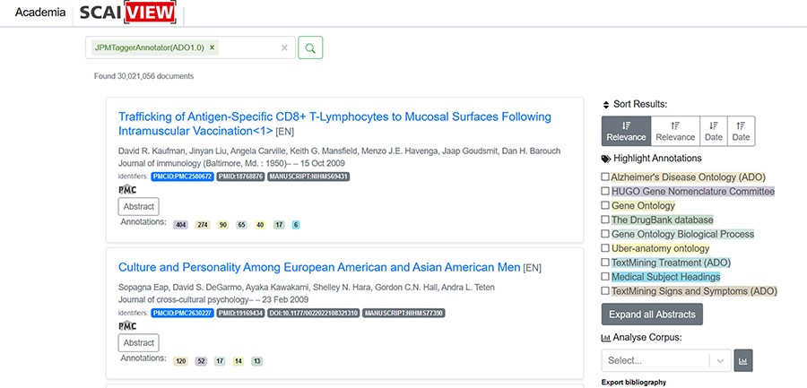
Figure 5. Number of documents extracted through applying the ‘ADO’ tagger.
Notes:
Figure 5. Number of documents extracted through applying the ‘ADO’ tagger.
Unless provided in the caption above, the following copyright applies to the content of this slide: © The Author(s) 2023. Published by Oxford University Press.This is an Open Access article distributed under the terms of the Creative Commons Attribution License (https://creativecommons.org/licenses/by/4.0/), which permits unrestricted reuse, distribution, and reproduction in any medium, provided the original work is properly cited.

Slide 6
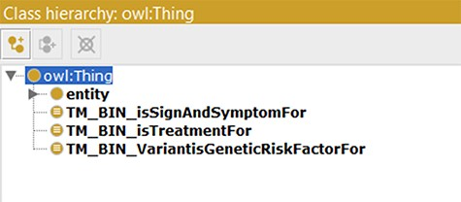
Figure 4. Classes used as text mining bins.
Notes:
Figure 4. Classes used as text mining bins.
Unless provided in the caption above, the following copyright applies to the content of this slide: © The Author(s) 2023. Published by Oxford University Press.This is an Open Access article distributed under the terms of the Creative Commons Attribution License (https://creativecommons.org/licenses/by/4.0/), which permits unrestricted reuse, distribution, and reproduction in any medium, provided the original work is properly cited.

Slide 7
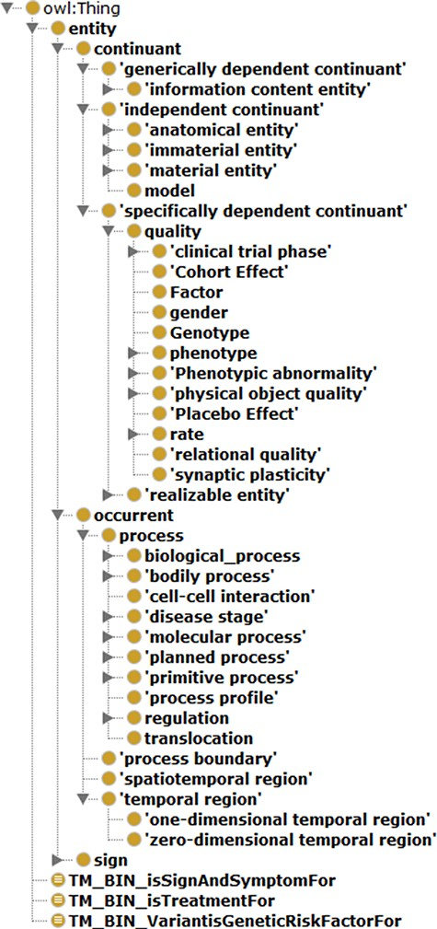
Figure 7. General hierarchical view of ADO ontology.
Notes:
Figure 7. General hierarchical view of ADO ontology.
Unless provided in the caption above, the following copyright applies to the content of this slide: © The Author(s) 2023. Published by Oxford University Press.This is an Open Access article distributed under the terms of the Creative Commons Attribution License (https://creativecommons.org/licenses/by/4.0/), which permits unrestricted reuse, distribution, and reproduction in any medium, provided the original work is properly cited.

Slide 8
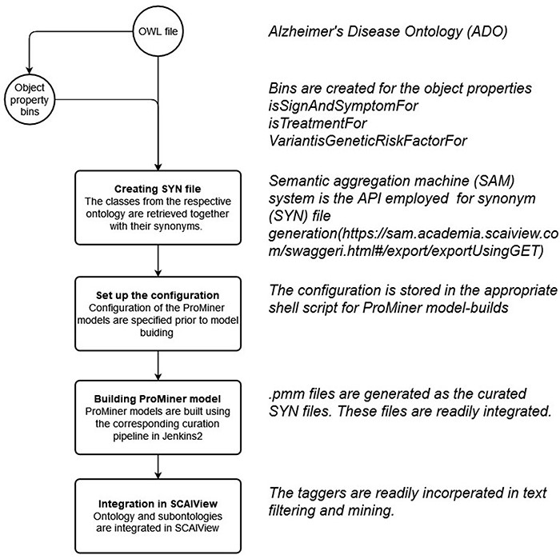
Figure 8. Schematic view of integration of ADO in SCAIView.
Notes:
Figure 8. Schematic view of integration of ADO in SCAIView.
Unless provided in the caption above, the following copyright applies to the content of this slide: © The Author(s) 2023. Published by Oxford University Press.This is an Open Access article distributed under the terms of the Creative Commons Attribution License (https://creativecommons.org/licenses/by/4.0/), which permits unrestricted reuse, distribution, and reproduction in any medium, provided the original work is properly cited.

