Slide 1
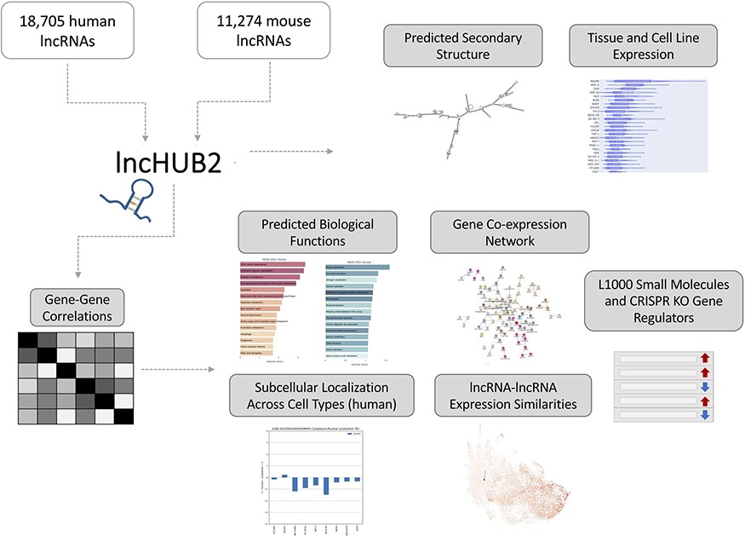
Figure 1. lncHUB2 Appyter and web application workflow. The lncHUB2 Appyter or web-based application takes as input ...
Notes:
Figure 1. lncHUB2 Appyter and web application workflow. The lncHUB2 Appyter or web-based application takes as input 18 705 unique human and 11 274 unique mouse lncRNAs and generates a report. This report contains useful information such as the predicted secondary structure and expression levels in various tissues and cell lines. Additionally, using gene–gene correlations generated from publicly available RNA-seq data from ARCHS4, lncHUB2 provides predicted biological functions, as well as predicted small molecules and CRISPR-KO gene regulators, and gene-gene co-expression networks to explore closely related genes and lncRNAs associations based on expression similarity.
Unless provided in the caption above, the following copyright applies to the content of this slide: © The Author(s) 2023. Published by Oxford University Press.This is an Open Access article distributed under the terms of the Creative Commons Attribution License (https://creativecommons.org/licenses/by/4.0/), which permits unrestricted reuse, distribution, and reproduction in any medium, provided the original work is properly cited.

