Slide 1
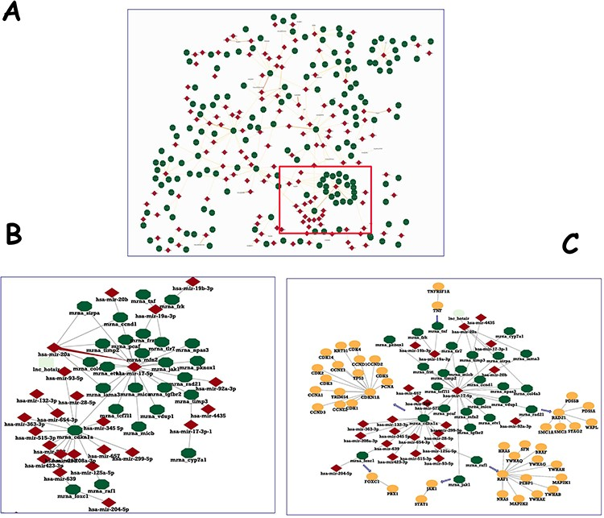
Figure 3. Human microRNA network in IntAct. (A) The section of the human microRNA network, showing hubs of both entry ...
Notes:
Figure 3. Human microRNA network in IntAct. (A) The section of the human microRNA network, showing hubs of both entry types. (B) Enlargement of a detail to show two nodes and their interactors. (C) PPI network for the genes targeted by hsa-mir-17-5p was downloaded and filtered to a molecular interaction (MI) score (24) of ⋝0.7 and merged with microRNA–mRNA interactions.
Unless provided in the caption above, the following copyright applies to the content of this slide: © The Author(s) 2023. Published by Oxford University Press.This is an Open Access article distributed under the terms of the Creative Commons Attribution License (https://creativecommons.org/licenses/by/4.0/), which permits unrestricted reuse, distribution, and reproduction in any medium, provided the original work is properly cited.

