Slide 1
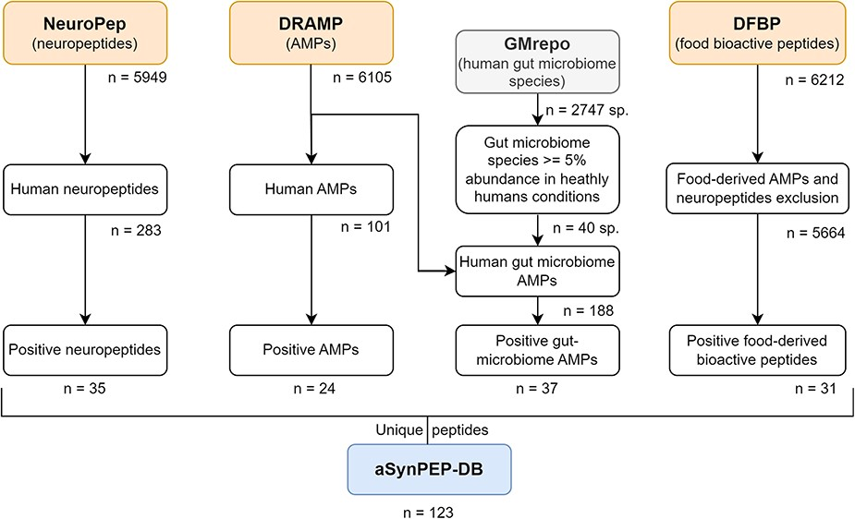
Figure 1. Data curation scheme. Peptides collected in the aSynPEP-DB are obtained from independent source datasets of ...
Notes:
Figure 1. Data curation scheme. Peptides collected in the aSynPEP-DB are obtained from independent source datasets of biogenic peptides. These include human neuropeptides (NeuroPep database), human and human gut microbiome AMPs (DRAMP database) and food-derived bioactive peptides (DFBP database). To select which bacterial species were found in the gut microbiome, the GMrepo database was employed. A total of 123 unique peptides were obtained with the discriminative algorithm.
Unless provided in the caption above, the following copyright applies to the content of this slide: © The Author(s) 2023. Published by Oxford University Press.This is an Open Access article distributed under the terms of the Creative Commons Attribution License (https://creativecommons.org/licenses/by/4.0/), which permits unrestricted reuse, distribution, and reproduction in any medium, provided the original work is properly cited.

