Slide 1
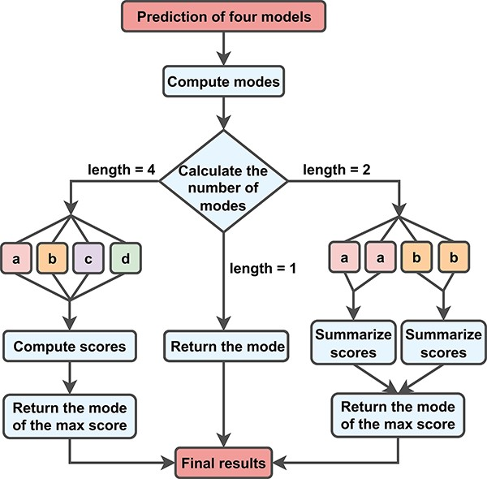
Figure 2. New metrics for aggregating MantaID models. To incorporate the information, we multiply the model’s F1 score ...
Notes:
Figure 2. New metrics for aggregating MantaID models. To incorporate the information, we multiply the model’s F1 score metrics by the mismatch rates of other models to calculate the submodel’s score. When the submodels disagree, we assign a score to each result and select the best one.
Unless provided in the caption above, the following copyright applies to the content of this slide: © The Author(s) 2023. Published by Oxford University Press.This is an Open Access article distributed under the terms of the Creative Commons Attribution License (https://creativecommons.org/licenses/by/4.0/), which permits unrestricted reuse, distribution, and reproduction in any medium, provided the original work is properly cited.

