Slide 1
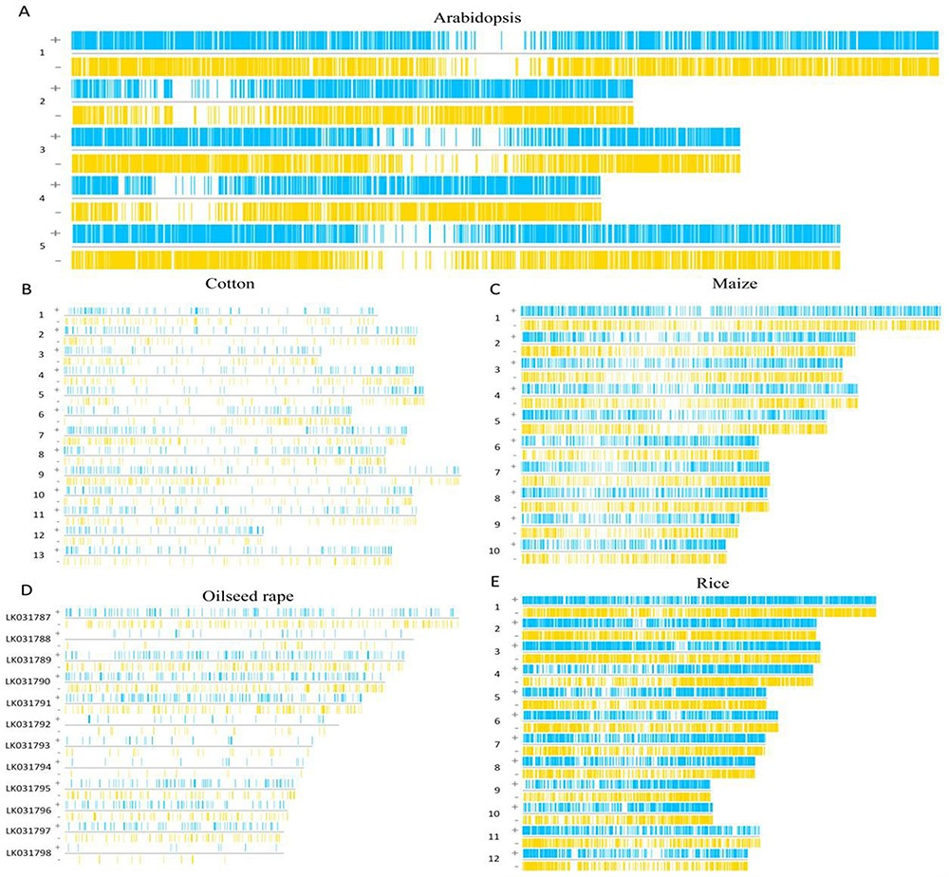
Figure 3. The region of functional elements in introns. (A) The functional elements of Arabidopsis introns are ...
Notes:
Figure 3. The region of functional elements in introns. (A) The functional elements of Arabidopsis introns are distributed on its chromosomes. (B) The functional elements of cotton introns are distributed on its chromosomes. (C) The functional elements of maize introns are distributed on its chromosomes. (D) The functional elements of oilseed rape introns are distributed on its chromosomes. (E) The functional elements of rice introns are distributed on its chromosomes.
Unless provided in the caption above, the following copyright applies to the content of this slide: © The Author(s) 2023. Published by Oxford University Press.This is an Open Access article distributed under the terms of the Creative Commons Attribution License (https://creativecommons.org/licenses/by/4.0/), which permits unrestricted reuse, distribution, and reproduction in any medium, provided the original work is properly cited.

