Slide 1
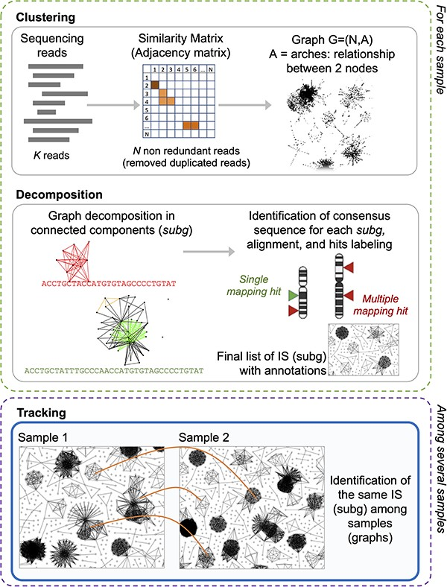
Figure 2. γ-TRIS main steps: (1) clustering, (2) decomposition, and (3) tracking. Steps 1 and 2 are performed for each ...
Notes:
Figure 2. γ-TRIS main steps: (1) clustering, (2) decomposition, and (3) tracking. Steps 1 and 2 are performed for each sample in the sequencing library, whereas step 3 only generates the tracking matrix (indeed it may be run at the library level or even as collections of several libraries, as expected in clinical trial monitoring).
Unless provided in the caption above, the following copyright applies to the content of this slide: © The Author(s) 2023. Published by Oxford University Press.This is an Open Access article distributed under the terms of the Creative Commons Attribution License (https://creativecommons.org/licenses/by/4.0/), which permits unrestricted reuse, distribution, and reproduction in any medium, provided the original work is properly cited.

Slide 2
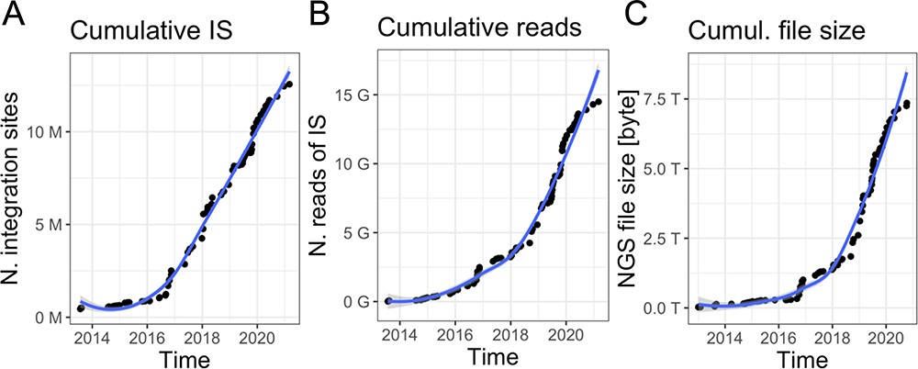
Figure 1. Data volume of clonal tracking studies in clinical trials for gene therapy applications at SR-Tiget by (A) ...
Notes:
Figure 1. Data volume of clonal tracking studies in clinical trials for gene therapy applications at SR-Tiget by (A) integration sites, (B) sequencing reads of IS and (C) NGS file size (sequencing pools from several technologies). ‘Number of reads’ refers to the overall number of sequencing reads; ‘Number of IS’ refers to the number of integration sites identified in the samples, corresponding to clones. ‘File size’ corresponds to the size of the files of the NGS pools (gzip compression).
Unless provided in the caption above, the following copyright applies to the content of this slide: © The Author(s) 2023. Published by Oxford University Press.This is an Open Access article distributed under the terms of the Creative Commons Attribution License (https://creativecommons.org/licenses/by/4.0/), which permits unrestricted reuse, distribution, and reproduction in any medium, provided the original work is properly cited.

Slide 3
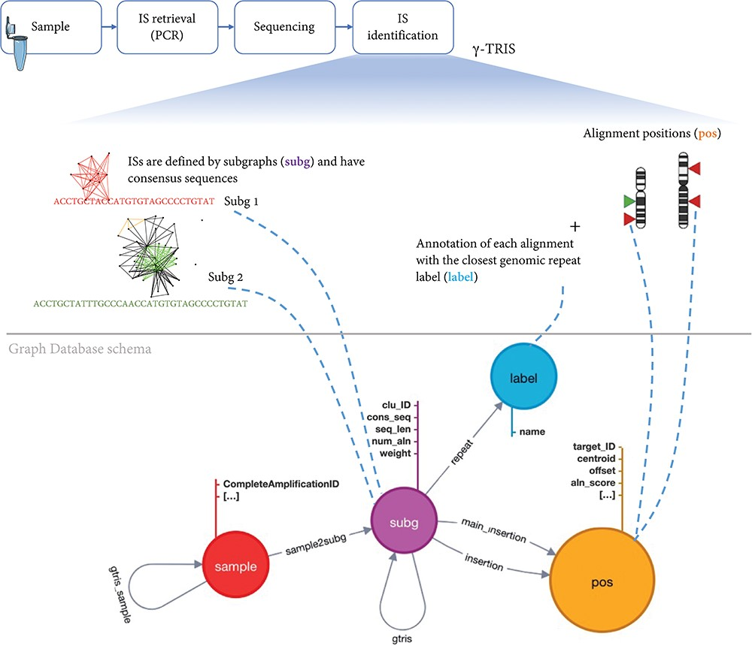
Figure 3. Schema of the graph database archiving clonal data obtained from ISs using γ-TRIS. A node subg represents a ...
Notes:
Figure 3. Schema of the graph database archiving clonal data obtained from ISs using γ-TRIS. A node subg represents a subgraph and collects information about a source IS and the consensus sequence. One sample node is connected to many subg nodes, while a subg node is linked to one and only one sample. Subgraph annotations/labels are represented by label nodes, as well as the genomic loci of the ISs on the reference genome are represented by pos nodes. The relationship connecting a subg and a label is called repeat, while the link between a subg and a pos is called insertion. This information is all included in the files representing the input of the tracking step. On the other hand, γ-TRIS links are computed during the tracking step using the rules described in ‘Data description’ section and incrementally, i.e. new gtris links are computed and added only when a new sample is inserted in the database. These links represent the novel approach for speeding up and scaling the tracking step analysis.
Unless provided in the caption above, the following copyright applies to the content of this slide: © The Author(s) 2023. Published by Oxford University Press.This is an Open Access article distributed under the terms of the Creative Commons Attribution License (https://creativecommons.org/licenses/by/4.0/), which permits unrestricted reuse, distribution, and reproduction in any medium, provided the original work is properly cited.

Slide 4
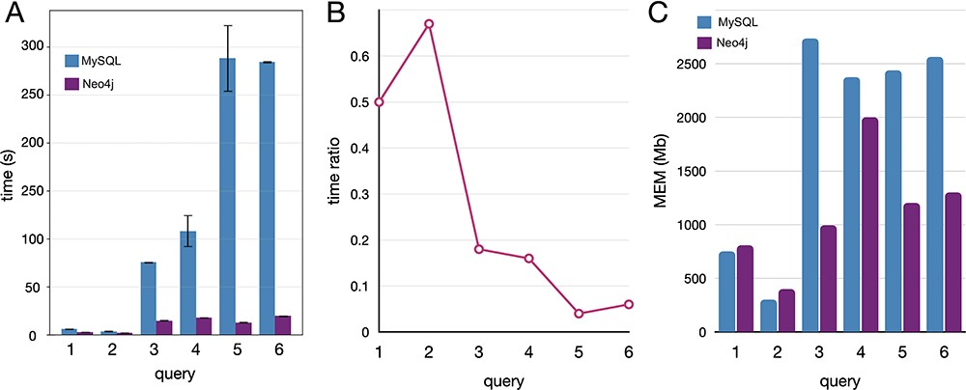
Figure 5. Comparative benchmarks of the computational performances between Neo4J and MySQL databases applied to ...
Notes:
Figure 5. Comparative benchmarks of the computational performances between Neo4J and MySQL databases applied to real-case queries, here reported with five instances covering different operations. (A) Time in seconds, with variance (whiskers) for the replicates, scaled to log10; (B) time ratio between Neo4j and MySQL (query time Neo4j/MySQL); (C) the memory utilization in megabytes.
Unless provided in the caption above, the following copyright applies to the content of this slide: © The Author(s) 2023. Published by Oxford University Press.This is an Open Access article distributed under the terms of the Creative Commons Attribution License (https://creativecommons.org/licenses/by/4.0/), which permits unrestricted reuse, distribution, and reproduction in any medium, provided the original work is properly cited.

Slide 5
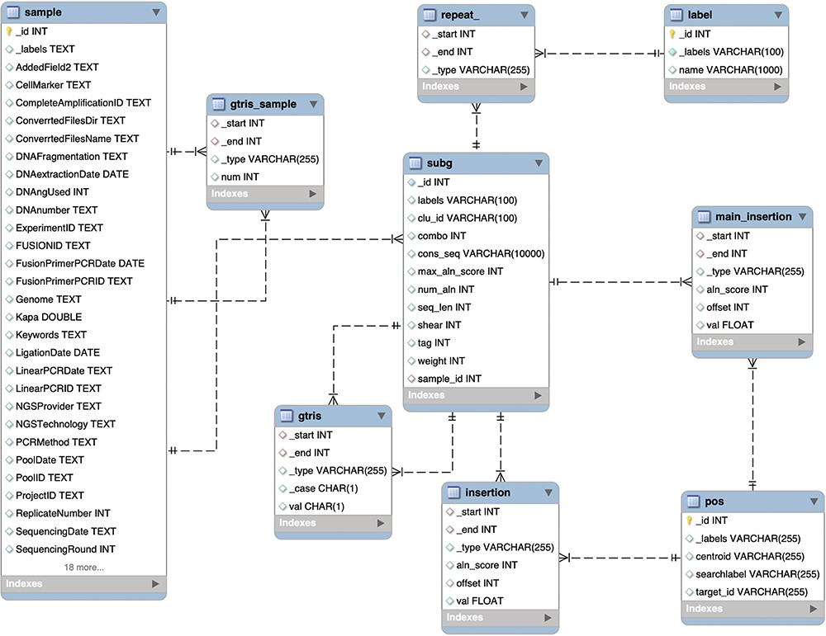
Figure 4. Schema of the relational database MySQL archiving clonal data obtained from integration sites using γ-TRIS. ...
Notes:
Figure 4. Schema of the relational database MySQL archiving clonal data obtained from integration sites using γ-TRIS. Similarly to the Graph DB structure (3), the entity-relationship diagram of the requirements described in the ‘Data description’ section has been converted in this table schema.
Unless provided in the caption above, the following copyright applies to the content of this slide: © The Author(s) 2023. Published by Oxford University Press.This is an Open Access article distributed under the terms of the Creative Commons Attribution License (https://creativecommons.org/licenses/by/4.0/), which permits unrestricted reuse, distribution, and reproduction in any medium, provided the original work is properly cited.

