Slide 1
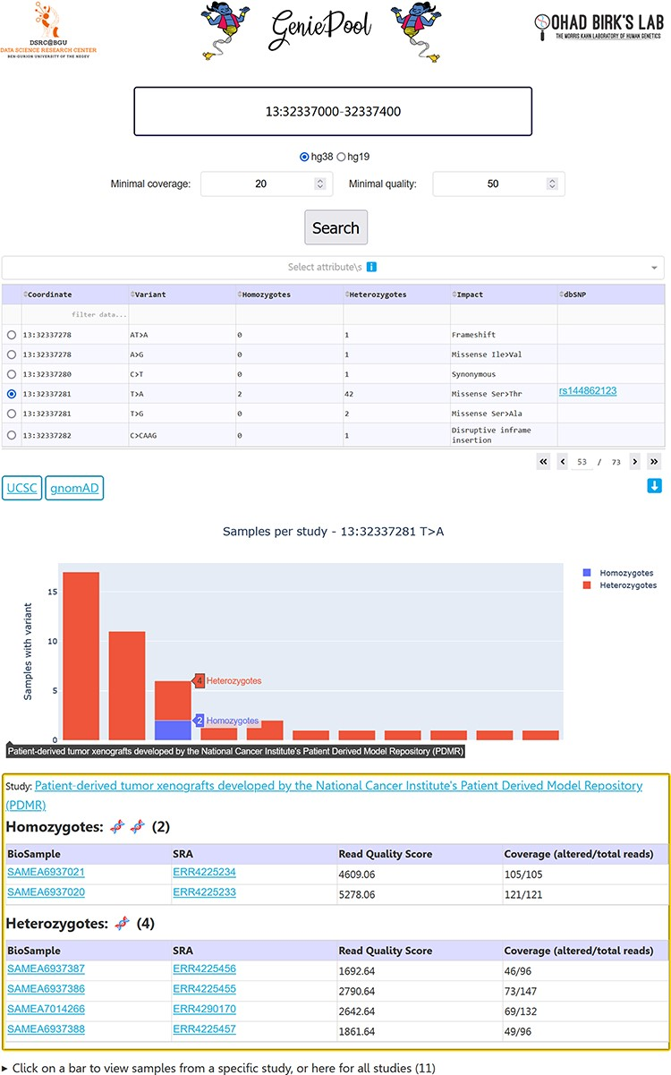
Figure 2. GeniePool’s UI. Genomic coordinates can be searched for variants within NGS samples from SRA. Results are ...
Notes:
Figure 2. GeniePool’s UI. Genomic coordinates can be searched for variants within NGS samples from SRA. Results are displayed in a table with selectable rows. Variants can be filtered by sample attributes. Selecting a variant generates an interactive graph displaying relevant samples per study. Clicking a bar provides direct links for additional information regarding the study and each of the samples harbouring the variant.
Unless provided in the caption above, the following copyright applies to the content of this slide: © The Author(s) 2023. Published by Oxford University Press.This is an Open Access article distributed under the terms of the Creative Commons Attribution License (https://creativecommons.org/licenses/by/4.0/), which permits unrestricted reuse, distribution, and reproduction in any medium, provided the original work is properly cited.

