Slide 1
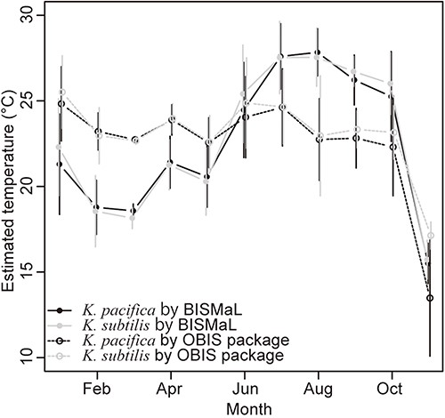
Figure 4. Monthly mean temperatures for the two Krohnitta species, which were estimated by BISMaL with FORA (solid ...
Notes:
Figure 4. Monthly mean temperatures for the two Krohnitta species, which were estimated by BISMaL with FORA (solid lines) and the OBIS package ‘obistools’ (dashed lines) with WOA. Vertical bars indicate standard deviation.
Unless provided in the caption above, the following copyright applies to the content of this slide: © The Author(s) 2023. Published by Oxford University Press.This is an Open Access article distributed under the terms of the Creative Commons Attribution License (https://creativecommons.org/licenses/by/4.0/), which permits unrestricted reuse, distribution, and reproduction in any medium, provided the original work is properly cited.

