Slide 1
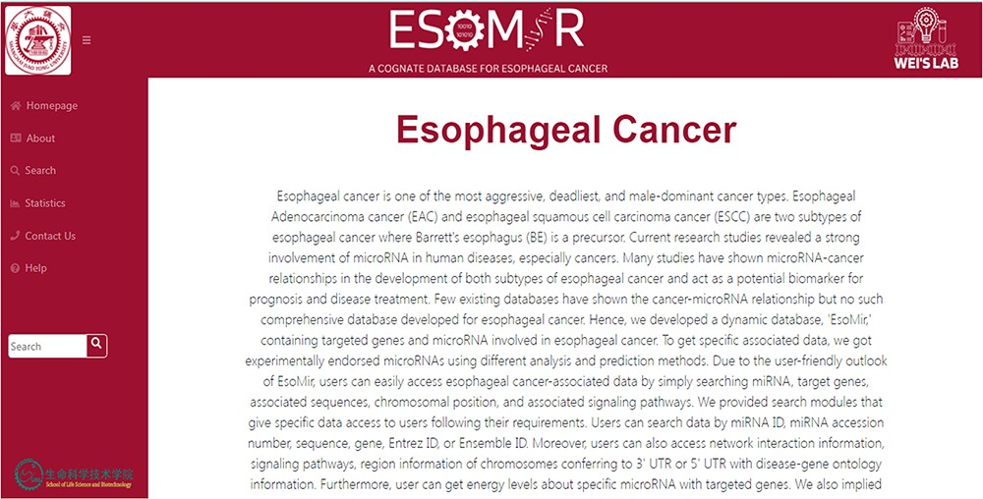
Figure 4. ESOMIR Homepage: a comprehensive miRNA database for EC. The home page shows the description of the database ...
Notes:
Figure 4. ESOMIR Homepage: a comprehensive miRNA database for EC. The home page shows the description of the database with different tabs that are included in the database. The Fuzzy Search Functionality implemented in ESOMIR is also given.
Unless provided in the caption above, the following copyright applies to the content of this slide: © The Author(s) 2023. Published by Oxford University Press.This is an Open Access article distributed under the terms of the Creative Commons Attribution License (https://creativecommons.org/licenses/by/4.0/), which permits unrestricted reuse, distribution, and reproduction in any medium, provided the original work is properly cited.

