Slide 1
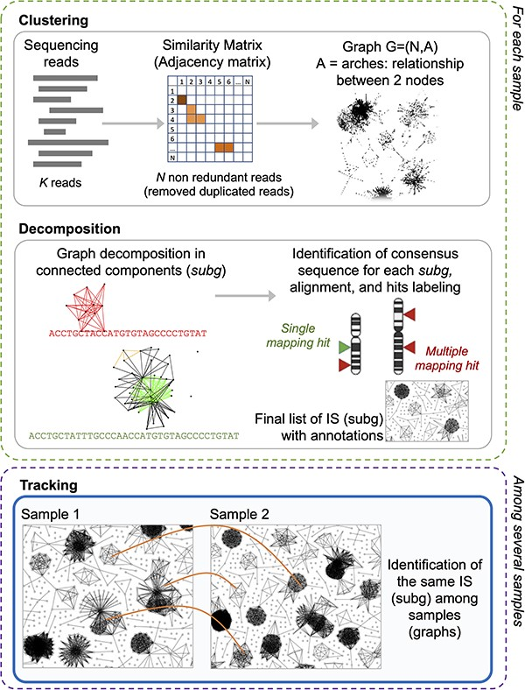
Figure 2. γ-TRIS main steps: (1) clustering, (2) decomposition, and (3) tracking. Steps 1 and 2 are performed for each ...
Notes:
Figure 2. γ-TRIS main steps: (1) clustering, (2) decomposition, and (3) tracking. Steps 1 and 2 are performed for each sample in the sequencing library, whereas step 3 only generates the tracking matrix (indeed it may be run at the library level or even as collections of several libraries, as expected in clinical trial monitoring).
Unless provided in the caption above, the following copyright applies to the content of this slide: © The Author(s) 2023. Published by Oxford University Press.This is an Open Access article distributed under the terms of the Creative Commons Attribution License (https://creativecommons.org/licenses/by/4.0/), which permits unrestricted reuse, distribution, and reproduction in any medium, provided the original work is properly cited.

