Slide 1
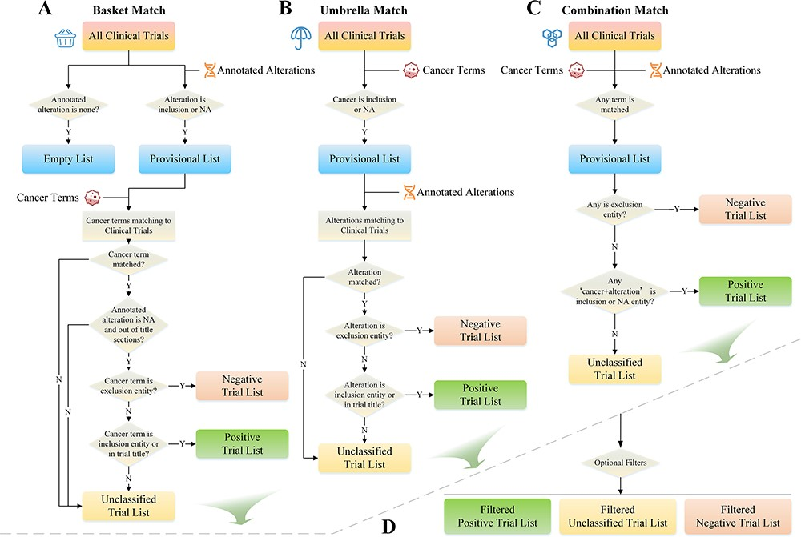
Figure 4. Trials matching strategies.
Notes:
Figure 4. Trials matching strategies. A) Basket match prioritizes alterations as the primary matching condition; B) umbrella match prioritizes cancer type as the primary matching condition; C) combination match combines multiple matching conditions for more precise matching; D) trial list filter allows users to filter and narrow down the list of matched clinical trials based on various criteria.
Unless provided in the caption above, the following copyright applies to the content of this slide: © The Author(s) 2023. Published by Oxford University Press.This is an Open Access article distributed under the terms of the Creative Commons Attribution License (https://creativecommons.org/licenses/by/4.0/), which permits unrestricted reuse, distribution, and reproduction in any medium, provided the original work is properly cited.

