Slide 1
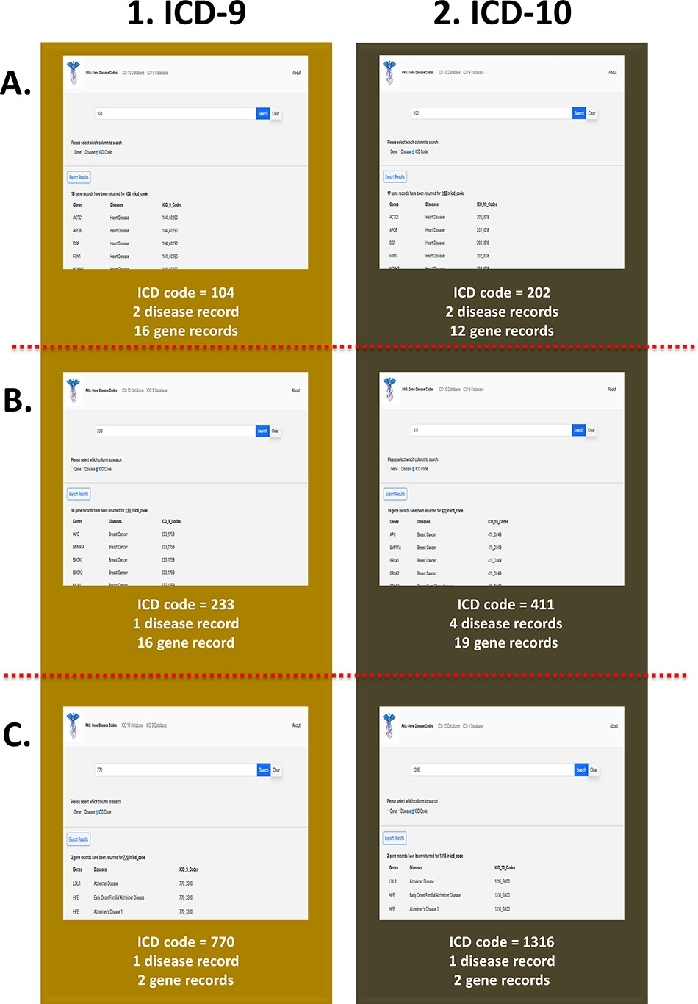
Figure 6. PAS-GDC use case—ICD code. This figure presents three different case studies exploring ICD-9 and ICD-10 ...
Notes:
Figure 6. PAS-GDC use case—ICD code. This figure presents three different case studies exploring ICD-9 and ICD-10 codes. (A) The results for ICD-9 and ICD-10 codes starting with ‘104’ and ‘202’, respectively. (B) The results for ICD-9 and ICD-10 codes starting with ‘233’ and ‘411’, respectively. (C) The results for ICD-9 and ICD-10 codes starting with ‘770’ and ‘1316’, respectively.
Unless provided in the caption above, the following copyright applies to the content of this slide: © The Author(s) 2023. Published by Oxford University Press.This is an Open Access article distributed under the terms of the Creative Commons Attribution License (https://creativecommons.org/licenses/by/4.0/), which permits unrestricted reuse, distribution, and reproduction in any medium, provided the original work is properly cited.

