Slide 1
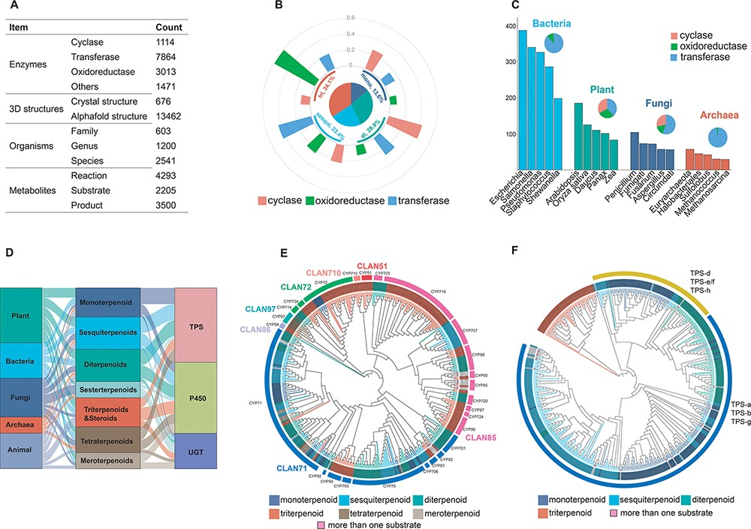
Figure 2. Database content. (A) The status of the recorded data for the construction of the TeroENZ database. (B) The ...
Notes:
Figure 2. Database content. (A) The status of the recorded data for the construction of the TeroENZ database. (B) The pie chart shows the distribution of the enzymes that catalyze the four substrates and the histograms measured on the arcs represent the functional distribution of the enzymes (i.e. the values are normalized namely sum to 1 for each kind of enzyme). (C) Enzymes of different species sources were counted and the top five species were selected for display in bacteria, plants, fungi and archaea, respectively (histograms). All enzymes from these species were also classified according to function (pie charts). (D) The Sankey of species (left), substrate (middle) and enzyme (right). (E) Plant-derived P450 classified by family (evolutionary map). Multiple sequence alignment using muscle (34), evolutionary analysis with IQ-TREE (35), visualization with iTOL (36) and then a manual annotation. (F) Plant-derived TPS classified by function (evolutionary map), Outer ring: Class I, Class II. Inner ring: gray for angiosperms, black for gymnosperms and others.
Unless provided in the caption above, the following copyright applies to the content of this slide: © The Author(s) 2023. Published by Oxford University Press.This is an Open Access article distributed under the terms of the Creative Commons Attribution License (https://creativecommons.org/licenses/by/4.0/), which permits unrestricted reuse, distribution, and reproduction in any medium, provided the original work is properly cited.

