Slide 1
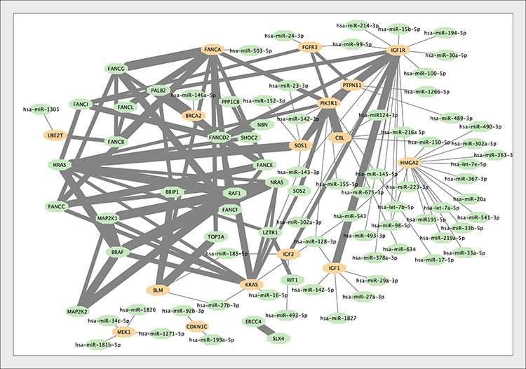
Figure 4. The interaction network of the genes associated with Growth Failure in Early Childhood (GFEC). Interactions ...
Notes:
Figure 4. The interaction network of the genes associated with Growth Failure in Early Childhood (GFEC). Interactions within proteins associated with GFEC merged into the microRNA–mRNA network. Proteins regulated by microRNAs are indicated. The thickness of the edge between proteins is proportional to the MI score (i.e. reliability) of the interaction (24).
Unless provided in the caption above, the following copyright applies to the content of this slide: © The Author(s) 2023. Published by Oxford University Press.This is an Open Access article distributed under the terms of the Creative Commons Attribution License (https://creativecommons.org/licenses/by/4.0/), which permits unrestricted reuse, distribution, and reproduction in any medium, provided the original work is properly cited.

