Slide 1
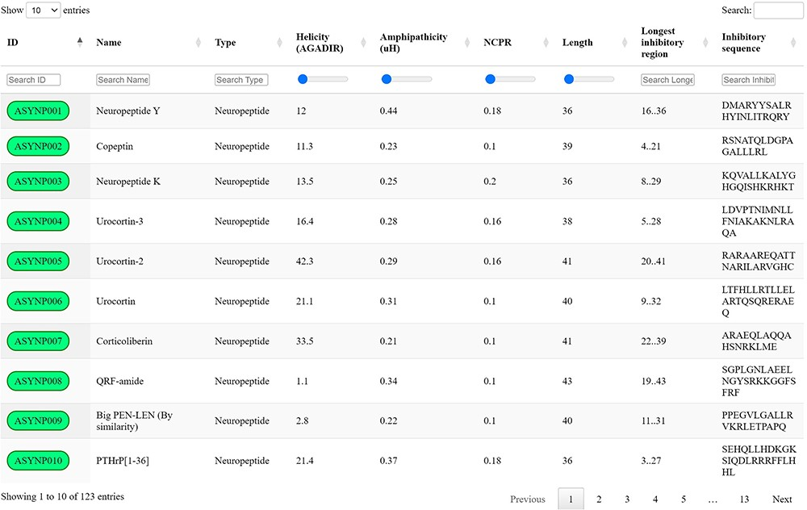
Figure 2. aSynPEP-DB database view. Positive entries are collected in an interactive data table under the ‘Database’ ...
Notes:
Figure 2. aSynPEP-DB database view. Positive entries are collected in an interactive data table under the ‘Database’ tab of the website. Users can perform general searches using the top right text box or by typing under each specific column. For numerical variables, range sliders are provided to filter entries. All columns can be sorted by clicking on the specific header. The number of displayed entries can be modified with the top left selector. Extended peptide details can be accessed by clicking on each peptide identifier.
Unless provided in the caption above, the following copyright applies to the content of this slide: © The Author(s) 2023. Published by Oxford University Press.This is an Open Access article distributed under the terms of the Creative Commons Attribution License (https://creativecommons.org/licenses/by/4.0/), which permits unrestricted reuse, distribution, and reproduction in any medium, provided the original work is properly cited.

