Slide 1
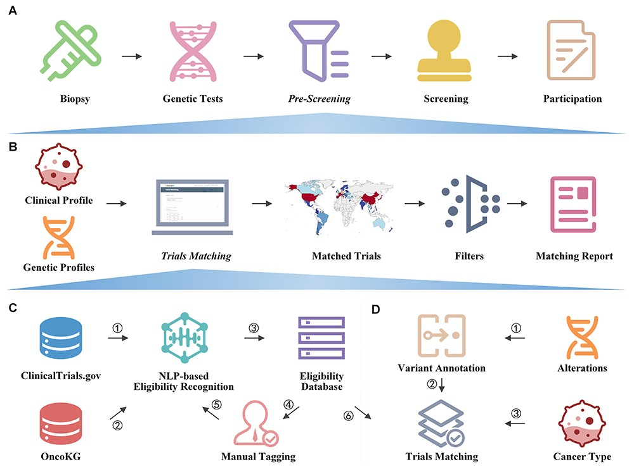
Figure 1. Overview of OncoCTMiner.
Notes:
Figure 1. Overview of OncoCTMiner. A) OncoCTMiner’s role in precision oncology trial enrollment. B) OncoCTMiner takes clinical and genetic profiles as inputs and utilizes a trial matching and filtering system to generate a report of matched trials. C) Strategy for building the clinical trial eligibility criteria database. D) Automatic matching strategy for genomics-driven oncology trials.
Unless provided in the caption above, the following copyright applies to the content of this slide: © The Author(s) 2023. Published by Oxford University Press.This is an Open Access article distributed under the terms of the Creative Commons Attribution License (https://creativecommons.org/licenses/by/4.0/), which permits unrestricted reuse, distribution, and reproduction in any medium, provided the original work is properly cited.

Slide 2
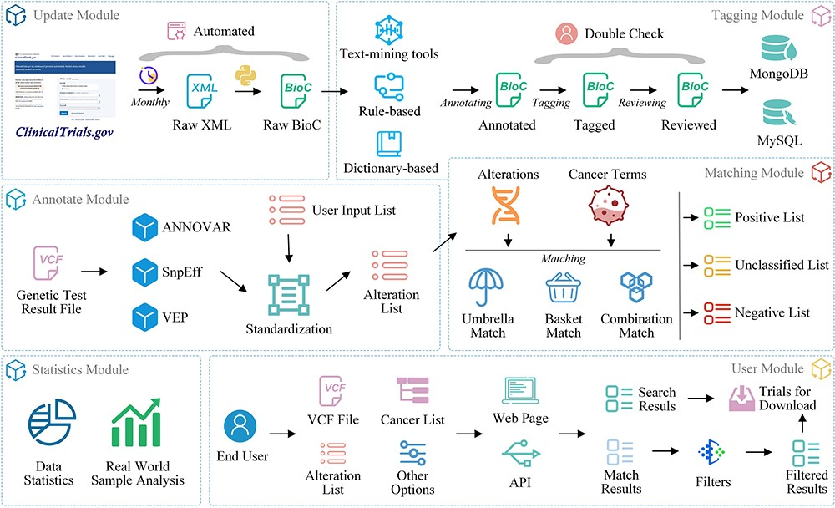
Figure 2. OncoCTMiner modules.
Notes:
Figure 2. OncoCTMiner modules. OncoCTMiner consists of several modules: 1) The update module downloads XML-formatted trial data and parses them into BioC-JSON format on a monthly basis; 2) The tagging module identifies bio-concepts using NLP-based tools with double-checking by biomedical professionals to construct the clinical trial eligibility database; 3) The annotation module assists in annotating genetic alterations detected from patient tumors; 4) The matching module utilizes cancer terms and the annotated alterations as key criteria for clinical trial matching; 5) The statistics module provides various statistical analyses of the clinical trial data; and 6) the user module allows users to interact with the system and perform various tasks.
Unless provided in the caption above, the following copyright applies to the content of this slide: © The Author(s) 2023. Published by Oxford University Press.This is an Open Access article distributed under the terms of the Creative Commons Attribution License (https://creativecommons.org/licenses/by/4.0/), which permits unrestricted reuse, distribution, and reproduction in any medium, provided the original work is properly cited.

Slide 3
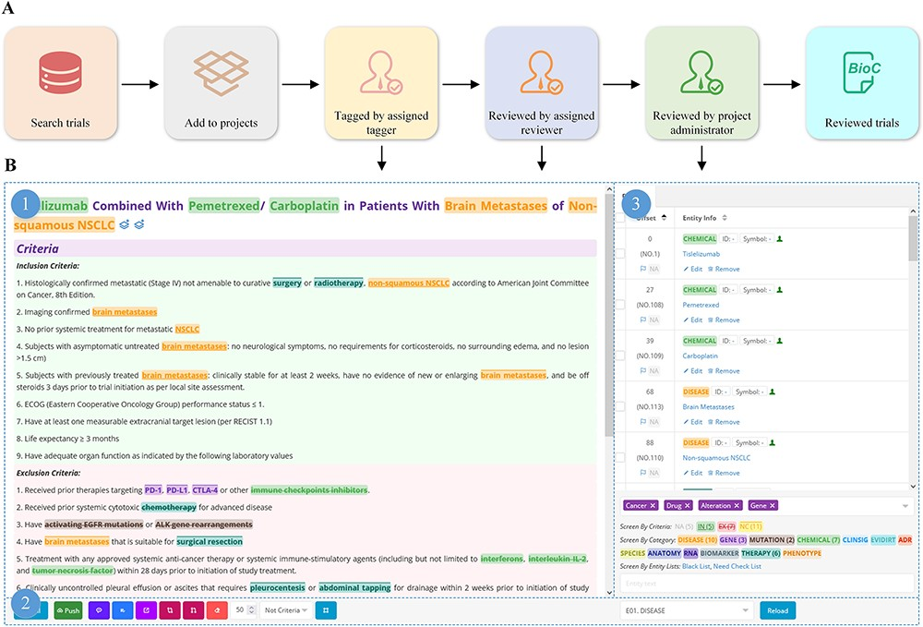
Figure 3. Manual tagging of clinical trials.
Notes:
Figure 3. Manual tagging of clinical trials. A) Workflow for manual tagging of clinical trials; B) overview of the trial tagging page: 1) trial details with highlighted bio-concepts, 2) the manual tagging tools bar, and 3) real-time presentation of entity information.
Unless provided in the caption above, the following copyright applies to the content of this slide: © The Author(s) 2023. Published by Oxford University Press.This is an Open Access article distributed under the terms of the Creative Commons Attribution License (https://creativecommons.org/licenses/by/4.0/), which permits unrestricted reuse, distribution, and reproduction in any medium, provided the original work is properly cited.

Slide 4
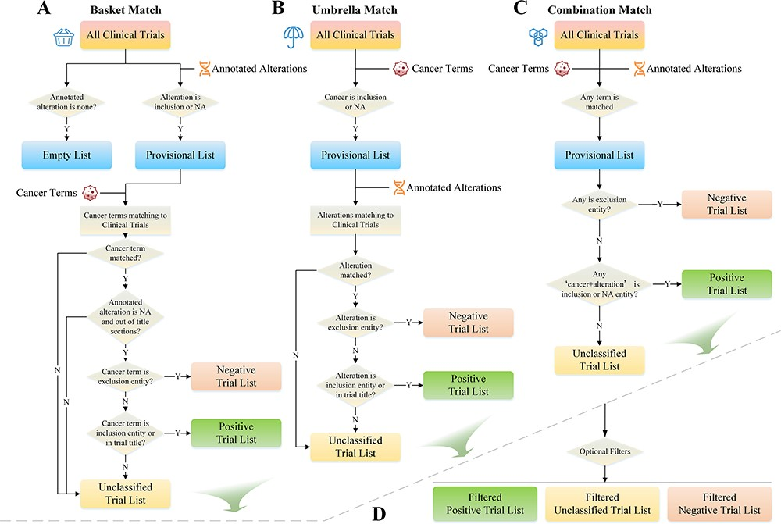
Figure 4. Trials matching strategies.
Notes:
Figure 4. Trials matching strategies. A) Basket match prioritizes alterations as the primary matching condition; B) umbrella match prioritizes cancer type as the primary matching condition; C) combination match combines multiple matching conditions for more precise matching; D) trial list filter allows users to filter and narrow down the list of matched clinical trials based on various criteria.
Unless provided in the caption above, the following copyright applies to the content of this slide: © The Author(s) 2023. Published by Oxford University Press.This is an Open Access article distributed under the terms of the Creative Commons Attribution License (https://creativecommons.org/licenses/by/4.0/), which permits unrestricted reuse, distribution, and reproduction in any medium, provided the original work is properly cited.

Slide 5
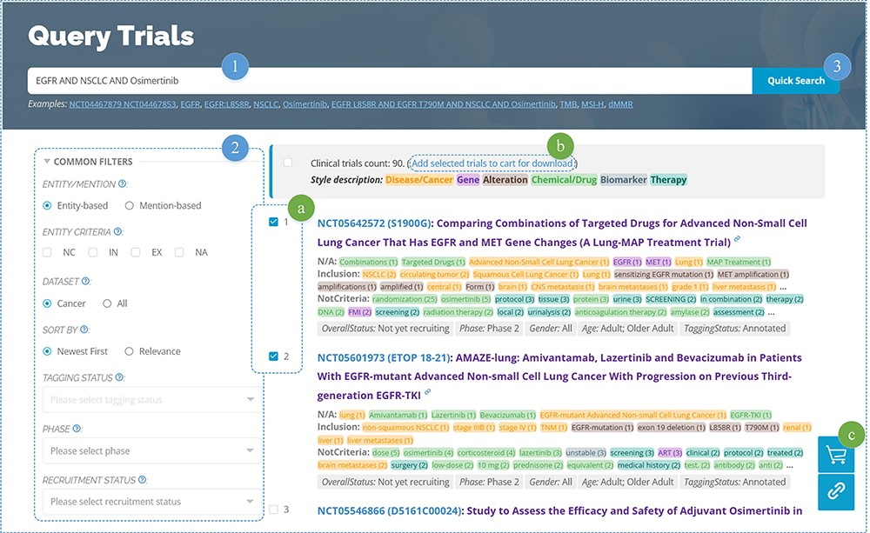
Figure 5. Clinical trials searching.
Notes:
Figure 5. Clinical trials searching. 1) Enter entity-related keyword(s), 2) set filters, and then 3) click the search button to display the search results. Additionally, users can (a) select different trials and (b) add them to their trials cart for subsequent download.
Unless provided in the caption above, the following copyright applies to the content of this slide: © The Author(s) 2023. Published by Oxford University Press.This is an Open Access article distributed under the terms of the Creative Commons Attribution License (https://creativecommons.org/licenses/by/4.0/), which permits unrestricted reuse, distribution, and reproduction in any medium, provided the original work is properly cited.

Slide 6
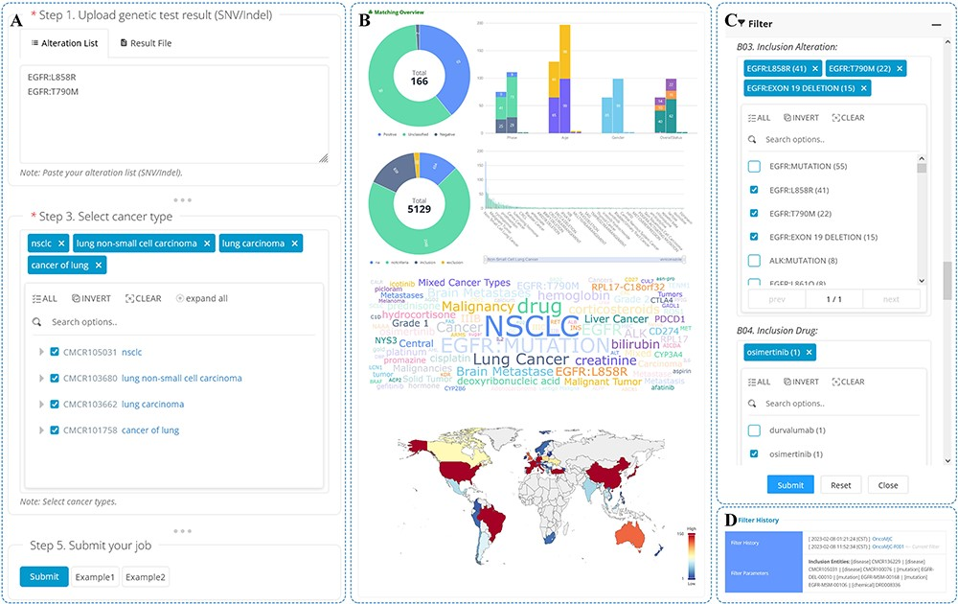
Figure 6. Trials matching.
Notes:
Figure 6. Trials matching. An overview of the trial matching and pre-screening function is shown. A) On the trial matching page, users can enter genetic test results, select cancer types and submit a matching job. B) The matching report displays jobs that have been matched or filtered and provides a permanent URL for users to access the report at any time. C) Users can set filters on the matching report page to screen trials based on the list of matches. D) The filter history can be viewed from the matching report page.
Unless provided in the caption above, the following copyright applies to the content of this slide: © The Author(s) 2023. Published by Oxford University Press.This is an Open Access article distributed under the terms of the Creative Commons Attribution License (https://creativecommons.org/licenses/by/4.0/), which permits unrestricted reuse, distribution, and reproduction in any medium, provided the original work is properly cited.

