Slide 1
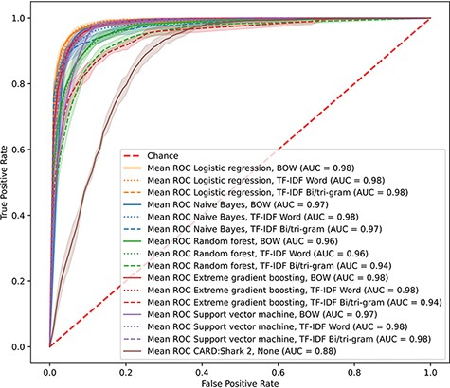
Figure 1. CARD*Shark 2 and supervised learning cross-validation ROC curves. Results from 5-fold cross-validation of ...
Notes:
Figure 1. CARD*Shark 2 and supervised learning cross-validation ROC curves. Results from 5-fold cross-validation of several supervised learning models using three feature extraction methods, plus CARD*Shark 2. Results from all five cross-validation tests were averaged to produce a single curve. Shadows around each line are ±1SD from the mean. For CARD*Shark 2, high-level predictions are considered positive predictions, and low-level predictions are considered negative predictions.
Unless provided in the caption above, the following copyright applies to the content of this slide: © The Author(s) 2023. Published by Oxford University Press.This is an Open Access article distributed under the terms of the Creative Commons Attribution License (https://creativecommons.org/licenses/by/4.0/), which permits unrestricted reuse, distribution, and reproduction in any medium, provided the original work is properly cited.

