Slide 1
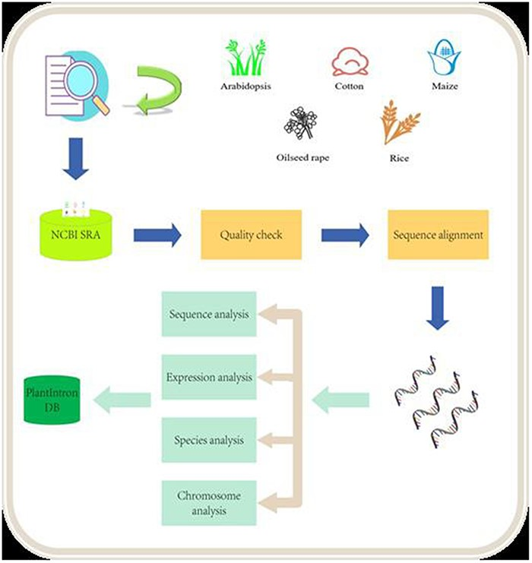
Figure 1. Data analysis pipeline. The raw data from NCB SRA were downloaded and processed after quality check. The ...
Notes:
Figure 1. Data analysis pipeline. The raw data from NCB SRA were downloaded and processed after quality check. The alignment data were then analyzed for identifying functional introns. The final results were deposited into the PlantIntronDB.
Unless provided in the caption above, the following copyright applies to the content of this slide: © The Author(s) 2023. Published by Oxford University Press.This is an Open Access article distributed under the terms of the Creative Commons Attribution License (https://creativecommons.org/licenses/by/4.0/), which permits unrestricted reuse, distribution, and reproduction in any medium, provided the original work is properly cited.

Slide 2
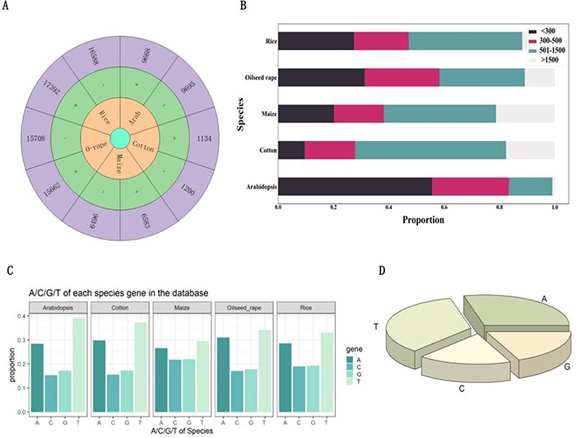
Figure 2. Analysis of introns that hosting functional elements. (A) Number of introns carrying functional elements on ...
Notes:
Figure 2. Analysis of introns that hosting functional elements. (A) Number of introns carrying functional elements on the positive and negative strands of Arabidopsis, cotton, maize, oilseed rape and rice. (B) Length of introns with functional elements in Arabidopsis, cotton, maize, oilseed rape and rice. (C) The proportion of each base in introns with functional elements of Arabidopsis, cotton, maize, oilseed rape and rice. (D) The proportion of bases in all introns with functional elements.
Unless provided in the caption above, the following copyright applies to the content of this slide: © The Author(s) 2023. Published by Oxford University Press.This is an Open Access article distributed under the terms of the Creative Commons Attribution License (https://creativecommons.org/licenses/by/4.0/), which permits unrestricted reuse, distribution, and reproduction in any medium, provided the original work is properly cited.

Slide 3
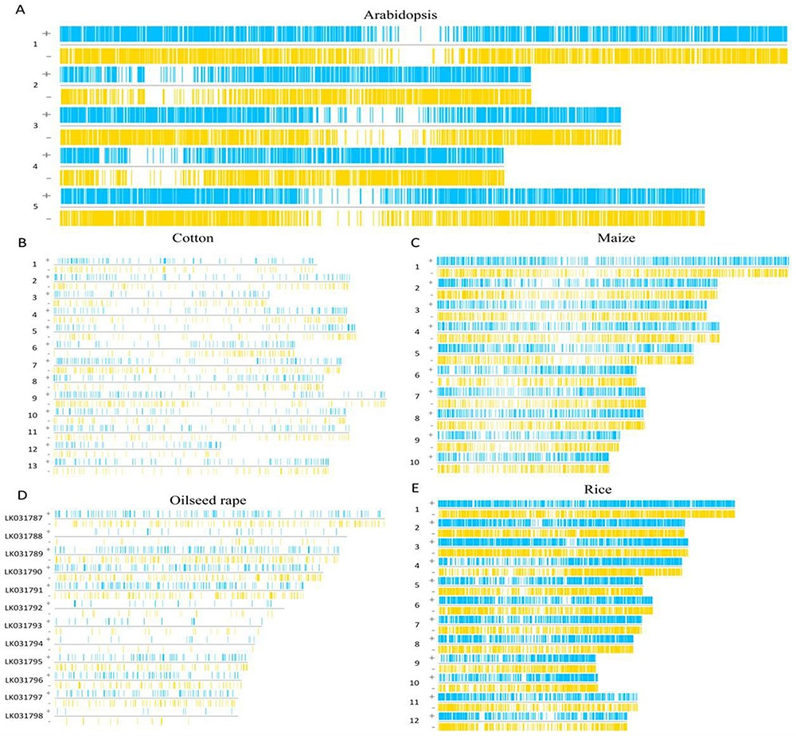
Figure 3. The region of functional elements in introns. (A) The functional elements of Arabidopsis introns are ...
Notes:
Figure 3. The region of functional elements in introns. (A) The functional elements of Arabidopsis introns are distributed on its chromosomes. (B) The functional elements of cotton introns are distributed on its chromosomes. (C) The functional elements of maize introns are distributed on its chromosomes. (D) The functional elements of oilseed rape introns are distributed on its chromosomes. (E) The functional elements of rice introns are distributed on its chromosomes.
Unless provided in the caption above, the following copyright applies to the content of this slide: © The Author(s) 2023. Published by Oxford University Press.This is an Open Access article distributed under the terms of the Creative Commons Attribution License (https://creativecommons.org/licenses/by/4.0/), which permits unrestricted reuse, distribution, and reproduction in any medium, provided the original work is properly cited.

Slide 4
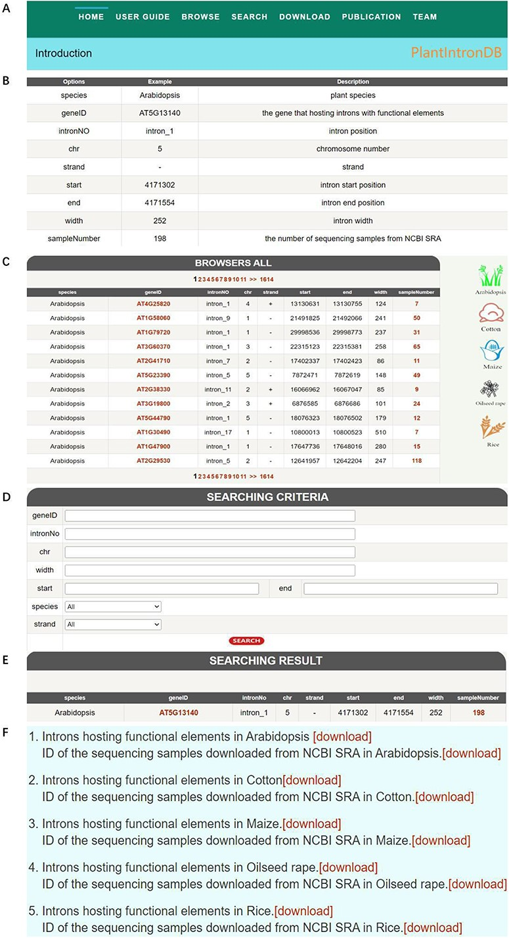
Figure 4. PlantIntronDB database. (A) PlantIntronDB navigation bar. (B) PlantIntronDB user guide page. (C) ...
Notes:
Figure 4. PlantIntronDB database. (A) PlantIntronDB navigation bar. (B) PlantIntronDB user guide page. (C) PlantIntronDB browsing page. (D) PlantIntronDB search page. (E) Search result of PlantIntronDB. (F) PlantIntronDB download page.
Unless provided in the caption above, the following copyright applies to the content of this slide: © The Author(s) 2023. Published by Oxford University Press.This is an Open Access article distributed under the terms of the Creative Commons Attribution License (https://creativecommons.org/licenses/by/4.0/), which permits unrestricted reuse, distribution, and reproduction in any medium, provided the original work is properly cited.

