Slide 1
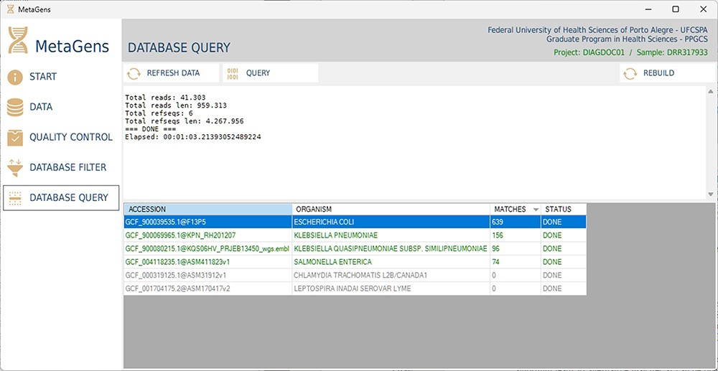
Figure 14. Graphical interface of the MetaGens software showing the database query panel. On the query screen, it is ...
Notes:
Figure 14. Graphical interface of the MetaGens software showing the database query panel. On the query screen, it is possible to follow the progress of the alignment. The table shows the subjects under analysis and their matches. Source: the authors.
Unless provided in the caption above, the following copyright applies to the content of this slide: © The Author(s) 2023. Published by Oxford University Press.This is an Open Access article distributed under the terms of the Creative Commons Attribution License (https://creativecommons.org/licenses/by/4.0/), which permits unrestricted reuse, distribution, and reproduction in any medium, provided the original work is properly cited.

