Slide 1
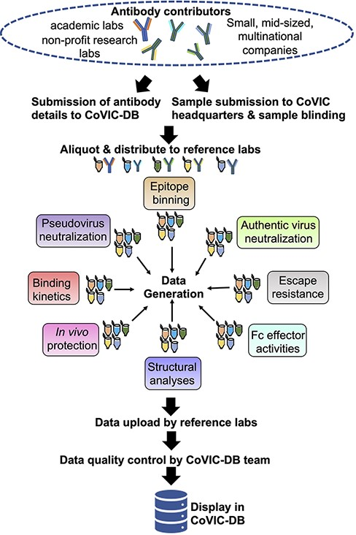
Figure 1. Illustration of the workflow, beginning from antibody collection, to data generation and deposition in the ...
Notes:
Figure 1. Illustration of the workflow, beginning from antibody collection, to data generation and deposition in the COVIC-DB.
Unless provided in the caption above, the following copyright applies to the content of this slide: © The Author(s) 2023. Published by Oxford University Press.This is an Open Access article distributed under the terms of the Creative Commons Attribution License (https://creativecommons.org/licenses/by/4.0/), which permits unrestricted reuse, distribution, and reproduction in any medium, provided the original work is properly cited.

Slide 2
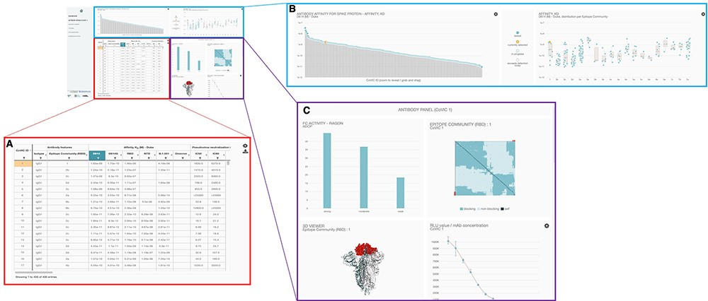
Figure 2. Overall layout of the COVIC-DB landing page. (A) contains the summary table showing results for different ...
Notes:
Figure 2. Overall layout of the COVIC-DB landing page. (A) contains the summary table showing results for different assays carried out for COVIC antibodies. The user has highlighted the upper left-most cell in orange by clicking on the cell. (B) displays graphical representations of the affinity data shown in the summary table. (C) highlights the ‘Antibody Panel section of the dashboard that appears when the user selects an individual antibody (here, COVIC-1).
Unless provided in the caption above, the following copyright applies to the content of this slide: © The Author(s) 2023. Published by Oxford University Press.This is an Open Access article distributed under the terms of the Creative Commons Attribution License (https://creativecommons.org/licenses/by/4.0/), which permits unrestricted reuse, distribution, and reproduction in any medium, provided the original work is properly cited.

Slide 3
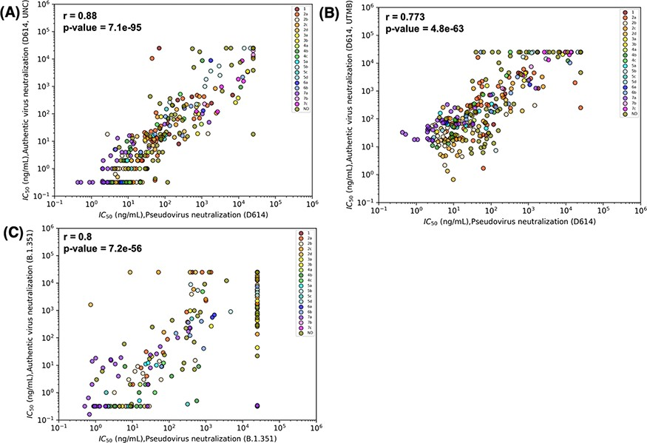
Figure 3. Results for pseudovirus and authentic virus neutralization assays strongly correlate. Correlations were ...
Notes:
Figure 3. Results for pseudovirus and authentic virus neutralization assays strongly correlate. Correlations were estimated by Spearman’s correlation coefficients and relate neutralization of pseudovirus bearing D614 and (A) authentic D614 virus (measured at University of North Carolina, Chapel Hill (UNC)), (B) D614 (measured at University of Texas Medical Branch at Galveston (UTMB)) and (C) authentic Beta (B.1.351) virus (measured at UNC). Data points are colored according to the epitope community to which the antibody belongs. ND: Epitope community not determined.
Unless provided in the caption above, the following copyright applies to the content of this slide: © The Author(s) 2023. Published by Oxford University Press.This is an Open Access article distributed under the terms of the Creative Commons Attribution License (https://creativecommons.org/licenses/by/4.0/), which permits unrestricted reuse, distribution, and reproduction in any medium, provided the original work is properly cited.

Slide 4
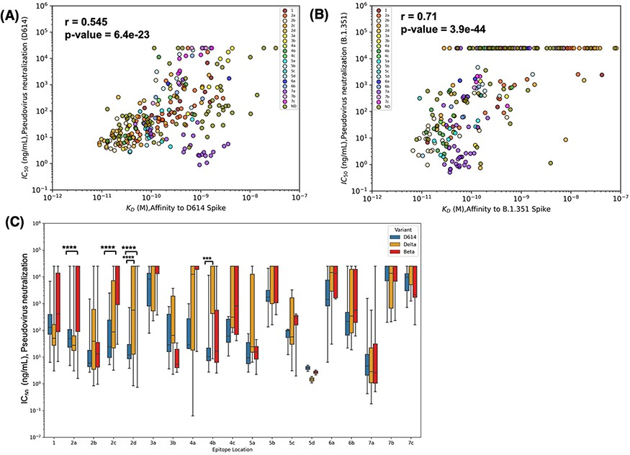
Figure 4. Epitope location and binding affinity together drive neutralization. (A) Spearman’s correlation between ...
Notes:
Figure 4. Epitope location and binding affinity together drive neutralization. (A) Spearman’s correlation between binding affinity and neutralization of pseudovirus bearing D614 spike. Data points are colored according to the epitope community to which the antibody belongs. ND: Epitope community not determined. (B) Correlation between binding affinity and neutralization of pseudovirus bearing Beta spike. (C) Epitope-wise comparison of pseudovirus neutralization of wild-type SARS-CoV-2 (D614, blue bars) and its variants Beta (red bars) and Delta (orange bars). Statistical significances were calculated using Welch’s t-test (****P < 0.0001,*** P < 0.001, **P < 0.01, *P < 0.05). Antibodies are grouped according to the epitope community, and the bars represent the mean binding affinity (note that Community 5d includes only two antibodies).
Unless provided in the caption above, the following copyright applies to the content of this slide: © The Author(s) 2023. Published by Oxford University Press.This is an Open Access article distributed under the terms of the Creative Commons Attribution License (https://creativecommons.org/licenses/by/4.0/), which permits unrestricted reuse, distribution, and reproduction in any medium, provided the original work is properly cited.

Slide 5
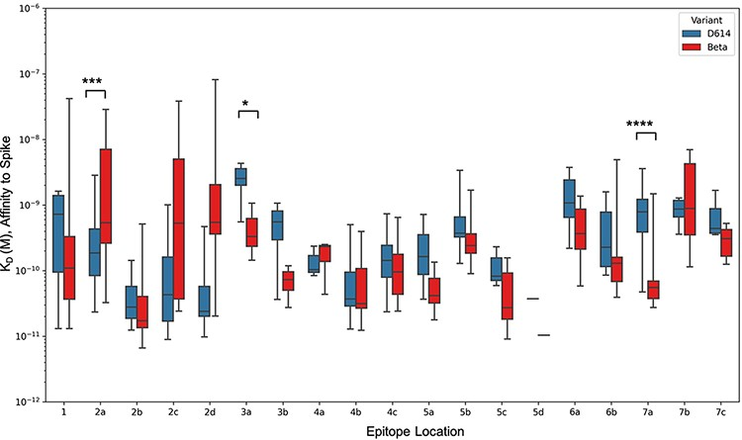
Figure 5. Epitope-wise comparison of antibody binding affinity for Spike D614 (blue bars) and Beta (red bars). ...
Notes:
Figure 5. Epitope-wise comparison of antibody binding affinity for Spike D614 (blue bars) and Beta (red bars). Statistical significances were calculated using Welch’s t-test (****P < 0.0001,*** P < 0.001, **P < 0.01, *P < 0.05). Antibodies are grouped according to the epitope community, and the bars represent the mean binding affinity (note that Community 5d includes only two antibodies).
Unless provided in the caption above, the following copyright applies to the content of this slide: © The Author(s) 2023. Published by Oxford University Press.This is an Open Access article distributed under the terms of the Creative Commons Attribution License (https://creativecommons.org/licenses/by/4.0/), which permits unrestricted reuse, distribution, and reproduction in any medium, provided the original work is properly cited.

