Slide 1
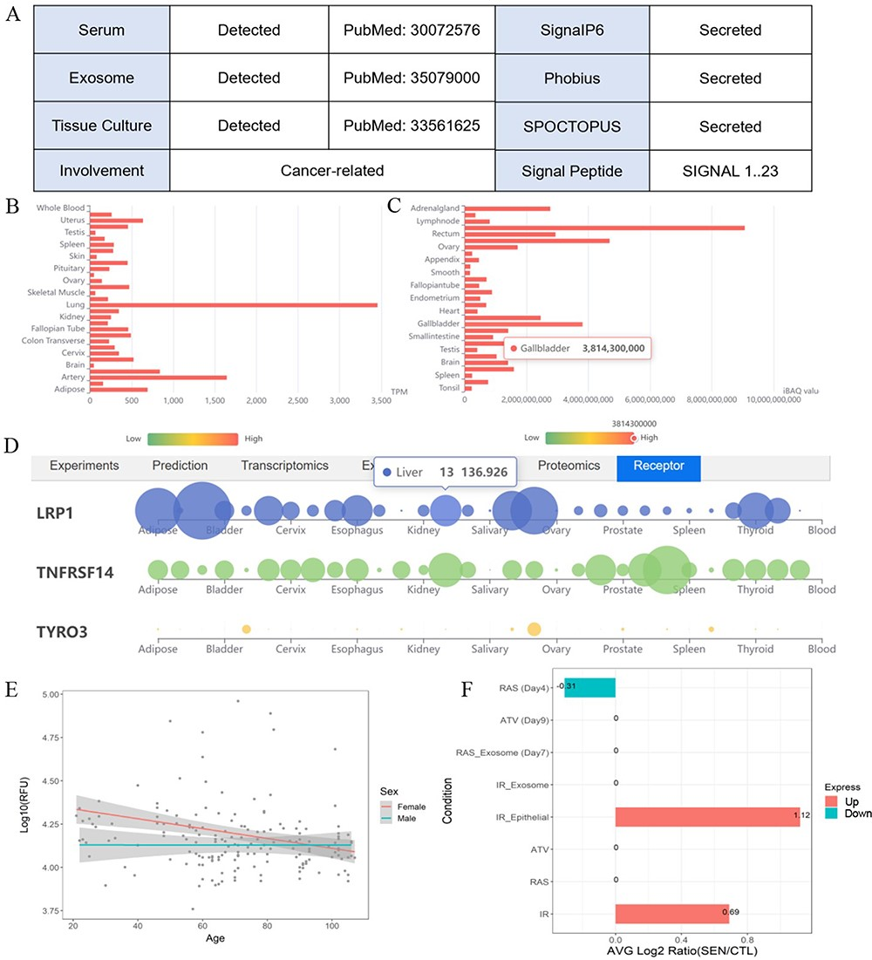
Figure 3. One example illustrates the multiple validation channels SEPDB provides for secreted proteins, helping to ...
Notes:
Figure 3. One example illustrates the multiple validation channels SEPDB provides for secreted proteins, helping to uncover protein function. (A) Secreted proteins validate evidence information. (B) Tissue-specific transcript data of alpha-2 macroglobulin. (C) Tissue-specific proteomic data of alpha-2 macroglobulin. (D) Alpha-2 macroglobulin receptor tissue-specific expression network. (E) Expression of alpha-2 macroglobulin in serum changed with age in 170 individuals. (F) Senescence-associated secretory phenotype (SASP) expression changes of alpha-2 macroglobulin after intervention under different conditions.
Unless provided in the caption above, the following copyright applies to the content of this slide: © The Author(s) 2024. Published by Oxford University Press.This is an Open Access article distributed under the terms of the Creative Commons Attribution License (https://creativecommons.org/licenses/by/4.0/), which permits unrestricted reuse, distribution, and reproduction in any medium, provided the original work is properly cited.

