Slide 1
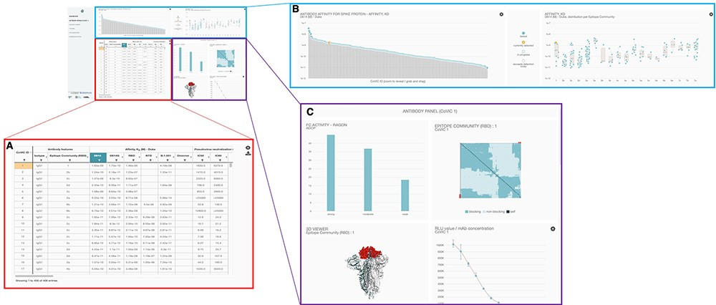
Figure 2. Overall layout of the COVIC-DB landing page. (A) contains the summary table showing results for different ...
Notes:
Figure 2. Overall layout of the COVIC-DB landing page. (A) contains the summary table showing results for different assays carried out for COVIC antibodies. The user has highlighted the upper left-most cell in orange by clicking on the cell. (B) displays graphical representations of the affinity data shown in the summary table. (C) highlights the ‘Antibody Panel section of the dashboard that appears when the user selects an individual antibody (here, COVIC-1).
Unless provided in the caption above, the following copyright applies to the content of this slide: © The Author(s) 2023. Published by Oxford University Press.This is an Open Access article distributed under the terms of the Creative Commons Attribution License (https://creativecommons.org/licenses/by/4.0/), which permits unrestricted reuse, distribution, and reproduction in any medium, provided the original work is properly cited.

