Slide 1
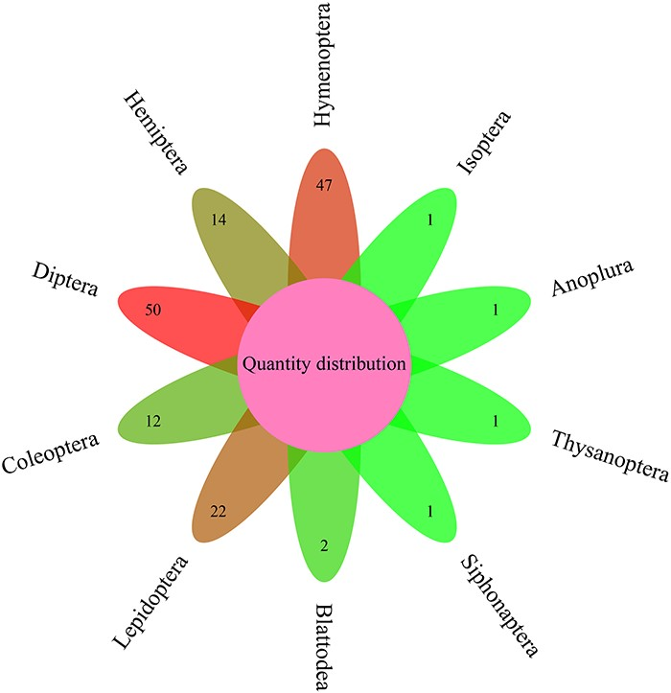
Figure 1. Distribution of insect numbers per order for 151 insects.
Notes:
Figure 1. Distribution of insect numbers per order for 151 insects.
Unless provided in the caption above, the following copyright applies to the content of this slide: © The Author(s) 2023. Published by Oxford University Press.This is an Open Access article distributed under the terms of the Creative Commons Attribution License (https://creativecommons.org/licenses/by/4.0/), which permits unrestricted reuse, distribution, and reproduction in any medium, provided the original work is properly cited.

Slide 2
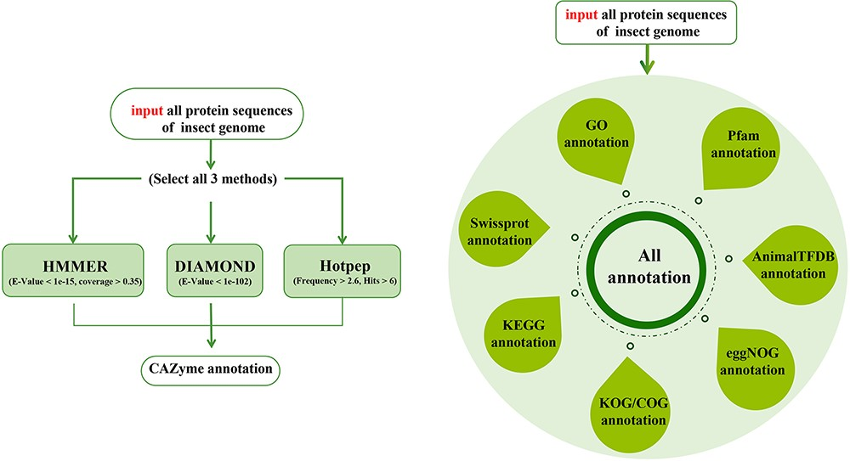
Figure 2. Design flow chart of iCAZyGFADB.
Notes:
Figure 2. Design flow chart of iCAZyGFADB.
Unless provided in the caption above, the following copyright applies to the content of this slide: © The Author(s) 2023. Published by Oxford University Press.This is an Open Access article distributed under the terms of the Creative Commons Attribution License (https://creativecommons.org/licenses/by/4.0/), which permits unrestricted reuse, distribution, and reproduction in any medium, provided the original work is properly cited.

Slide 3
Figure 3. Content and layout of iCAZyGFADB.
Notes:
Figure 3. Content and layout of iCAZyGFADB.
Unless provided in the caption above, the following copyright applies to the content of this slide: © The Author(s) 2023. Published by Oxford University Press.This is an Open Access article distributed under the terms of the Creative Commons Attribution License (https://creativecommons.org/licenses/by/4.0/), which permits unrestricted reuse, distribution, and reproduction in any medium, provided the original work is properly cited.

Slide 4
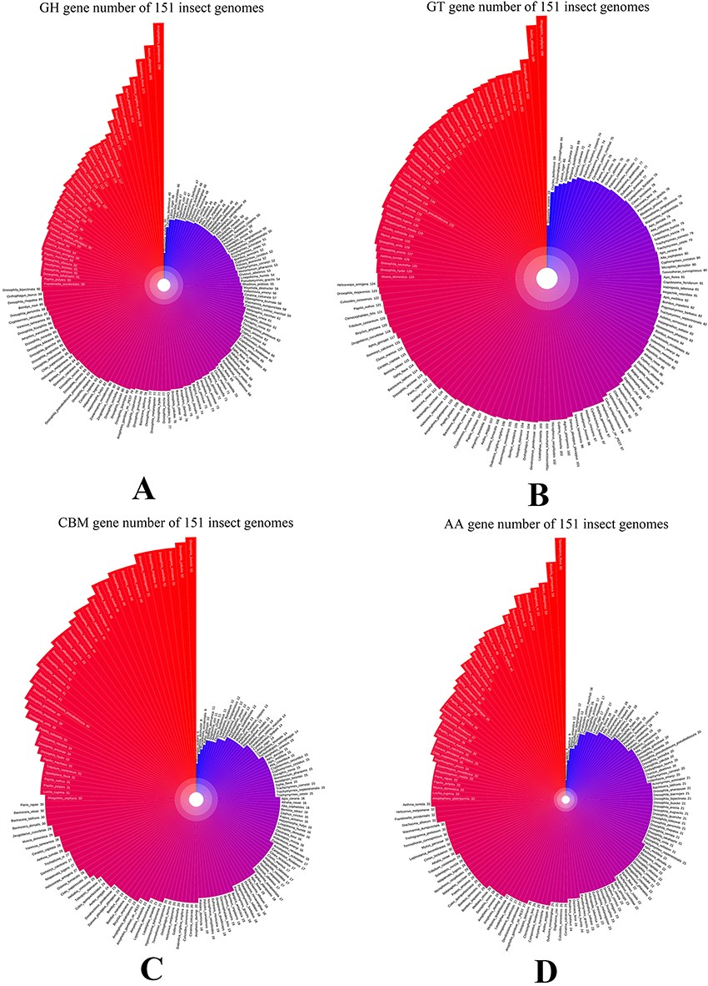
Figure 4. GH, GT, CBM and AA gene family distribution of 151 insect genomes in data summary part of iCAZyGFADB.
Notes:
Figure 4. GH, GT, CBM and AA gene family distribution of 151 insect genomes in data summary part of iCAZyGFADB.
Unless provided in the caption above, the following copyright applies to the content of this slide: © The Author(s) 2023. Published by Oxford University Press.This is an Open Access article distributed under the terms of the Creative Commons Attribution License (https://creativecommons.org/licenses/by/4.0/), which permits unrestricted reuse, distribution, and reproduction in any medium, provided the original work is properly cited.

Slide 5
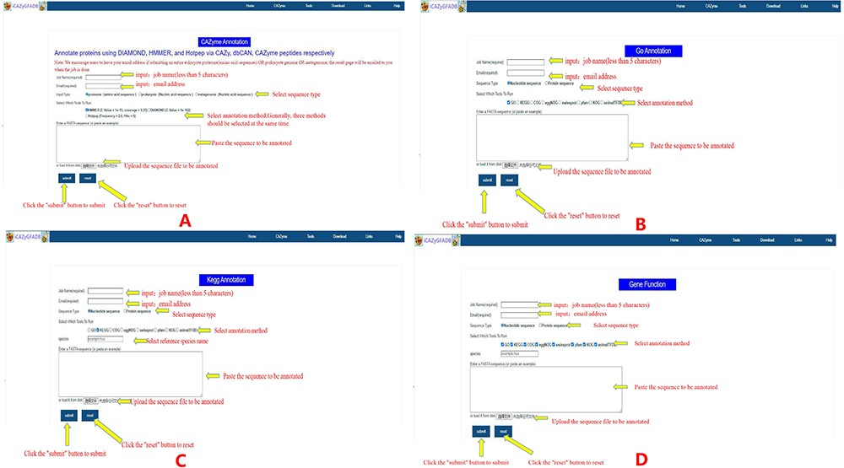
Figure 5. Instructions for the use of nine gene function annotation tools such as CAZyme, GO, KEGG and all annotation ...
Notes:
Figure 5. Instructions for the use of nine gene function annotation tools such as CAZyme, GO, KEGG and all annotation tools.
Unless provided in the caption above, the following copyright applies to the content of this slide: © The Author(s) 2023. Published by Oxford University Press.This is an Open Access article distributed under the terms of the Creative Commons Attribution License (https://creativecommons.org/licenses/by/4.0/), which permits unrestricted reuse, distribution, and reproduction in any medium, provided the original work is properly cited.

