Slide 1
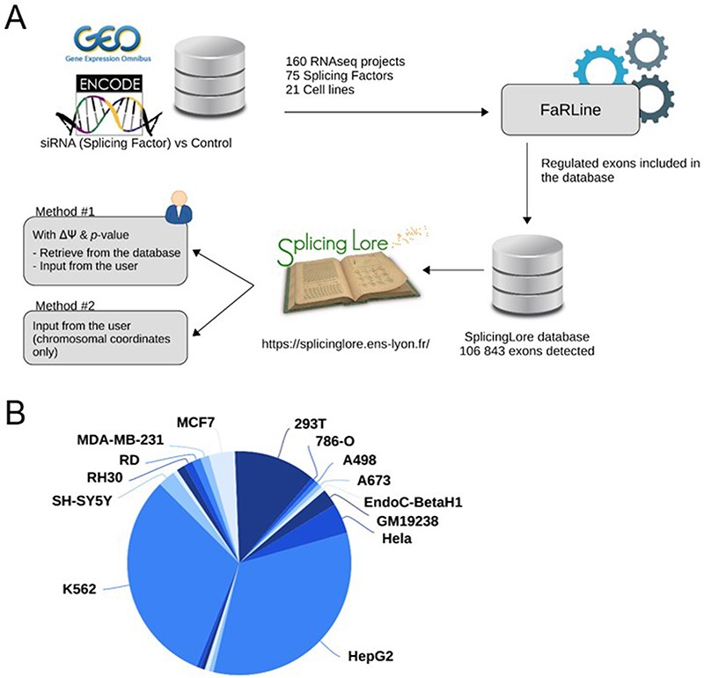
Figure 1. General features of SplicingLore. (A) Outline of the SplicingLore workflow. RNA-seq datasets from GEO and ...
Notes:
Figure 1. General features of SplicingLore. (A) Outline of the SplicingLore workflow. RNA-seq datasets from GEO and ENCODE databases were uniformly processed with FaRLine to generate lists of alternative exons regulated by 75 SFs in 21 human cell lines. These datasets can be used to compute correlation scores of exon regulation with a list of exons of interest, which is either retrieved from the database or provided by the user (Query Method 1). The user can alternatively query SplicingLore with a list of exons associated only with their chromosomal coordinates (Method 2). In the latter case, the list of exons can include or not a ΔPSI and P-value. (B) Diagram showing the repartition of the SplicingLore datasets between cell lines. Alt text for Figure 1: Description of the SplicingLore workflow and different methods of analysis, featuring the repartition of the datasets between different cell lines.
Unless provided in the caption above, the following copyright applies to the content of this slide: © The Author(s) 2023. Published by Oxford University Press.This is an Open Access article distributed under the terms of the Creative Commons Attribution License (https://creativecommons.org/licenses/by/4.0/), which permits unrestricted reuse, distribution, and reproduction in any medium, provided the original work is properly cited.

