Slide 1
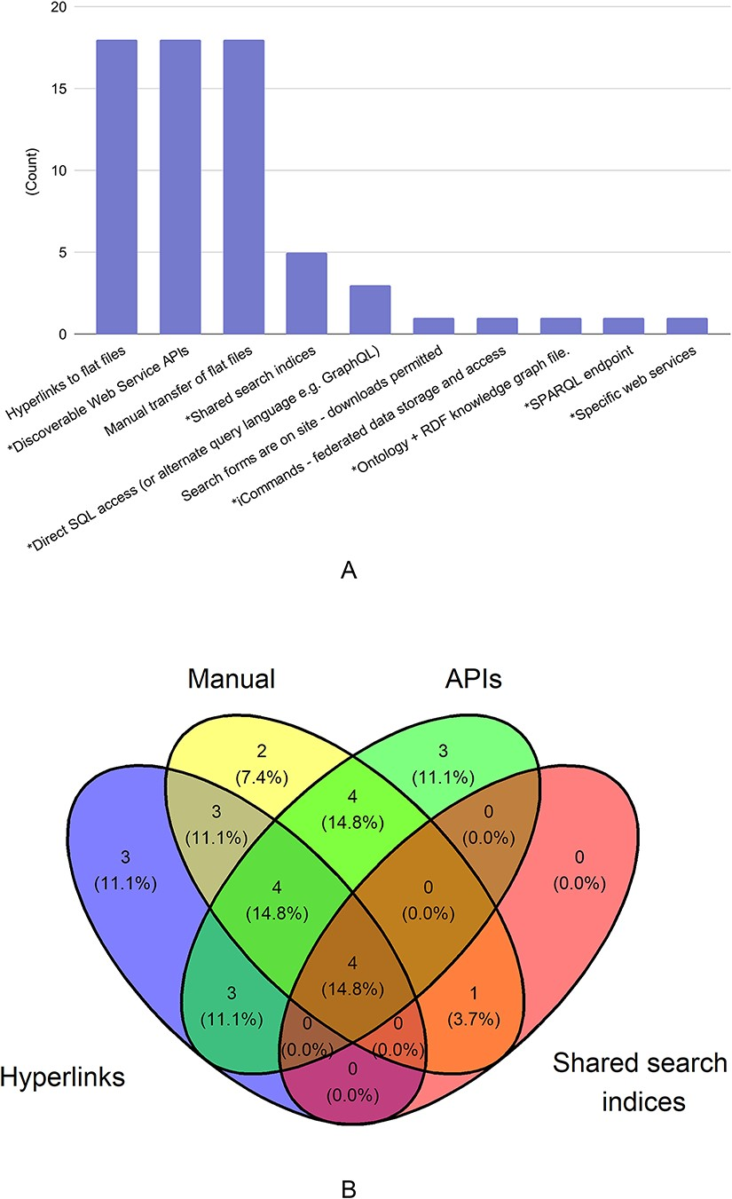
Figure 1. Mechanisms used for data sharing. There were 29 responses to this question. In Figure 1A, mechanisms that ...
Notes:
Figure 1. Mechanisms used for data sharing. There were 29 responses to this question. In Figure 1A, mechanisms that allow for programmatic access to the shared data are marked with asterisk (*). In Figure 1B, the four data types with the most responses are shown in a venn diagram.
Unless provided in the caption above, the following copyright applies to the content of this slide: Published by Oxford University Press 2023. This work is written by (a) US Government employee(s) and is in the public domain in the US.This work is written by (a) US Government employee(s) and is in the public domain in the US.

Slide 2
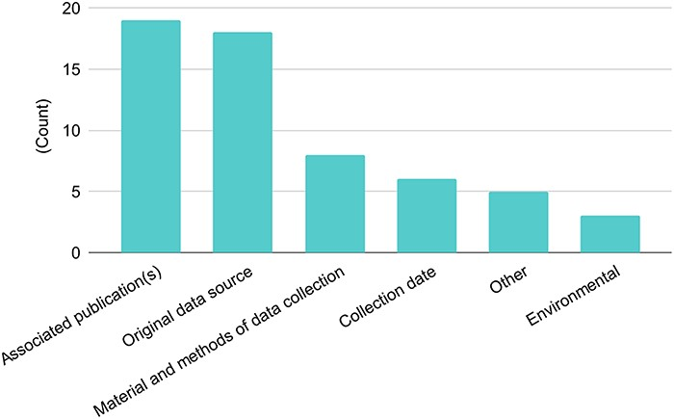
Figure 2. Types of metadata shared with other databases. There were 26 responses to this question. Singleton answers ...
Notes:
Figure 2. Types of metadata shared with other databases. There were 26 responses to this question. Singleton answers were collated into the ‘Other’ category, and metadata categories are abbreviated for this figure.
Unless provided in the caption above, the following copyright applies to the content of this slide: Published by Oxford University Press 2023. This work is written by (a) US Government employee(s) and is in the public domain in the US.This work is written by (a) US Government employee(s) and is in the public domain in the US.

Slide 3
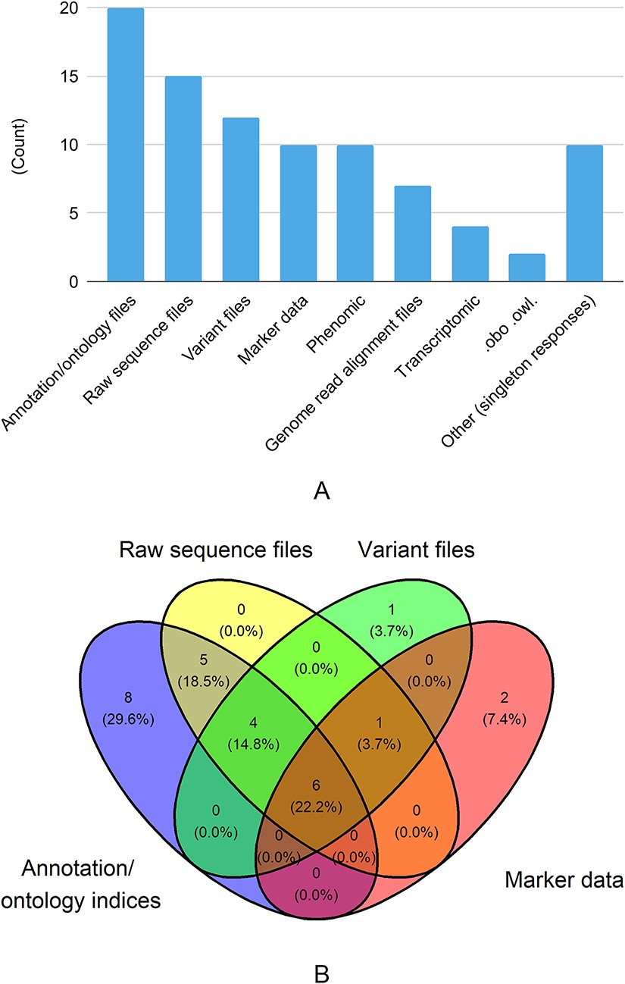
Figure 3. Data types shared with other databases. There were 29 responses to this question. In Figure 3A, singleton ...
Notes:
Figure 3. Data types shared with other databases. There were 29 responses to this question. In Figure 3A, singleton answers were collated into the ‘Other’ category. In Figure 3B, the four data types with the most responses are shown in a venn diagram.
Unless provided in the caption above, the following copyright applies to the content of this slide: Published by Oxford University Press 2023. This work is written by (a) US Government employee(s) and is in the public domain in the US.This work is written by (a) US Government employee(s) and is in the public domain in the US.

Slide 4
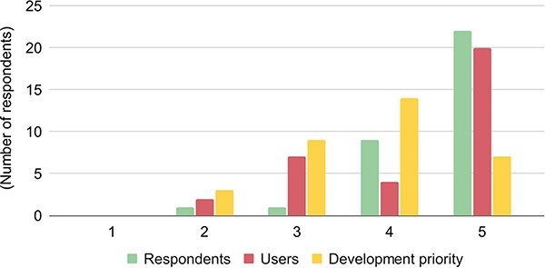
Figure 4. The importance of data discoverability and availability for respondents/databases (green), users (red), and ...
Notes:
Figure 4. The importance of data discoverability and availability for respondents/databases (green), users (red), and development priorities (yellow). The respondents ranked the importance from 1 to 5, with 1 denoting the lowest importance and 5 denoting the highest importance.
Unless provided in the caption above, the following copyright applies to the content of this slide: Published by Oxford University Press 2023. This work is written by (a) US Government employee(s) and is in the public domain in the US.This work is written by (a) US Government employee(s) and is in the public domain in the US.

Slide 5
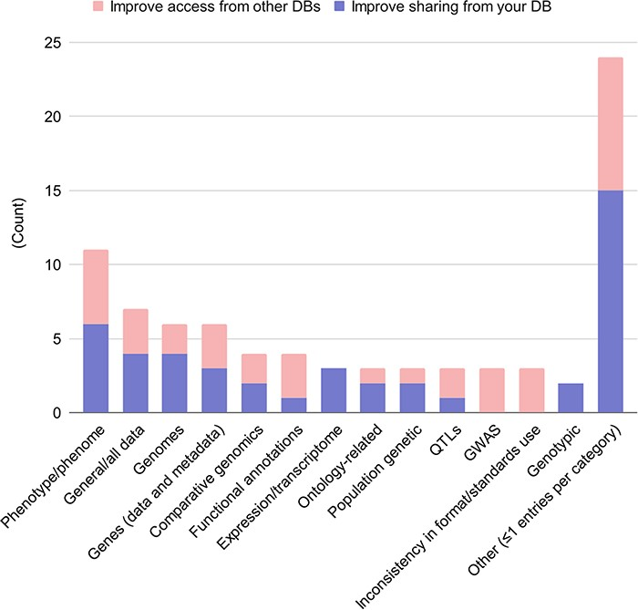
Figure 5. Desired data and metadata types shared among databases. Free-form answers from the questions 9.5 and 10.7 ...
Notes:
Figure 5. Desired data and metadata types shared among databases. Free-form answers from the questions 9.5 and 10.7 (what data and metadata would you like to share) were aggregated, with responses in blue; and free-form answers from questions 9.6 and 10.8 (what data and metadata would you like to access from other databases) were aggregated, with responses in red.
Unless provided in the caption above, the following copyright applies to the content of this slide: Published by Oxford University Press 2023. This work is written by (a) US Government employee(s) and is in the public domain in the US.This work is written by (a) US Government employee(s) and is in the public domain in the US.

Slide 6
Figure 8. Use of ontologies in AgBioData GGB Databases, showing the number of respondents that use a particular ...
Notes:
Figure 8. Use of ontologies in AgBioData GGB Databases, showing the number of respondents that use a particular ontology in their database. Results are shown based on the focus of the database: (A) plant data; (B) animal data; or (C) databases storing both the animal and plant data, as well as other types of data relevant to agricultural genetics, genomics and breeding.
Unless provided in the caption above, the following copyright applies to the content of this slide: Published by Oxford University Press 2023. This work is written by (a) US Government employee(s) and is in the public domain in the US.This work is written by (a) US Government employee(s) and is in the public domain in the US.

Slide 7
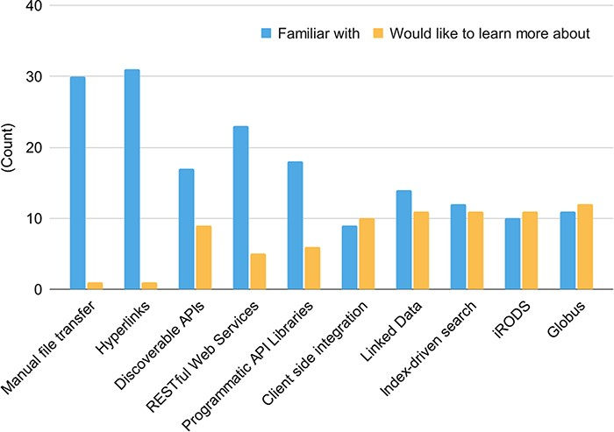
Figure 7. Familiarity with data-sharing technologies (blue) and data-sharing technology knowledge gaps (yellow). There ...
Notes:
Figure 7. Familiarity with data-sharing technologies (blue) and data-sharing technology knowledge gaps (yellow). There were 32 responses to this question.
Unless provided in the caption above, the following copyright applies to the content of this slide: Published by Oxford University Press 2023. This work is written by (a) US Government employee(s) and is in the public domain in the US.This work is written by (a) US Government employee(s) and is in the public domain in the US.

Slide 8
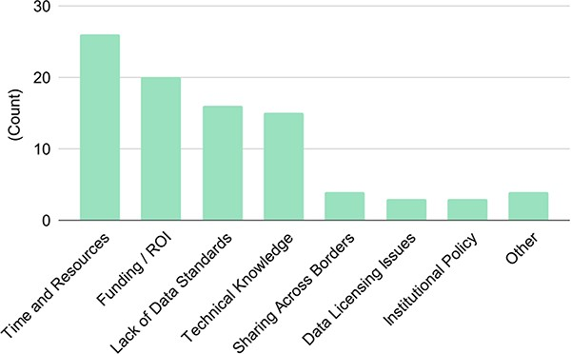
Figure 6. Blockers to successful data sharing. There were 32 responses to this question.
Notes:
Figure 6. Blockers to successful data sharing. There were 32 responses to this question.
Unless provided in the caption above, the following copyright applies to the content of this slide: Published by Oxford University Press 2023. This work is written by (a) US Government employee(s) and is in the public domain in the US.This work is written by (a) US Government employee(s) and is in the public domain in the US.

Slide 9
Notes:
Unless provided in the caption above, the following copyright applies to the content of this slide: Published by Oxford University Press 2023. This work is written by (a) US Government employee(s) and is in the public domain in the US.This work is written by (a) US Government employee(s) and is in the public domain in the US.

Slide 10
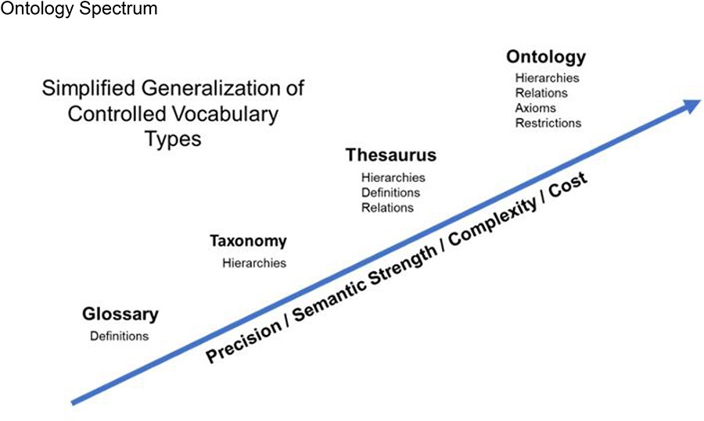
Notes:
Unless provided in the caption above, the following copyright applies to the content of this slide: Published by Oxford University Press 2023. This work is written by (a) US Government employee(s) and is in the public domain in the US.This work is written by (a) US Government employee(s) and is in the public domain in the US.

