Slide 1
Figure 1. List of hexaploid, tetraploid and diploid wheat species in the pan-genome BLAST database and synteny ...
Notes:
Figure 1. List of hexaploid, tetraploid and diploid wheat species in the pan-genome BLAST database and synteny comparison. Among the total 29 varieties, 16 are hexaploid, two are tetraploid and 11 are diploid (two with A genome, one with B genome, six with D genome and two with S genome).
Unless provided in the caption above, the following copyright applies to the content of this slide: © The Author(s) 2023. Published by Oxford University Press.This is an Open Access article distributed under the terms of the Creative Commons Attribution License (https://creativecommons.org/licenses/by/4.0/), which permits unrestricted reuse, distribution, and reproduction in any medium, provided the original work is properly cited.

Slide 2
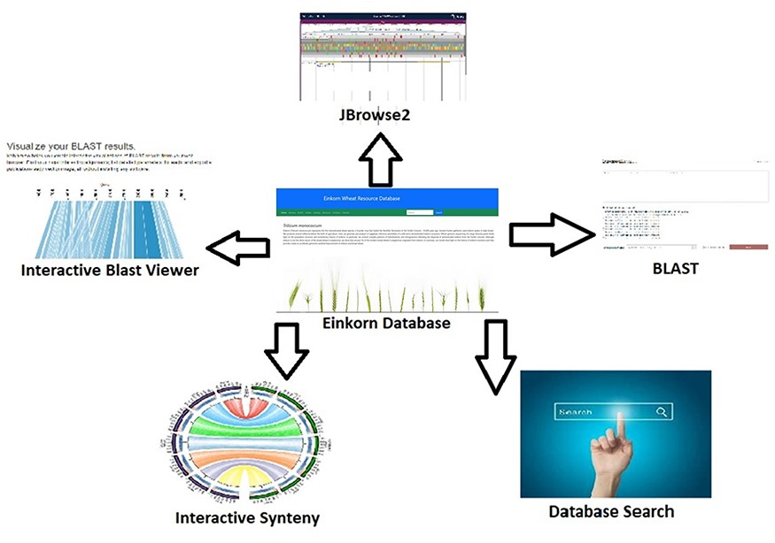
Figure 2. Interactive tools such as JBrowse2, BLAST database search, database search and synteny have been incorporated ...
Notes:
Figure 2. Interactive tools such as JBrowse2, BLAST database search, database search and synteny have been incorporated within the Einkorn database.
Unless provided in the caption above, the following copyright applies to the content of this slide: © The Author(s) 2023. Published by Oxford University Press.This is an Open Access article distributed under the terms of the Creative Commons Attribution License (https://creativecommons.org/licenses/by/4.0/), which permits unrestricted reuse, distribution, and reproduction in any medium, provided the original work is properly cited.

Slide 3
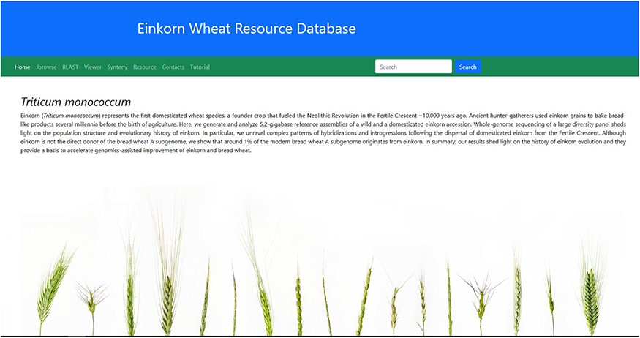
Figure 3. Home page of the einkorn wheat resource database.
Notes:
Figure 3. Home page of the einkorn wheat resource database.
Unless provided in the caption above, the following copyright applies to the content of this slide: © The Author(s) 2023. Published by Oxford University Press.This is an Open Access article distributed under the terms of the Creative Commons Attribution License (https://creativecommons.org/licenses/by/4.0/), which permits unrestricted reuse, distribution, and reproduction in any medium, provided the original work is properly cited.

Slide 4
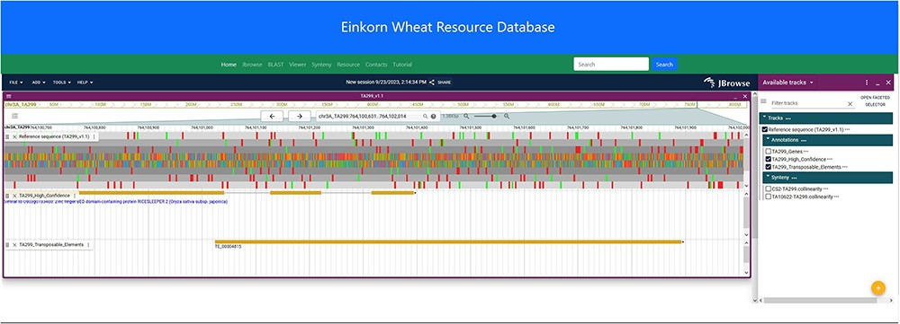
Figure 4. JBrowse2 Linear genome viewer page showing T. monococcum TA299 assembly, a gene structure, and a transposable ...
Notes:
Figure 4. JBrowse2 Linear genome viewer page showing T. monococcum TA299 assembly, a gene structure, and a transposable element. Users can scroll through the genome and can see available tracks from the panel on the right.
Unless provided in the caption above, the following copyright applies to the content of this slide: © The Author(s) 2023. Published by Oxford University Press.This is an Open Access article distributed under the terms of the Creative Commons Attribution License (https://creativecommons.org/licenses/by/4.0/), which permits unrestricted reuse, distribution, and reproduction in any medium, provided the original work is properly cited.

Slide 5
Figure 5. JBrowse2 linear synteny viewer showing synteny between T. monococcum TA10622 and T. aestivum CS-IWGSC ref2.1. ...
Notes:
Figure 5. JBrowse2 linear synteny viewer showing synteny between T. monococcum TA10622 and T. aestivum CS-IWGSC ref2.1. See tutorial on online webpage (https://avena.pw.usda.gov/genomes/mono/pan_help.php) on how to generate this view in JBrowse2.
Unless provided in the caption above, the following copyright applies to the content of this slide: © The Author(s) 2023. Published by Oxford University Press.This is an Open Access article distributed under the terms of the Creative Commons Attribution License (https://creativecommons.org/licenses/by/4.0/), which permits unrestricted reuse, distribution, and reproduction in any medium, provided the original work is properly cited.

Slide 6
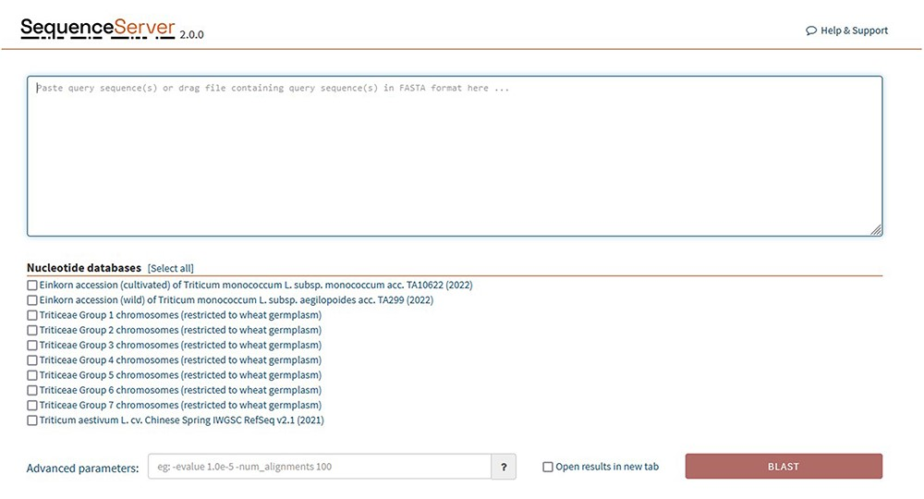
Figure 6. SequenceServer2 page for BLAST search. Specific BLAST databases have been provided for searching specific ...
Notes:
Figure 6. SequenceServer2 page for BLAST search. Specific BLAST databases have been provided for searching specific chromosome groups of all 29 wheat varieties studied.
Unless provided in the caption above, the following copyright applies to the content of this slide: © The Author(s) 2023. Published by Oxford University Press.This is an Open Access article distributed under the terms of the Creative Commons Attribution License (https://creativecommons.org/licenses/by/4.0/), which permits unrestricted reuse, distribution, and reproduction in any medium, provided the original work is properly cited.

Slide 7
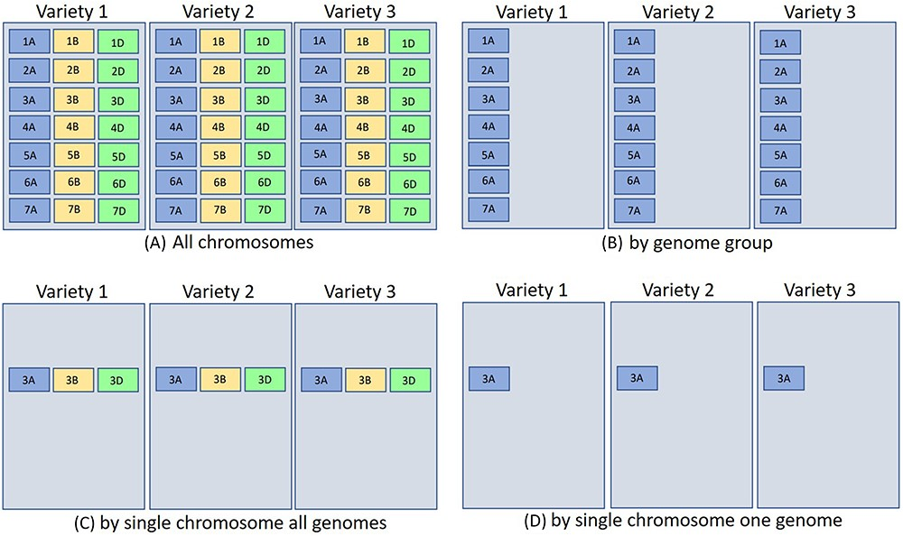
Figure 7. The above represents three different hexaploid wheat cultivars BLAST database sets searched by four different ...
Notes:
Figure 7. The above represents three different hexaploid wheat cultivars BLAST database sets searched by four different parameters [only the (a) quadrant contains all chromosomes for hexaploid wheat]. The other quadrants are partitioned by (b) genome group (1–7A genome), (c) single chromosome all genomes (3ABD), and (d) single chromosome single genome (3A). Database indexing partitioned in such a fashion for (b–d) takes less time and resources (see text for more explanation). For wheat, each chromosome block would represent about 700 Mb.
Unless provided in the caption above, the following copyright applies to the content of this slide: © The Author(s) 2023. Published by Oxford University Press.This is an Open Access article distributed under the terms of the Creative Commons Attribution License (https://creativecommons.org/licenses/by/4.0/), which permits unrestricted reuse, distribution, and reproduction in any medium, provided the original work is properly cited.

Slide 8
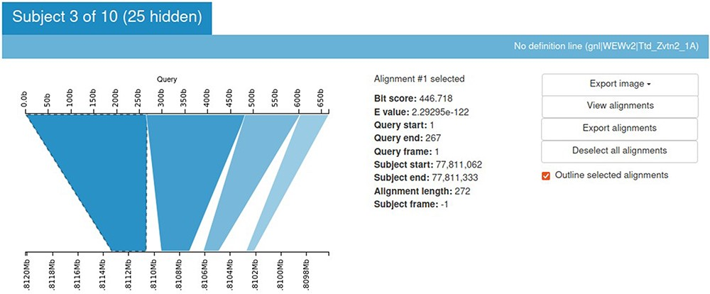
Figure 8. Kablammo display for the BLAST results of a sample query sequence. Various alignment statistics are being ...
Notes:
Figure 8. Kablammo display for the BLAST results of a sample query sequence. Various alignment statistics are being shown along with the option to view/download images and alignments. Please see the tutorial on the einkorn resource database webpage on how to generate this output (https://avena.pw.usda.gov/genomes/mono/pan_help.php).
Unless provided in the caption above, the following copyright applies to the content of this slide: © The Author(s) 2023. Published by Oxford University Press.This is an Open Access article distributed under the terms of the Creative Commons Attribution License (https://creativecommons.org/licenses/by/4.0/), which permits unrestricted reuse, distribution, and reproduction in any medium, provided the original work is properly cited.

Slide 9
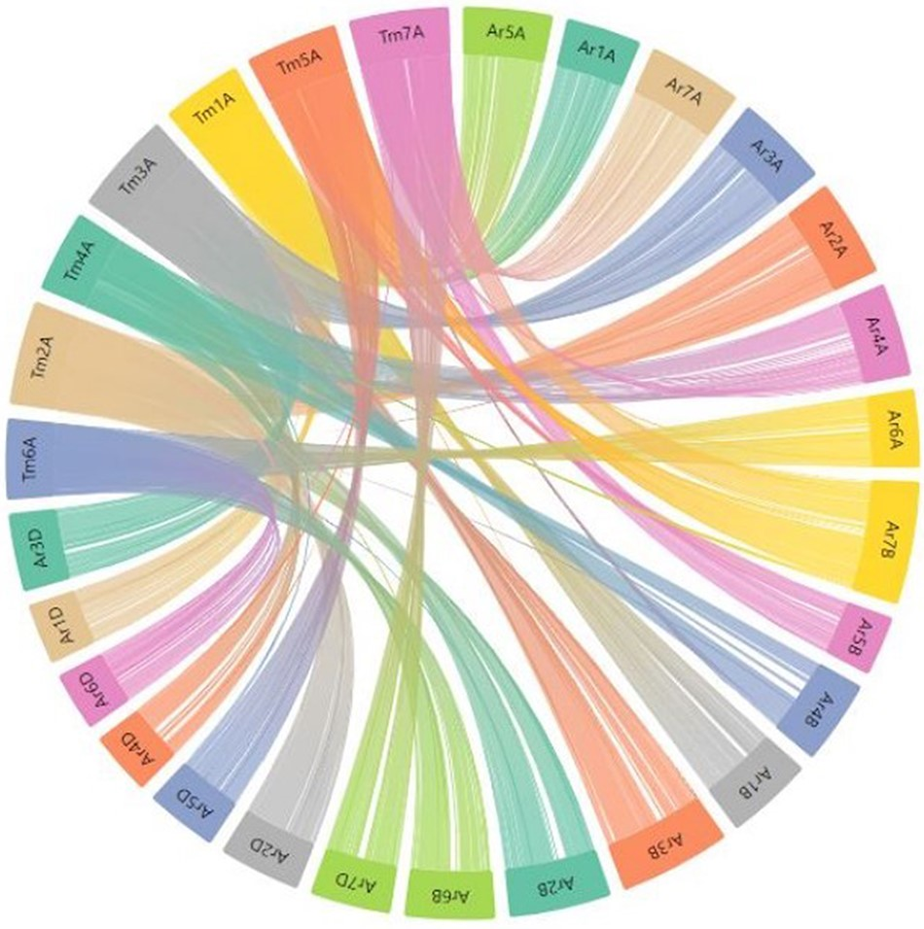
Figure 9. Part of the webpage shows a synteny between the T. monococcum TA10622 and T. aestivum ArinaLrFor. The figure ...
Notes:
Figure 9. Part of the webpage shows a synteny between the T. monococcum TA10622 and T. aestivum ArinaLrFor. The figure is available on the synteny tab of einkorn wheat resource database web page by selecting the respective genome. This figure can also be generated by uploading the two precomputed files (gff and collinearity) provided on the synteny tab of einkorn resource database web page on the AccuSyn server.
Unless provided in the caption above, the following copyright applies to the content of this slide: © The Author(s) 2023. Published by Oxford University Press.This is an Open Access article distributed under the terms of the Creative Commons Attribution License (https://creativecommons.org/licenses/by/4.0/), which permits unrestricted reuse, distribution, and reproduction in any medium, provided the original work is properly cited.

Slide 10
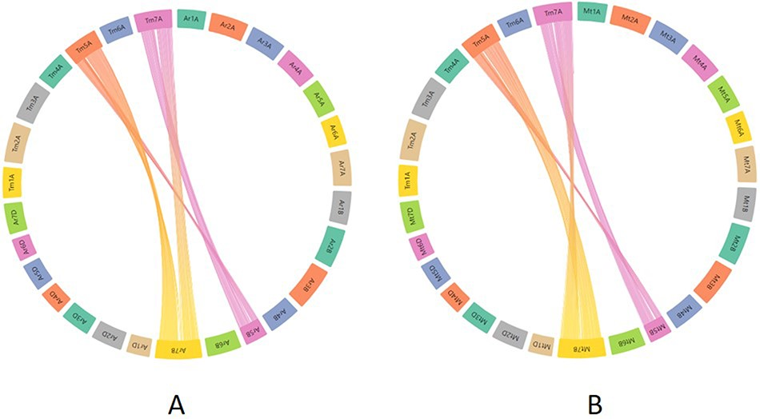
Figure 10. Synteny visualization of T. monococcum with ArinaLrFor (A) and SY Mattis (B). It shows the presence of a ...
Notes:
Figure 10. Synteny visualization of T. monococcum with ArinaLrFor (A) and SY Mattis (B). It shows the presence of a translocation between chromosomes 5B and 7B of ArinaLrFor (A) and SY Mattis (B). The figure was generated by uploading the two precomputed files (gff and collinearity) provided on the synteny tab of einkorn resource database web page and viewed on the AccuSyn server by selecting the respective chromosomes.
Unless provided in the caption above, the following copyright applies to the content of this slide: © The Author(s) 2023. Published by Oxford University Press.This is an Open Access article distributed under the terms of the Creative Commons Attribution License (https://creativecommons.org/licenses/by/4.0/), which permits unrestricted reuse, distribution, and reproduction in any medium, provided the original work is properly cited.

Slide 11
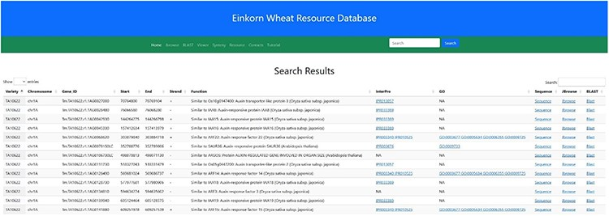
Figure 11. Search result for the search term ‘auxin’. Searching the relational database for any auxin-related genes ...
Notes:
Figure 11. Search result for the search term ‘auxin’. Searching the relational database for any auxin-related genes yielded 338 possible hits. Links to InterPro, Gene Ontology, Gene sequence, JBrowse2 and Blast results are provided in the subsequent columns.
Unless provided in the caption above, the following copyright applies to the content of this slide: © The Author(s) 2023. Published by Oxford University Press.This is an Open Access article distributed under the terms of the Creative Commons Attribution License (https://creativecommons.org/licenses/by/4.0/), which permits unrestricted reuse, distribution, and reproduction in any medium, provided the original work is properly cited.

Slide 12
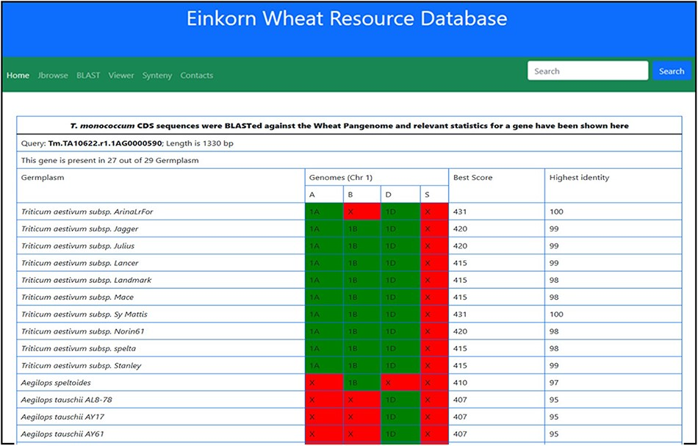
Figure 12. Table showing the BLAST statistics of a gene against the wheat pan-genome collection. This table is ...
Notes:
Figure 12. Table showing the BLAST statistics of a gene against the wheat pan-genome collection. This table is accessible from the Blast column of search results table.
Unless provided in the caption above, the following copyright applies to the content of this slide: © The Author(s) 2023. Published by Oxford University Press.This is an Open Access article distributed under the terms of the Creative Commons Attribution License (https://creativecommons.org/licenses/by/4.0/), which permits unrestricted reuse, distribution, and reproduction in any medium, provided the original work is properly cited.

