Slide 1
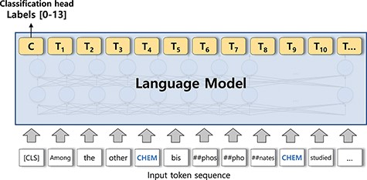
Figure 3. A sequence classification model. The output of the [CLS] token is used for the classification head.
Notes:
Figure 3. A sequence classification model. The output of the [CLS] token is used for the classification head.
Unless provided in the caption above, the following copyright applies to the content of this slide: © The Author(s) 2023. Published by Oxford University Press.This is an Open Access article distributed under the terms of the Creative Commons Attribution License (https://creativecommons.org/licenses/by/4.0/), which permits unrestricted reuse, distribution, and reproduction in any medium, provided the original work is properly cited.

Slide 2
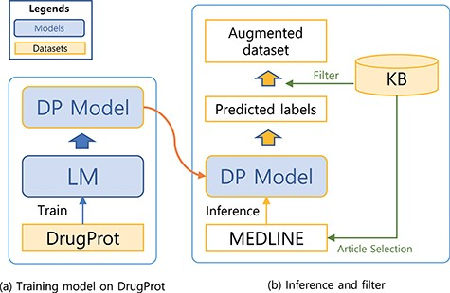
Figure 2. A system for building a large-scale augmented dataset: (a) training model on DrugProt and (b) inference and ...
Notes:
Figure 2. A system for building a large-scale augmented dataset: (a) training model on DrugProt and (b) inference and filter.
Unless provided in the caption above, the following copyright applies to the content of this slide: © The Author(s) 2023. Published by Oxford University Press.This is an Open Access article distributed under the terms of the Creative Commons Attribution License (https://creativecommons.org/licenses/by/4.0/), which permits unrestricted reuse, distribution, and reproduction in any medium, provided the original work is properly cited.

Slide 3
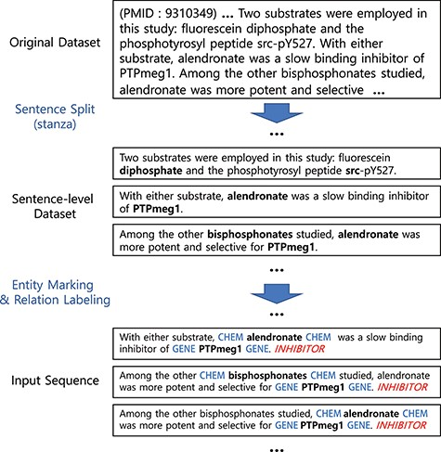
Figure 1. Preprocessing steps. Entity markers wrap entities in input sequences.
Notes:
Figure 1. Preprocessing steps. Entity markers wrap entities in input sequences.
Unless provided in the caption above, the following copyright applies to the content of this slide: © The Author(s) 2023. Published by Oxford University Press.This is an Open Access article distributed under the terms of the Creative Commons Attribution License (https://creativecommons.org/licenses/by/4.0/), which permits unrestricted reuse, distribution, and reproduction in any medium, provided the original work is properly cited.

Slide 4
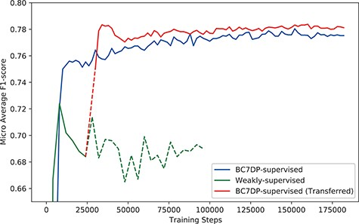
Figure 4. The performance (F1-score) of models by the total training steps. The solid line (BC7DP-supervised) ...
Notes:
Figure 4. The performance (F1-score) of models by the total training steps. The solid line (BC7DP-supervised) represents the performance of a model trained using the original dataset. The line starting with dotted line and soon changed into solid line, denoted as BC7DP-supervised (Transferred), represents the performance of our system. The line strarting with solid line but soon changed into dotted line, denoted as Weakly-supervised, represents a model trained only on weakly supervised datasets (without the third phase of our system). Note that the solid part of BC7DP-supervised (Transferred) linestarts at the 28 000th step of the Weakly-supervised line as it is transferred from the 28 000th step of the weakly supervised only model. For the BC7DP-supervised and BC7DP-supervised (Transferred), F1-scores are averaged across five independent runs.
Unless provided in the caption above, the following copyright applies to the content of this slide: © The Author(s) 2023. Published by Oxford University Press.This is an Open Access article distributed under the terms of the Creative Commons Attribution License (https://creativecommons.org/licenses/by/4.0/), which permits unrestricted reuse, distribution, and reproduction in any medium, provided the original work is properly cited.

Slide 5
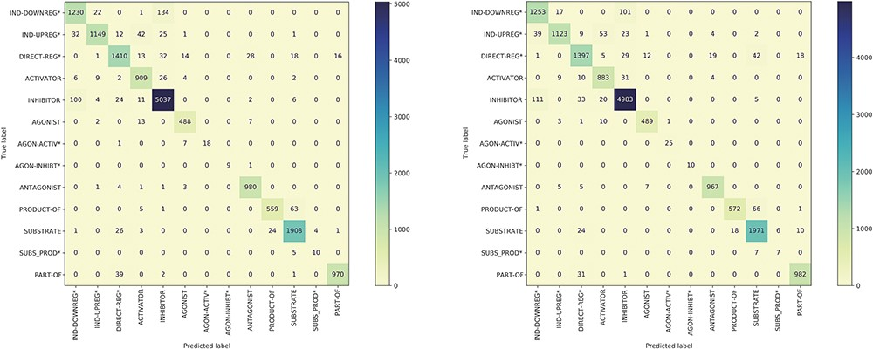
Figure 5. The confusion matrix of the model trained using the BC7DP dataset (left) and our proposed method (right) on ...
Notes:
Figure 5. The confusion matrix of the model trained using the BC7DP dataset (left) and our proposed method (right) on the development dataset.
Unless provided in the caption above, the following copyright applies to the content of this slide: © The Author(s) 2023. Published by Oxford University Press.This is an Open Access article distributed under the terms of the Creative Commons Attribution License (https://creativecommons.org/licenses/by/4.0/), which permits unrestricted reuse, distribution, and reproduction in any medium, provided the original work is properly cited.

Slide 6
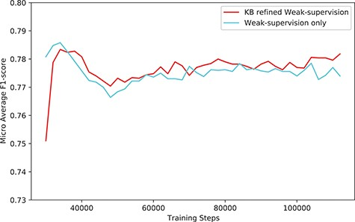
Figure 6. The performance (F1-score) of our system (KB-refined weak supervision) and the model trained using simple ...
Notes:
Figure 6. The performance (F1-score) of our system (KB-refined weak supervision) and the model trained using simple weak supervision (weak supervision without KB refine).
Unless provided in the caption above, the following copyright applies to the content of this slide: © The Author(s) 2023. Published by Oxford University Press.This is an Open Access article distributed under the terms of the Creative Commons Attribution License (https://creativecommons.org/licenses/by/4.0/), which permits unrestricted reuse, distribution, and reproduction in any medium, provided the original work is properly cited.

