Slide 1
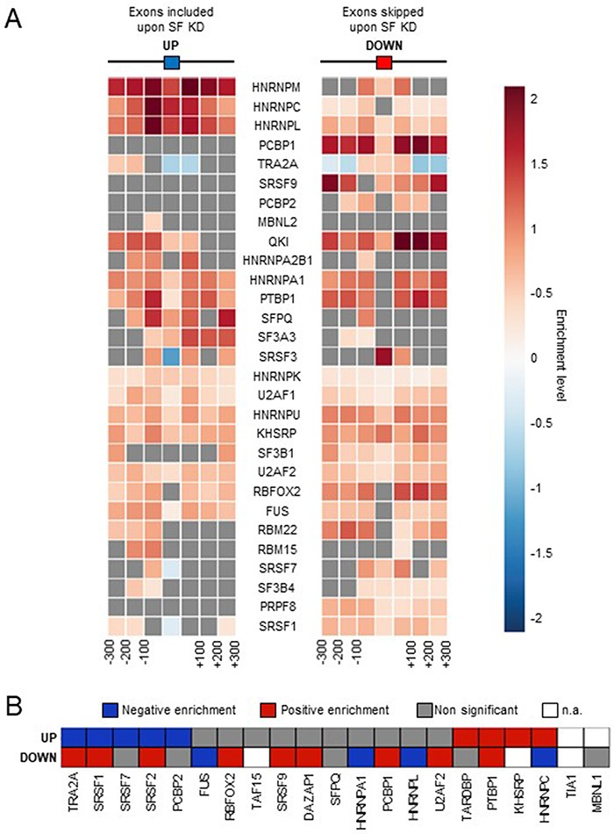
Figure 2. Comparison with SF binding sites. (A) Enrichment of SF binding sites (based on CLIP-seq data) at exons that ...
Notes:
Figure 2. Comparison with SF binding sites. (A) Enrichment of SF binding sites (based on CLIP-seq data) at exons that are up- or down-regulated by the corresponding factor and in their flanking regions. Each square on both sides of the exon represents a 100 nucleotide window upstream and upstream of the exon. (B) Enrichment of SF-specific binding sequences at exons (±200 nucleotides) that are up- or down-regulated by the corresponding factor. Not applicable (n.a.): less than 100 exons were identified by FaRLine as more included or excluded upon knockdown of the corresponding SF. Alt text for Figure 2: Heatmaps showing the relative enrichment of SF binding sites or binding motifs around exons that are up- or down-regulated by the same factor.
Unless provided in the caption above, the following copyright applies to the content of this slide: © The Author(s) 2023. Published by Oxford University Press.This is an Open Access article distributed under the terms of the Creative Commons Attribution License (https://creativecommons.org/licenses/by/4.0/), which permits unrestricted reuse, distribution, and reproduction in any medium, provided the original work is properly cited.

