Slide 1
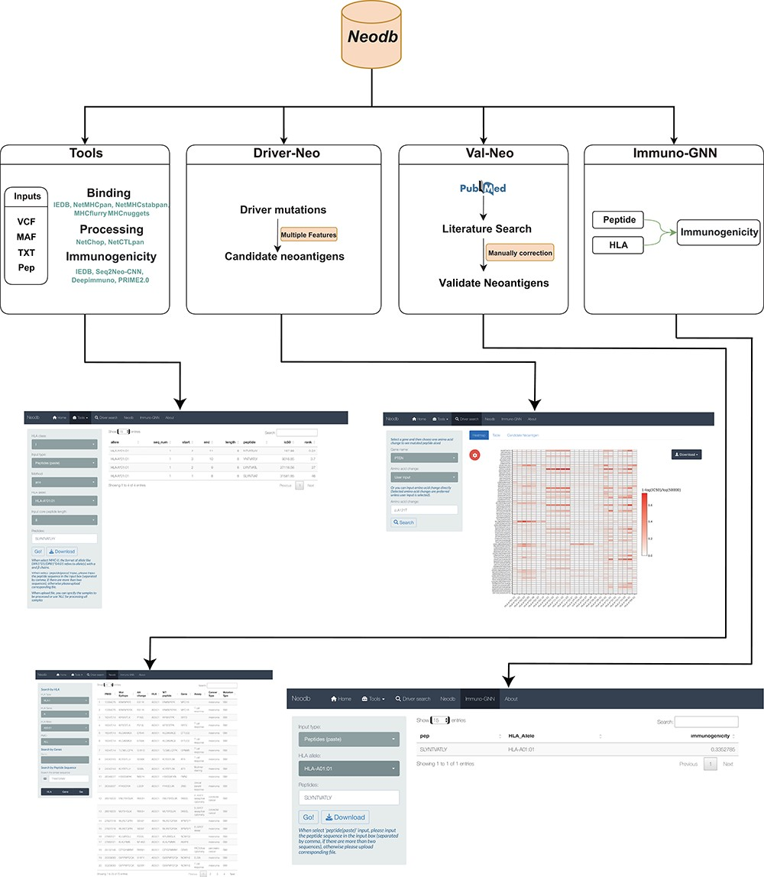
Figure 1. A comprehensive neoantigen database and discovery platform. An overview of the Neodb includes four modules: ...
Notes:
Figure 1. A comprehensive neoantigen database and discovery platform. An overview of the Neodb includes four modules: (i) the Tools module, which integrates the commonly used tools in the neoantigen prediction process; (ii) the Driver-Neo module, which includes the list of candidate neoantigens for common driver mutations predicted by combining multiple features; (iii) the Val-Neo module, which contains manually collected experimentally validated neoantigen peptide data; (iv) the Immuno-GNN model, which is a novel immunogenicity prediction tool.
Unless provided in the caption above, the following copyright applies to the content of this slide: © The Author(s) 2023. Published by Oxford University Press.This is an Open Access article distributed under the terms of the Creative Commons Attribution License (https://creativecommons.org/licenses/by/4.0/), which permits unrestricted reuse, distribution, and reproduction in any medium, provided the original work is properly cited.

Slide 2
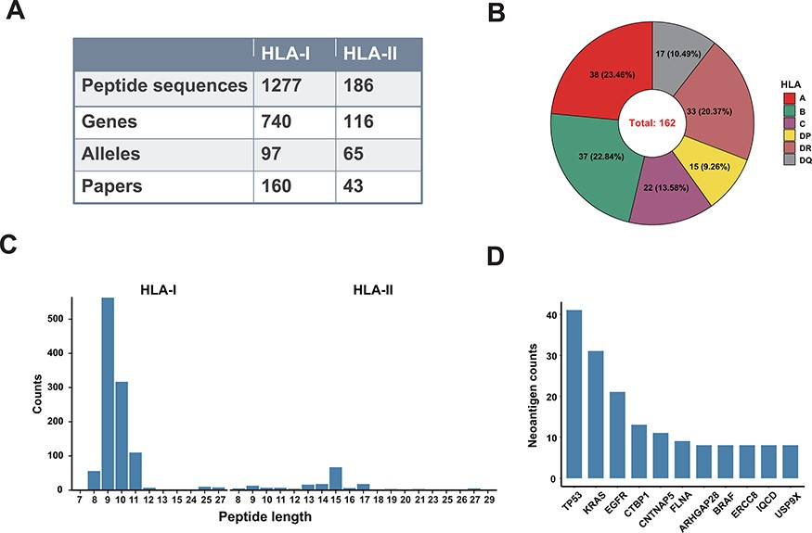
Figure 2. A data summary for Val-Neo. (A) A comparison of counts of neoantigens, genes, alleles and research papers ...
Notes:
Figure 2. A data summary for Val-Neo. (A) A comparison of counts of neoantigens, genes, alleles and research papers between HLA-I and HLA-II. (B) Distribution of different HLA alleles. (C) Distribution of peptide lengths of different HLA types. (D) Top 10 genes with the most number of validated neoantigens.
Unless provided in the caption above, the following copyright applies to the content of this slide: © The Author(s) 2023. Published by Oxford University Press.This is an Open Access article distributed under the terms of the Creative Commons Attribution License (https://creativecommons.org/licenses/by/4.0/), which permits unrestricted reuse, distribution, and reproduction in any medium, provided the original work is properly cited.

Slide 3
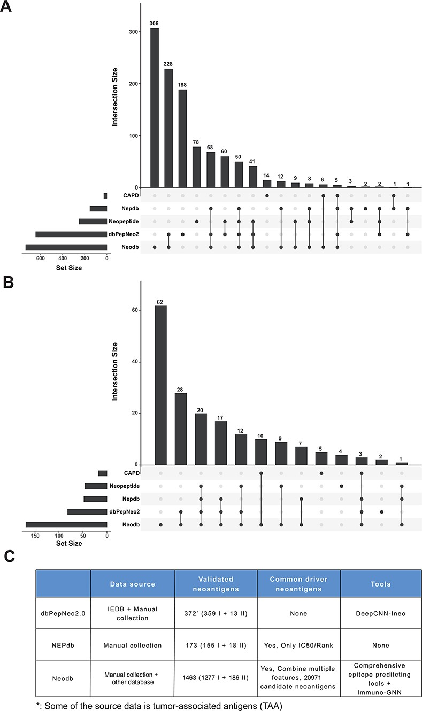
Figure 3. Comparison with other databases. (A) The amount of neoantigen–HLA pairs of different database and their ...
Notes:
Figure 3. Comparison with other databases. (A) The amount of neoantigen–HLA pairs of different database and their overlap. (B) The amount of research papers of different databases and their overlap. (C) Comparison of different databases, including data sources, the number of validated neoantigens and whether there is a list of candidate neoantigens derived from common cancer driver mutations. The neopeptide and cancer antigenic peptide database (CAPD) only have the neoantigen peptide sequence and do not include tools and other resources, therefore they are not shown in the table.
Unless provided in the caption above, the following copyright applies to the content of this slide: © The Author(s) 2023. Published by Oxford University Press.This is an Open Access article distributed under the terms of the Creative Commons Attribution License (https://creativecommons.org/licenses/by/4.0/), which permits unrestricted reuse, distribution, and reproduction in any medium, provided the original work is properly cited.

Slide 4
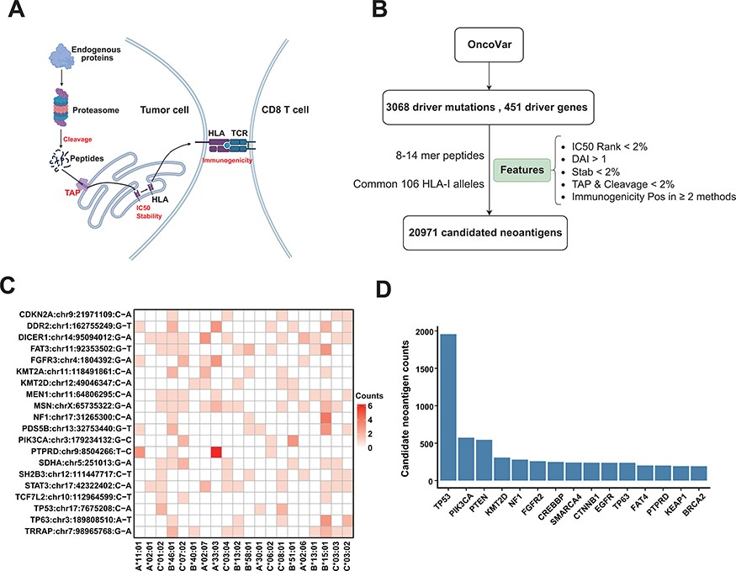
Figure 4. Candidate neoantigens of common cancer driver mutations. (A) The process of antigen presentation, including ...
Notes:
Figure 4. Candidate neoantigens of common cancer driver mutations. (A) The process of antigen presentation, including proteasome cleavage, transport into the endoplasmic reticulum by TAP, binding to HLA and then being presented to the cell surface to activate T cells. The processes of cleavage, translocating into endoplasmic reticulum by TAP, binding to HLA molecule and interacting with TCR are key steps in the antigen presentation process, so we use these features to filter neoantigens produced by common driver mutations as shown in (B) illustration of procedures for obtaining the list of potential neoantigens from common driver mutations by multiple features. (C) Common driver mutations that generate the top 20 amount of neoantigens and corresponding HLA allele (only show HLA alleles with top 20 population frequency). (D) The top 15 genes that can generate the largest number of potential neoantigens.
Unless provided in the caption above, the following copyright applies to the content of this slide: © The Author(s) 2023. Published by Oxford University Press.This is an Open Access article distributed under the terms of the Creative Commons Attribution License (https://creativecommons.org/licenses/by/4.0/), which permits unrestricted reuse, distribution, and reproduction in any medium, provided the original work is properly cited.

Slide 5
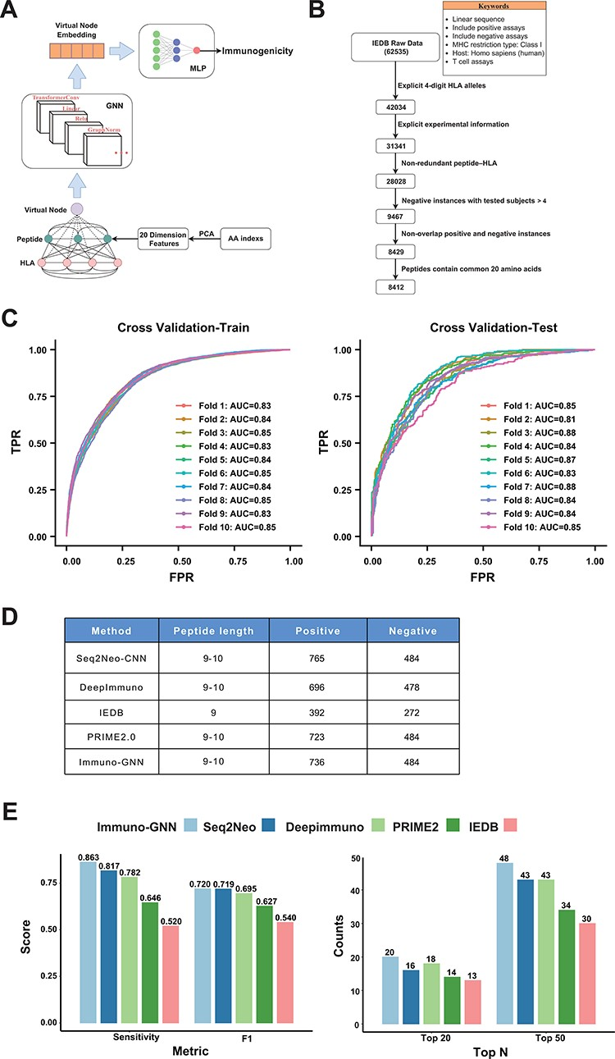
Figure 5. GNN model for immunogenicity prediction. (A) Architecture of the model for predicting immunogenicity based on ...
Notes:
Figure 5. GNN model for immunogenicity prediction. (A) Architecture of the model for predicting immunogenicity based on GNNs (Immuno-GNN). (B) The step-by-step training data filter process, (C) ROC curve of Immuno-GNN on 10-fold cross-validation of the filtered IEDB training dataset. ROC, receiver operating characteristic; AUC, area under curve; TPR, true-positive rate; FPR, false-positive rate. (D) Validation data summary of different immunogenicity prediction tools, these data were extracted from our Neodb database. (E) Comparison of multiple immunogenicity prediction tools based on our collection of validated neoantigen data.
Unless provided in the caption above, the following copyright applies to the content of this slide: © The Author(s) 2023. Published by Oxford University Press.This is an Open Access article distributed under the terms of the Creative Commons Attribution License (https://creativecommons.org/licenses/by/4.0/), which permits unrestricted reuse, distribution, and reproduction in any medium, provided the original work is properly cited.

