Slide 1
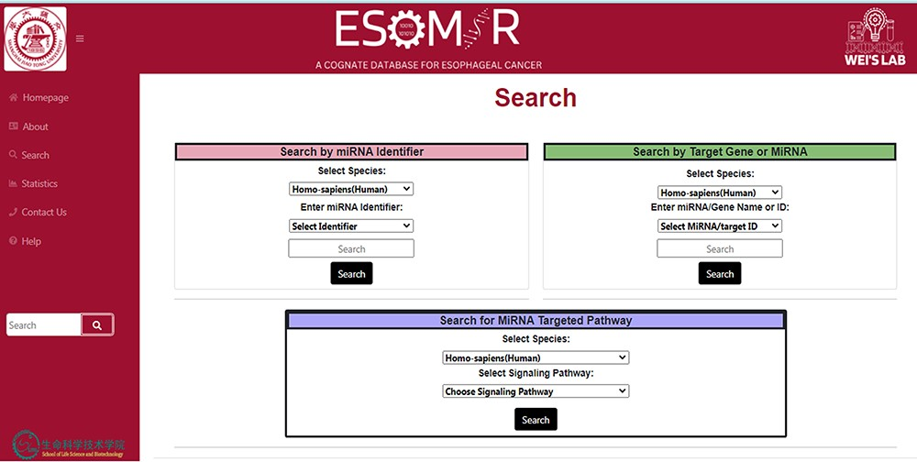
Figure 5. Demonstrative depiction of the Search page to access data using different modules. In the above figure from ...
Notes:
Figure 5. Demonstrative depiction of the Search page to access data using different modules. In the above figure from the database, it can be seen that the information can be retrieved through search by miRNA identifier search, search by target gene or miRNA or search for miRNA targeted pathway.
Unless provided in the caption above, the following copyright applies to the content of this slide: © The Author(s) 2023. Published by Oxford University Press.This is an Open Access article distributed under the terms of the Creative Commons Attribution License (https://creativecommons.org/licenses/by/4.0/), which permits unrestricted reuse, distribution, and reproduction in any medium, provided the original work is properly cited.

