Slide 1
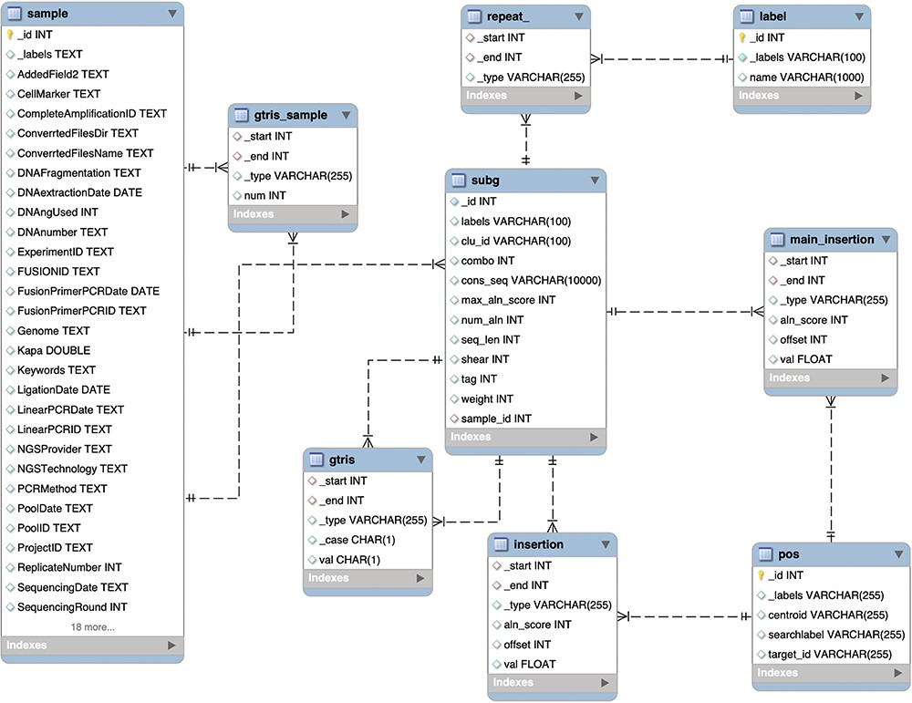
Figure 4. Schema of the relational database MySQL archiving clonal data obtained from integration sites using γ-TRIS. ...
Notes:
Figure 4. Schema of the relational database MySQL archiving clonal data obtained from integration sites using γ-TRIS. Similarly to the Graph DB structure (3), the entity-relationship diagram of the requirements described in the ‘Data description’ section has been converted in this table schema.
Unless provided in the caption above, the following copyright applies to the content of this slide: © The Author(s) 2023. Published by Oxford University Press.This is an Open Access article distributed under the terms of the Creative Commons Attribution License (https://creativecommons.org/licenses/by/4.0/), which permits unrestricted reuse, distribution, and reproduction in any medium, provided the original work is properly cited.

