Slide 1
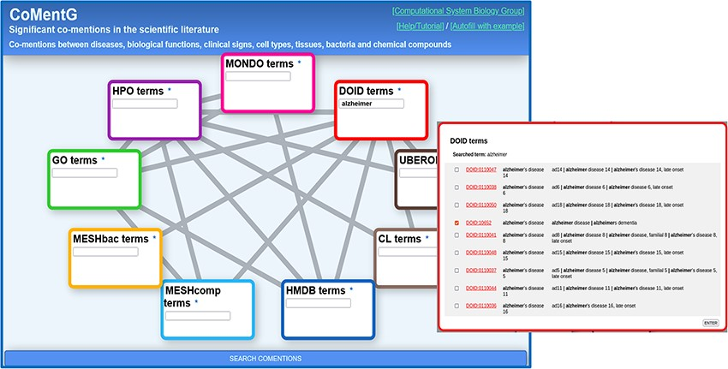
Figure 1. CoMentG main interface with the input form. In this example, the user is looking for relationships between ...
Notes:
Figure 1. CoMentG main interface with the input form. In this example, the user is looking for relationships between ‘Alzheimer’s disease’ (DOID: 10652) and clinical signs (HPO), gene/protein functions (GO), cell types (CL) and chemical compounds (HMDB).
Unless provided in the caption above, the following copyright applies to the content of this slide: © The Author(s) 2024. Published by Oxford University Press.This is an Open Access article distributed under the terms of the Creative Commons Attribution License (https://creativecommons.org/licenses/by/4.0/), which permits unrestricted reuse, distribution, and reproduction in any medium, provided the original work is properly cited.

